Slide 1
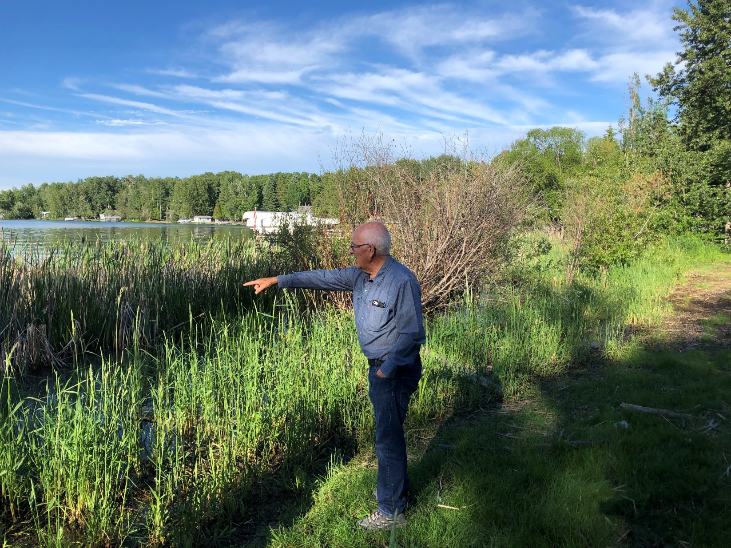
LILSA AGM
Aug 20th, 2022
Alberta Beach Agliplex
LILSA.CA
Stay Connected

Slide 2
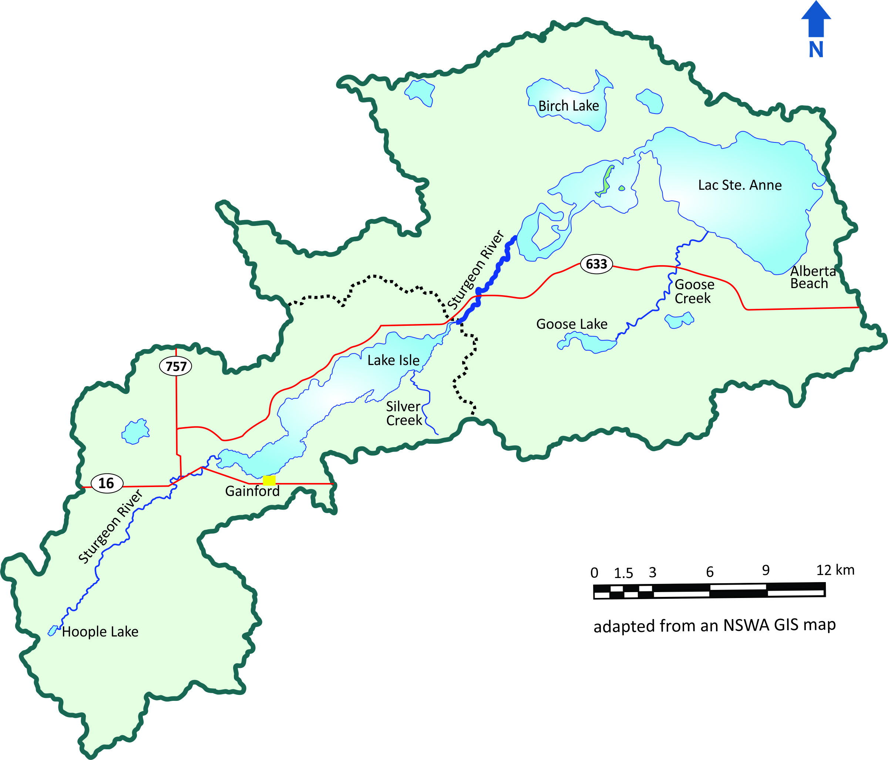
Sturgeon river Subwatershed

Slide 3
About LILSA
Non-profit society lake stewardship group since 2013
The members and volunteer executive of LILSA are regular people like you, who are care about lake and watershed health.
Meetings occur once a month to discuss issues, projects and opportunities
Member of the Sturgeon River Watershed Alliance

Slide 4
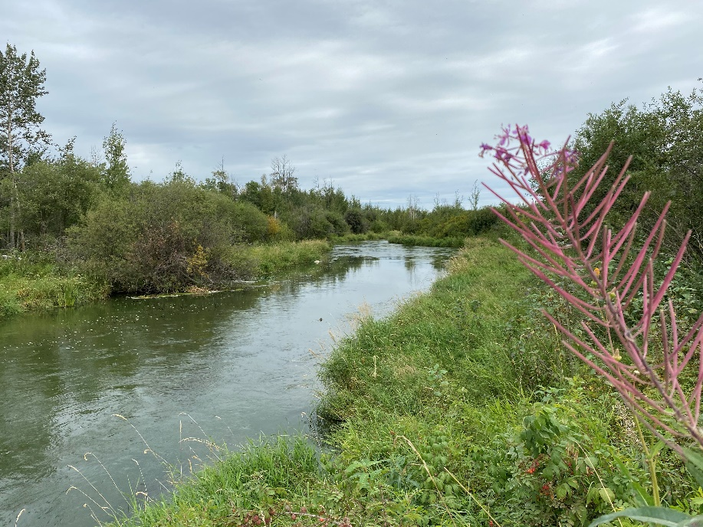
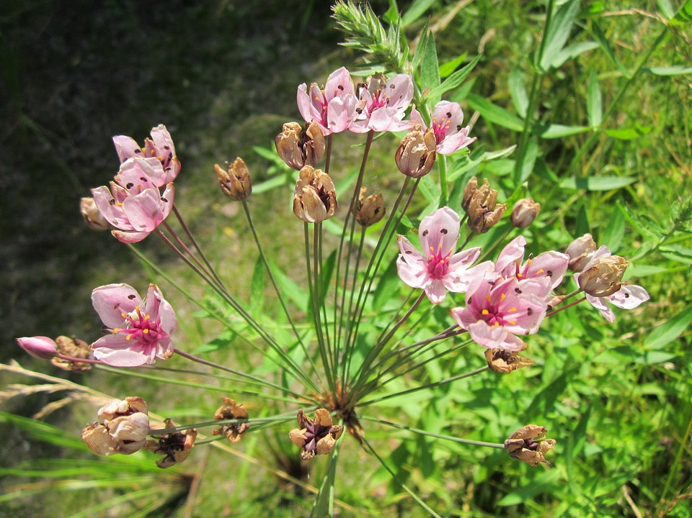
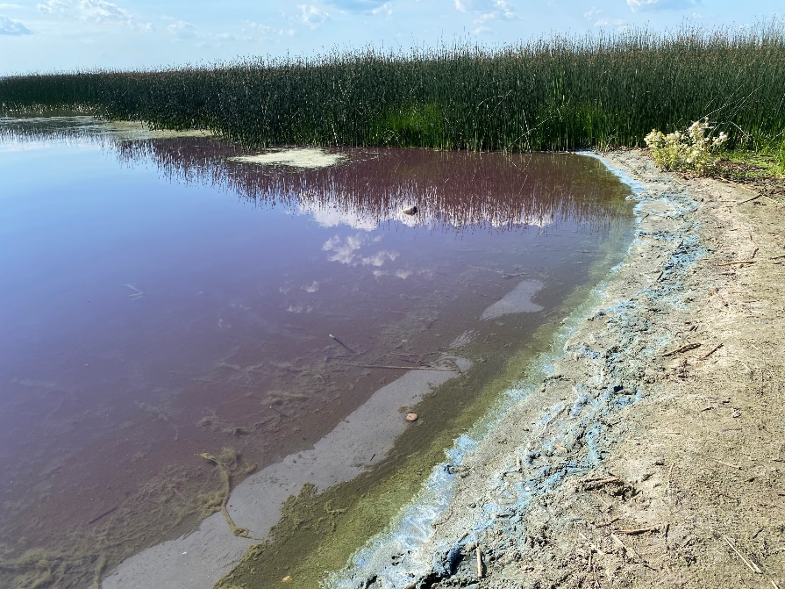
Main Concerns
Water Levels
Water Quality
Invasive Species

Slide 5
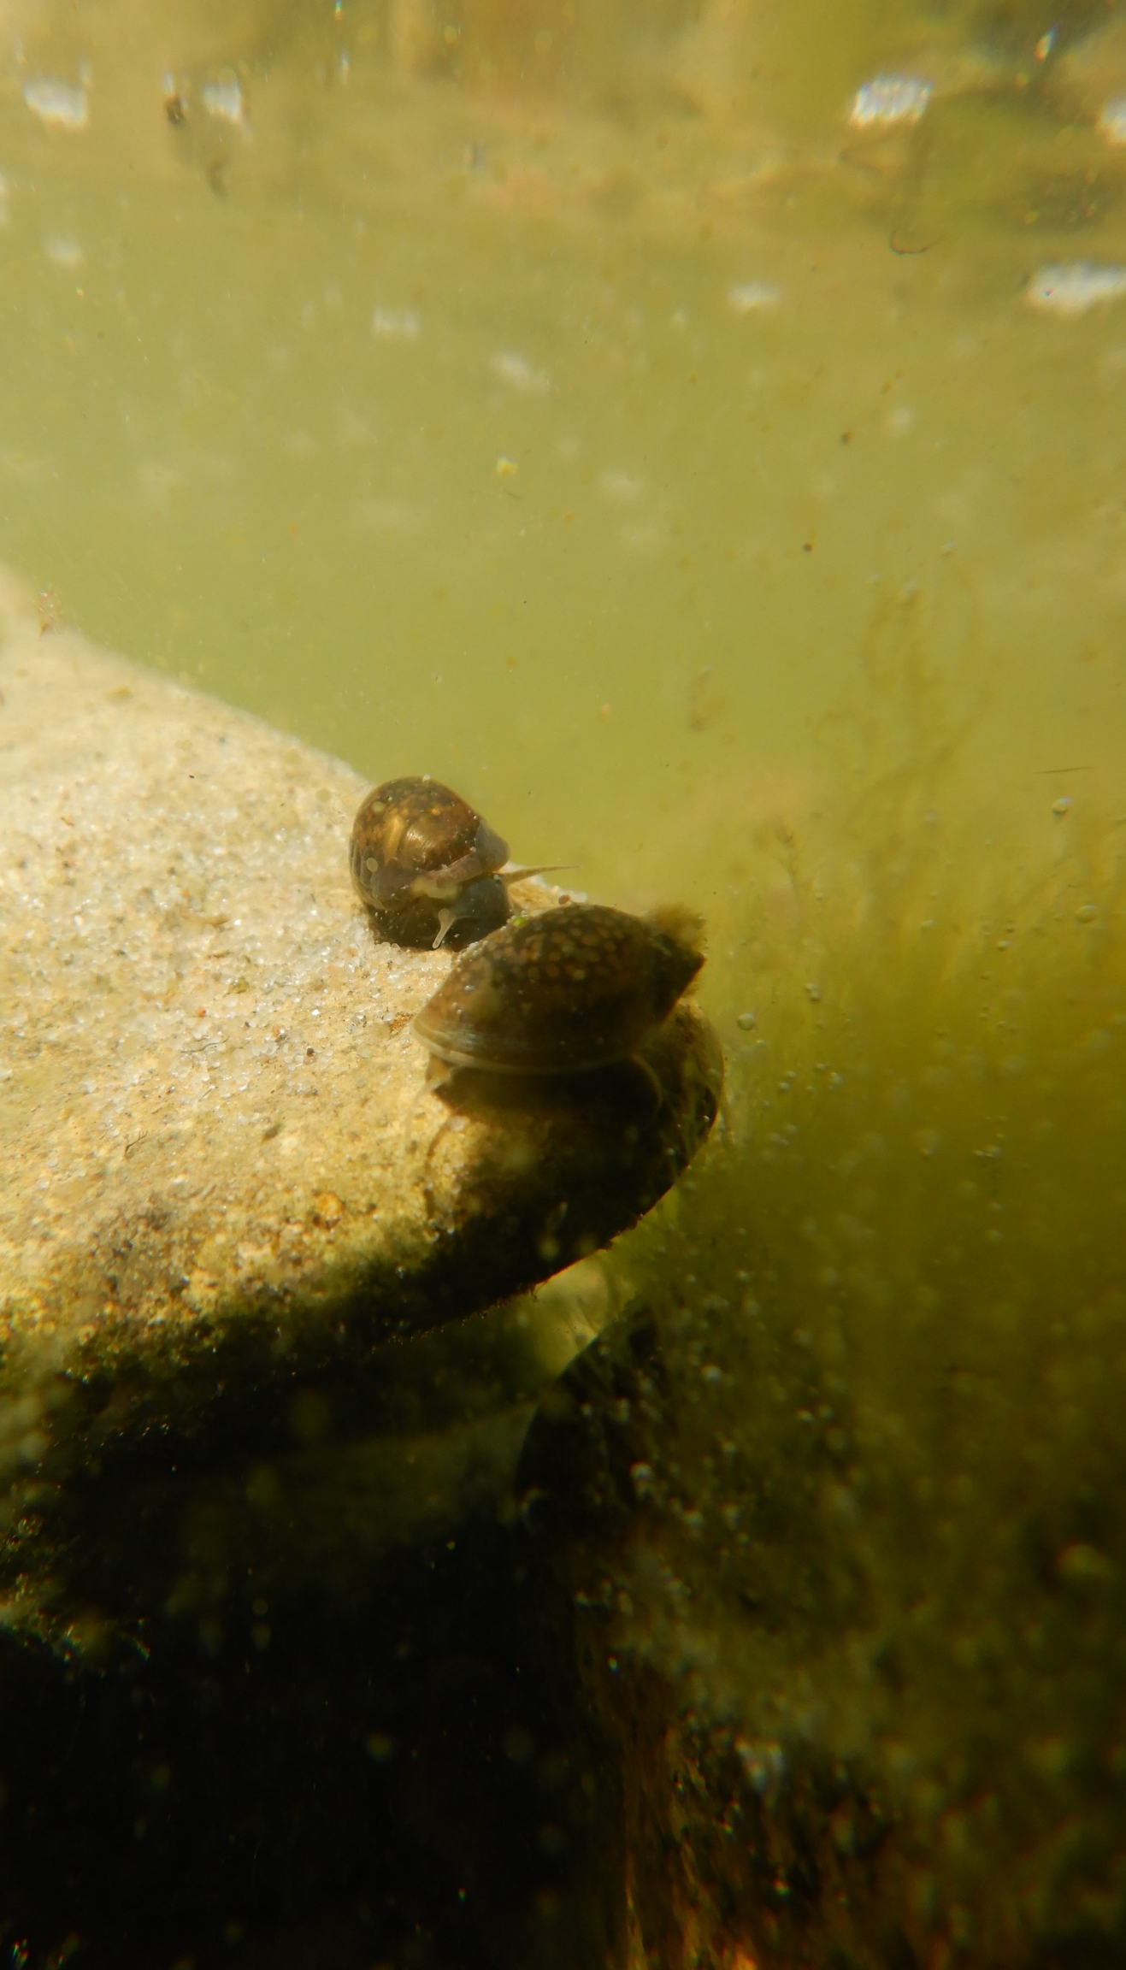
Agenda
Memberships
Approval of Agenda
Approval of Minutes – (Aug 2021)
President’s Report
Financials
Elections
Bylaw Amendment
Q & A
Adjournment
Draw
Presentations
Image: K. Norton

Slide 7
President’s report

Slide 8
Land Stewardship Centre’s Watershed Stewardship Grant
$12,000 helped us purchase promotional items for LILSA + boost online engagement.
We also purchased a large number of native plants to be distributed to lake residents at an Alberta Beach Farmers’ Market to restore riparian areas on lake properties.
We will continue to develop educational materials on best practices for lake quality.

Slide 9
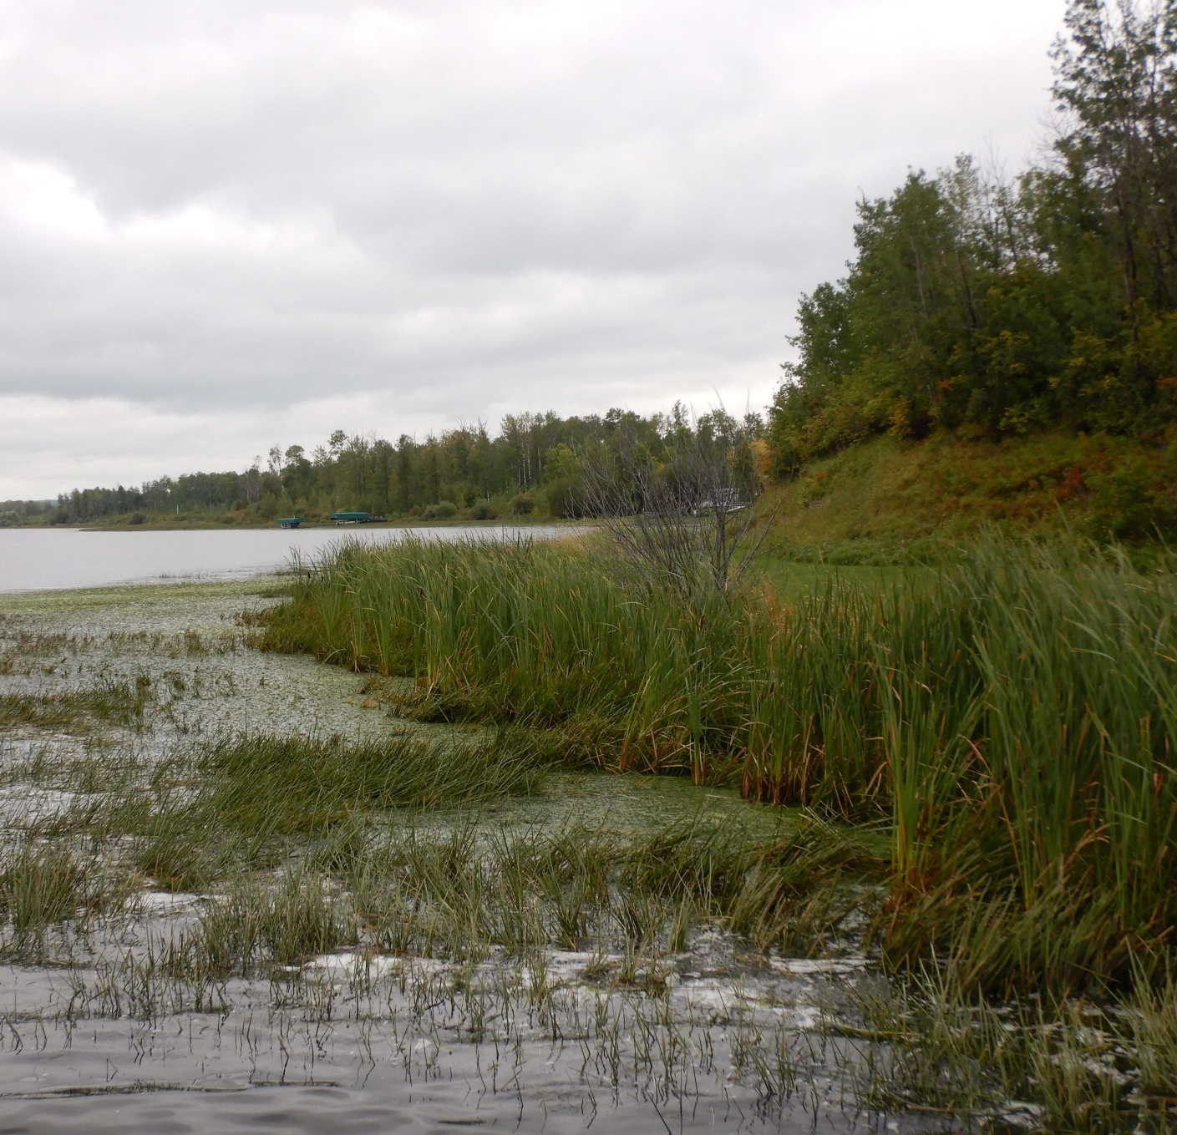
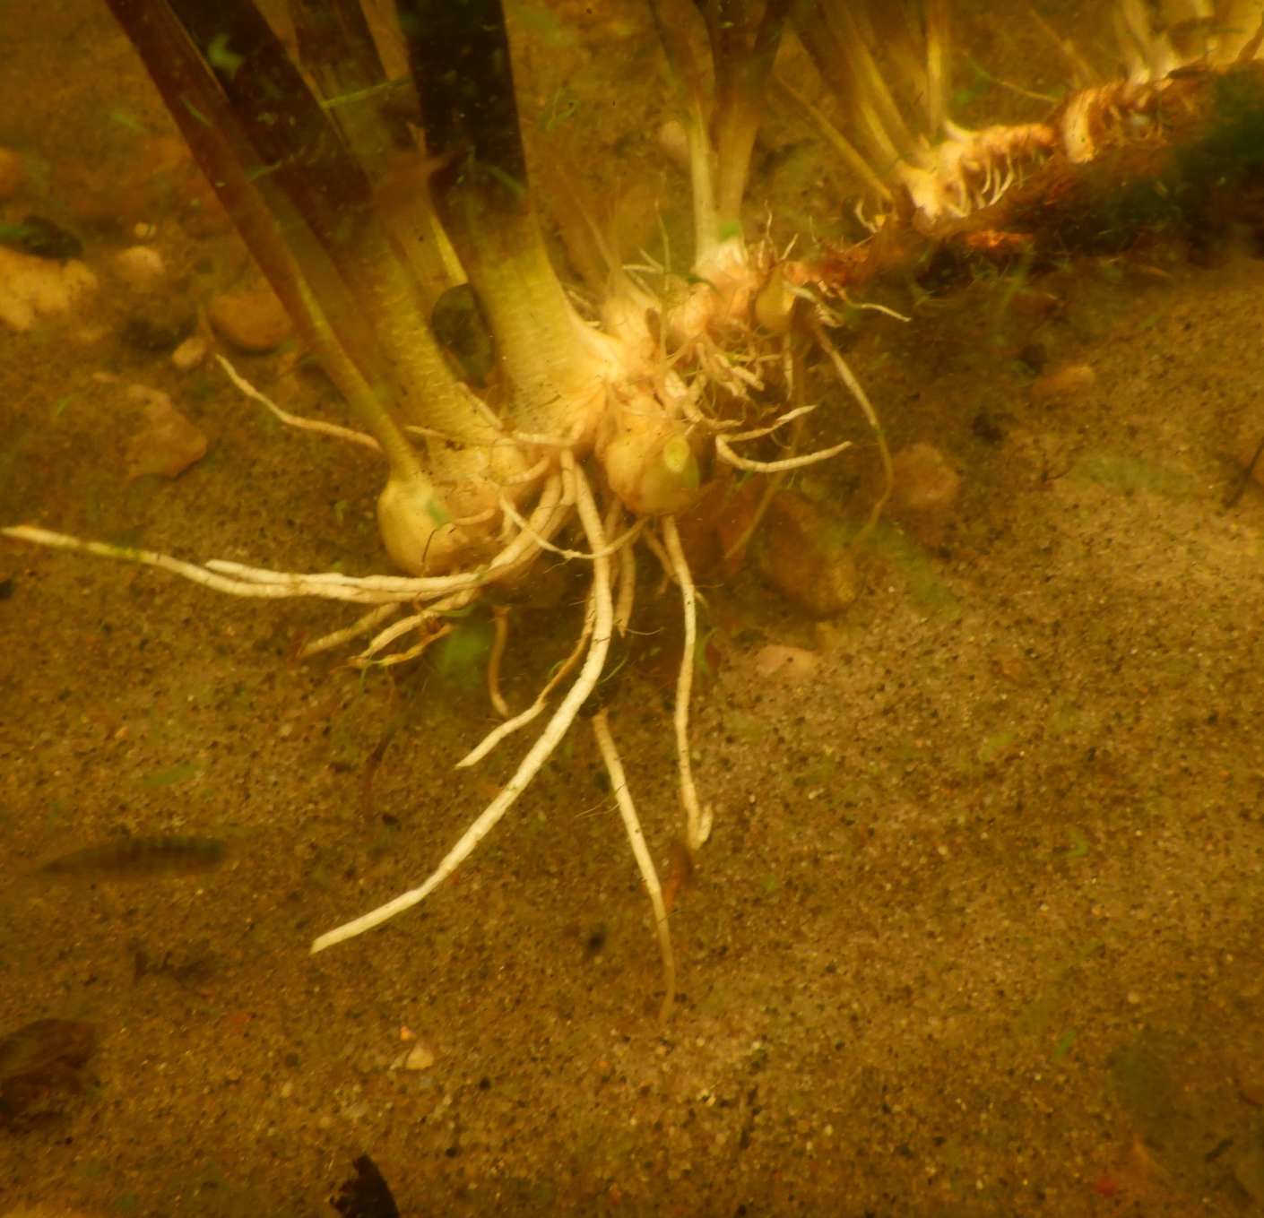
Flowering Rush Update

Slide 10
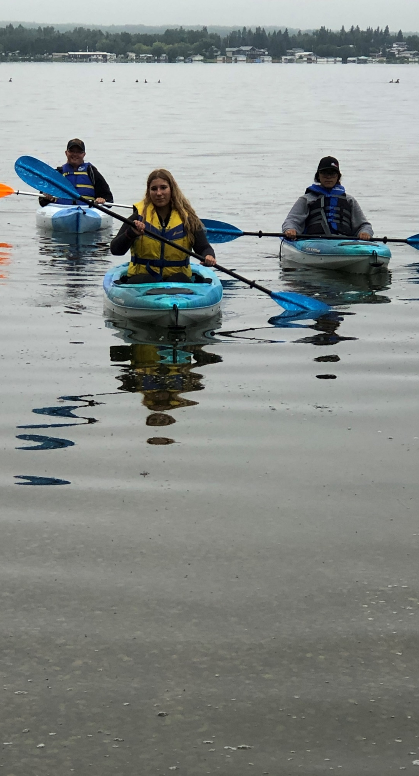
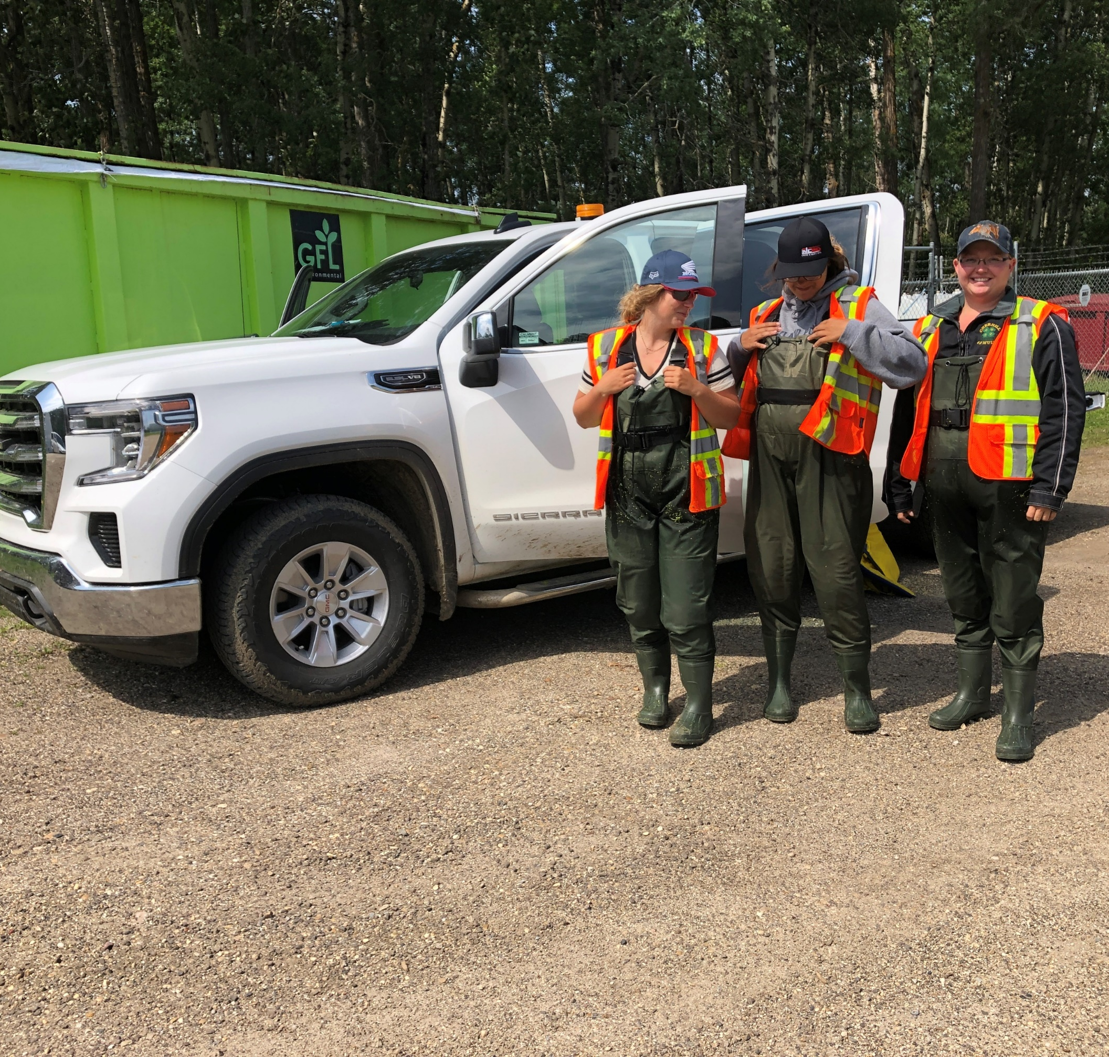
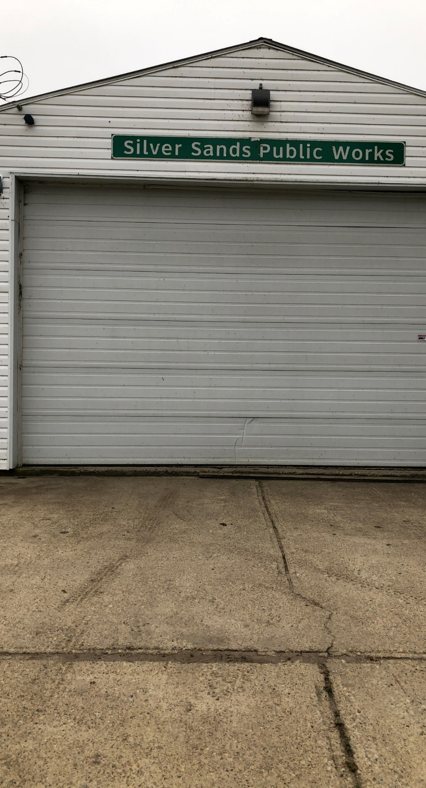

Slide 11
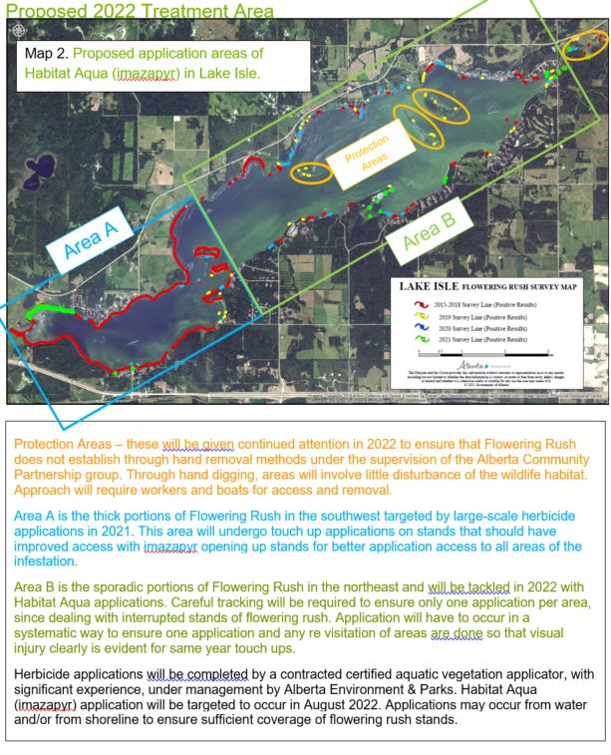

Slide 12
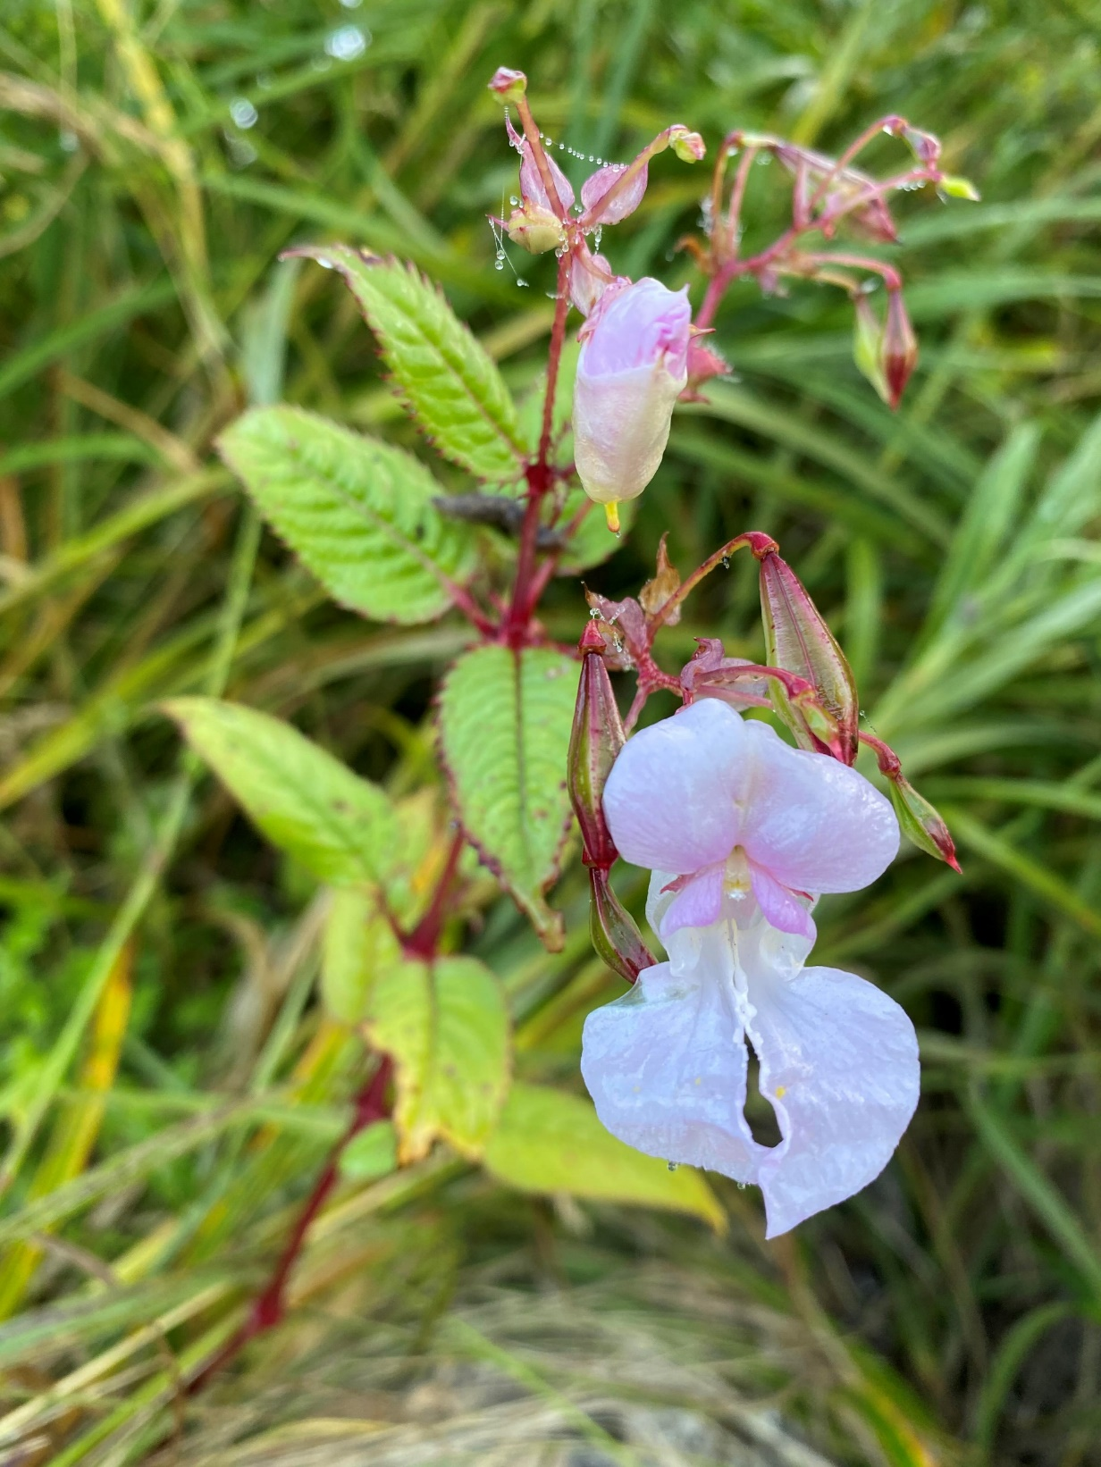
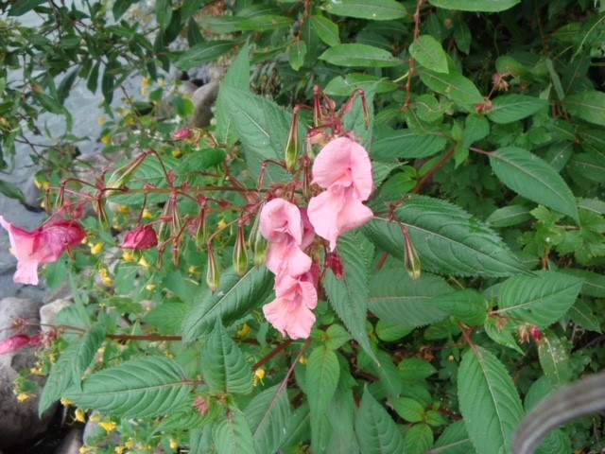
Himalayan Balsam Prohibited Noxious Weed Concerns - High reproduction rate + establishes easily Displaces native vegetation - Draws pollinators away from native plants

Slide 13
Wastewater
LILSA will work with the Darwell Wastewater Commission to educate residents of Lake Isle on the merits of a waste water system.
The waste water system will be for all residents on the north and south sides of the lake.

Slide 14
LSA Weir
The weir remains an unknown currently.
LILSA does not have the resources to tackle this issue.

Slide 15
Notes:
There are many factors that influence water levels; such as land use impacts in the Sturgeon River drainage basin, precipitation, groundwater recharge + use and evaporation. Historical water levels showcase the cyclical trends of water levels.
In 1951 a weir was installed at the outlet of Lac Ste. Anne to the Sturgeon River

Slide 16
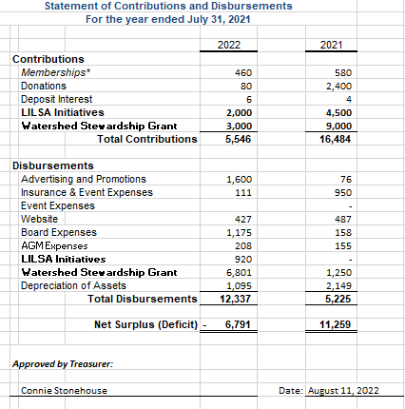
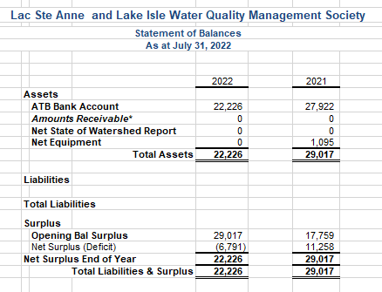
Financials

Slide 17
Election of 3 Directors 4-Year Term
Image: K. Norton

Slide 18
Bylaw Amendment
Image: K. Norton
Amend the LILSA Constitution item 6.6.4, the Lac Ste. Anne Metis Community Association may nominate one Member at Large to be a voting director of the society.

Slide 19
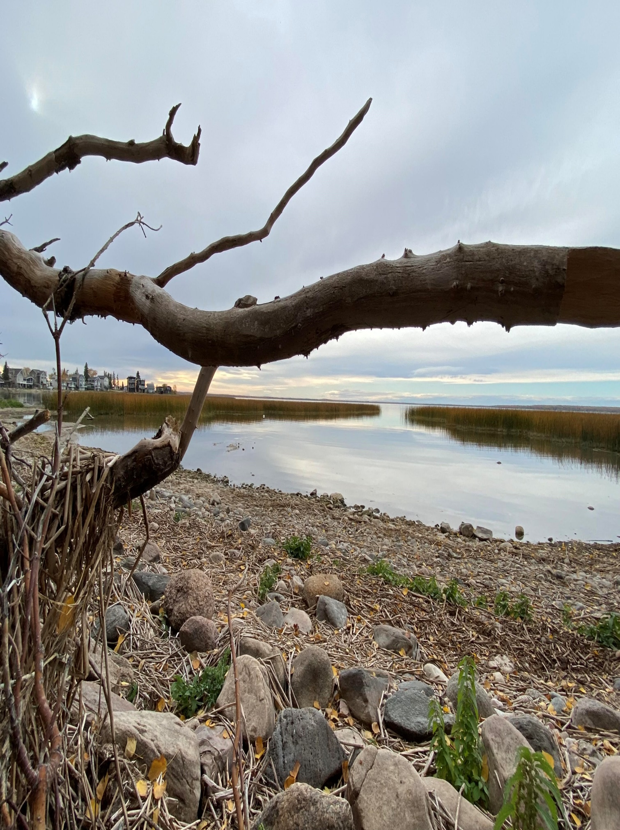
Q & A
Adjournment

Slide 20
Thank you!
Image: K. Norton

