Slide 1
2022 Update
Kelsie Norton | LILSA AGM | August 20, 2021

Slide 2
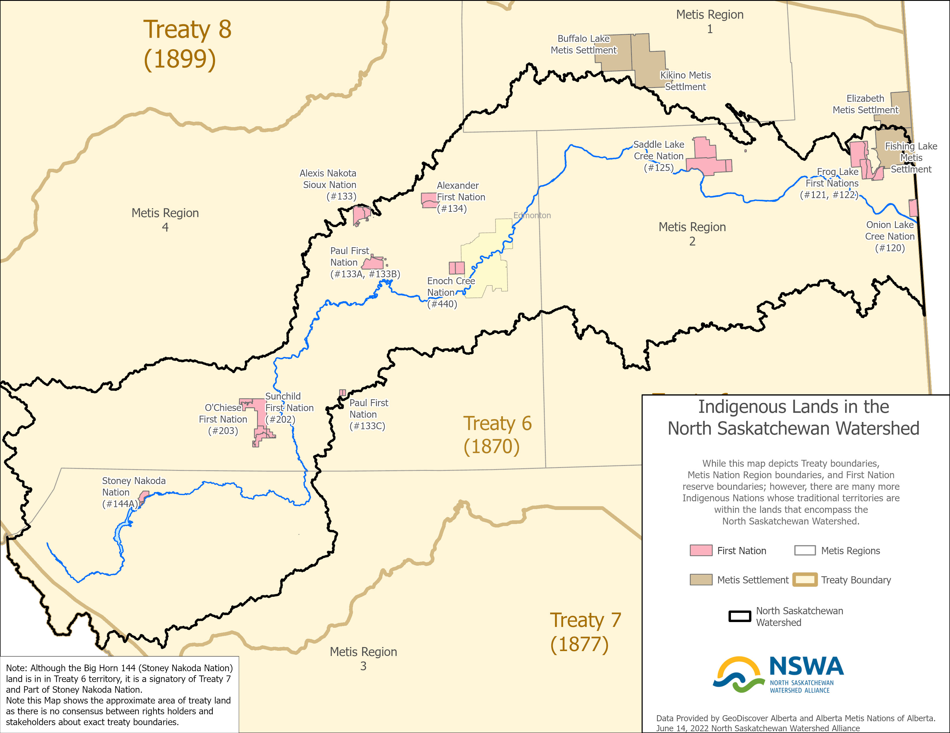
Notes:
LAND ACKNOWLEDGEMENT
In the spirit of respect and reciprocity, we acknowledge that the lands within the North Saskatchewan River watershed are located in Treaty 6, Treaty 8, and the Métis Homeland. These lands are the traditional territories and gathering places of diverse First Nations, Métis, and Inuit peoples. We recognize the contributions of Indigenous peoples who have cared for this land since time immemorial and whose rich histories, cultures, languages, and presence continue to enrich these sacred lands we all steward as Treaty People.

Slide 3
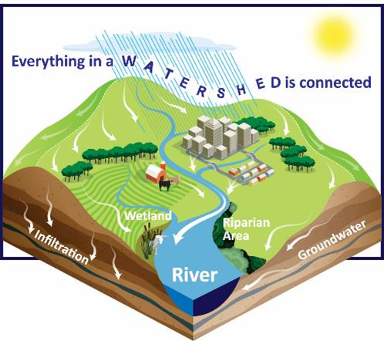
Watershed
Notes:
A watershed also known as a basin, takes a holistic approach to the landscape. Water flows to a low point, which include wetlands, creeks rivers and lakes.
Watershed planning focuses on the land around key waterbodies and how the landcover and land uses on that land affect the waterbody.
Ultimately, what we do on the land will in return affect out water quality and quantity.

Slide 4
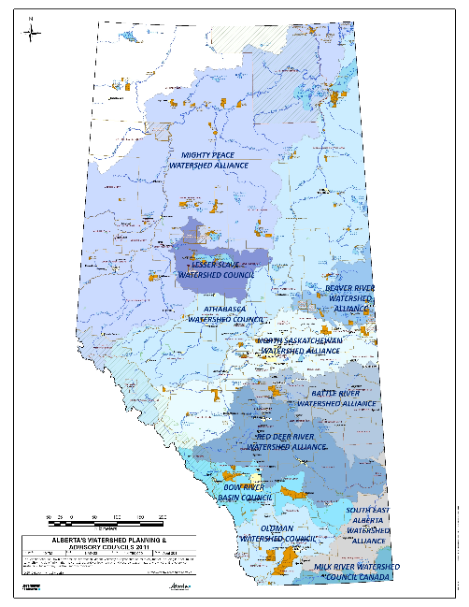
Notes:
We are on of 11 Watershed Planning and Advisory Councils across Alberta – The Government of Alberta designated watershed based independent, non-profit organizations that undertake water management planning, provide advice, collaborate with watershed stakeholders.
There is a WPAC for every major river system, such as Old Man, Peace River and Athabasca.

Slide 5
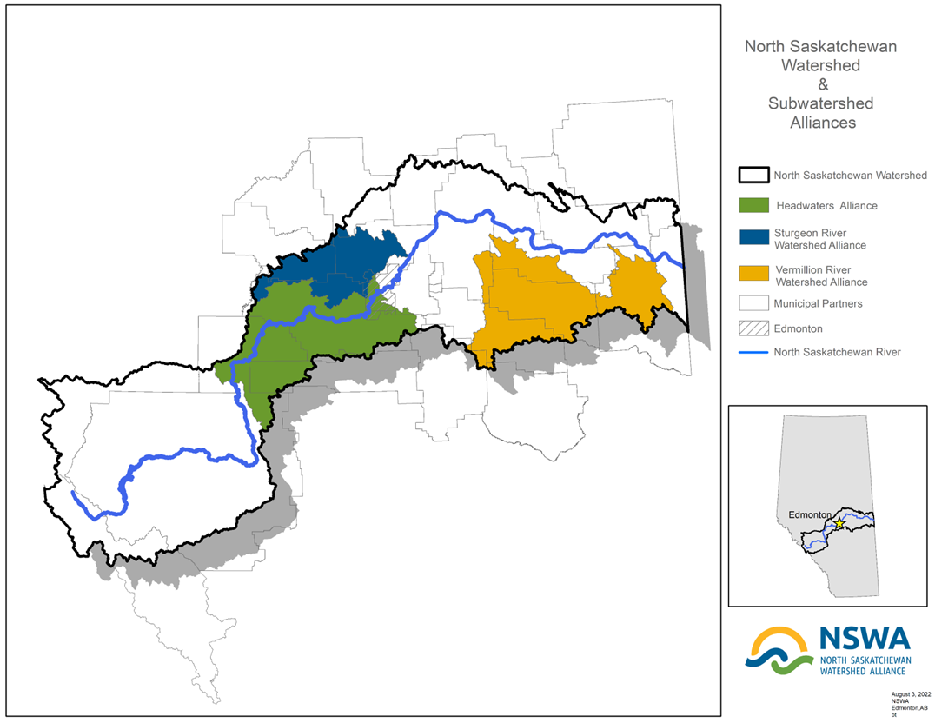

Slide 6
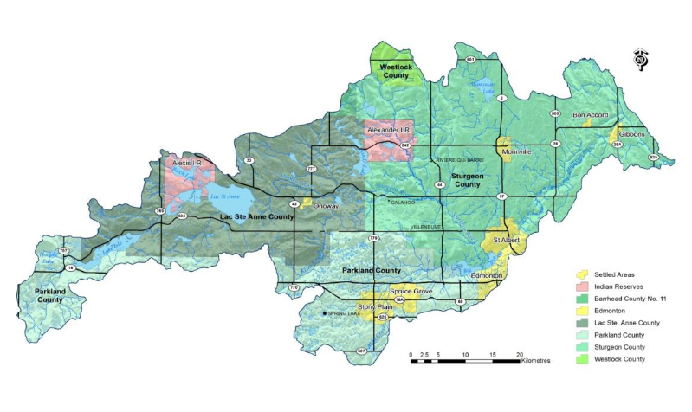
Sturgeon River Watershed

Slide 7
State of the Watershed
Completed in 2012 by the City of St. Albert.
Assessed overall ecological health using 15 indicators and gave an overall grade of FAIR.
Establish a municipally led watershed group
Fill information gaps by completing technical studies
Develop an Integrated Watershed Management Plan
Notes:
In 2012 State of Watershed Report done by City of St. Albert: grade of Fair– which is the first step and summarizes all the information that is known and provides a clearer picture of the overall health of the watershed.
Looked at land use, water quantity, water quality and biological (vegetation, fish and invertebrates)
It provides the benchmark for moving forward and highlighted the data needs to fill knowledge gaps; such as wetlands, riparian buffers and aquatic life.
Good Health:
Water allocations by Sector
Pesticide + E.Coli Indicators
Poor + Insufficient Data:
Nitrogen + Phosphorus
Vegetation types
Insufficient data on surface water quality (temp, color, metals, minerals)
Macrophytes (aquatic veg) + Benthic Invertebrates
Challenges:
Rapid urban development
Agricultural intensification (71% of the watershed is agriculture)
Loss of natural areas, riparian buffers and wetlands
Low, fluctuating water levels
High nutrient inputs and poor water quality
Increase in stormwater runoff and pollution
Blue-green algae, fish kills, invasive species

Slide 8
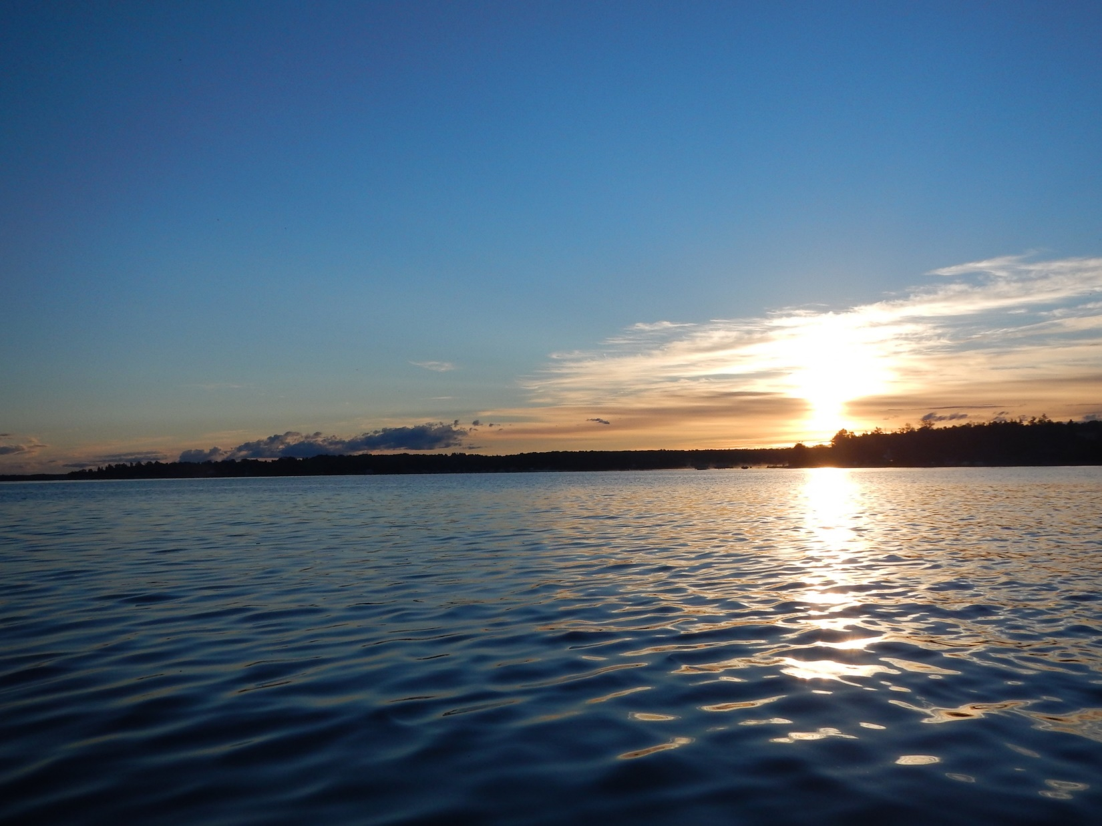
Information Gaps
Water Quantity
Groundwater
Water Quality
Aquatic Health
Riparian Areas
Land Planning Tools
Notes:
1st recommendation: Create a municipally led watershed group
2nd recommendation: fill data gaps. With NSWA assistance, the SRWA completed a number of technical reports between 2015 and 2019

Slide 9
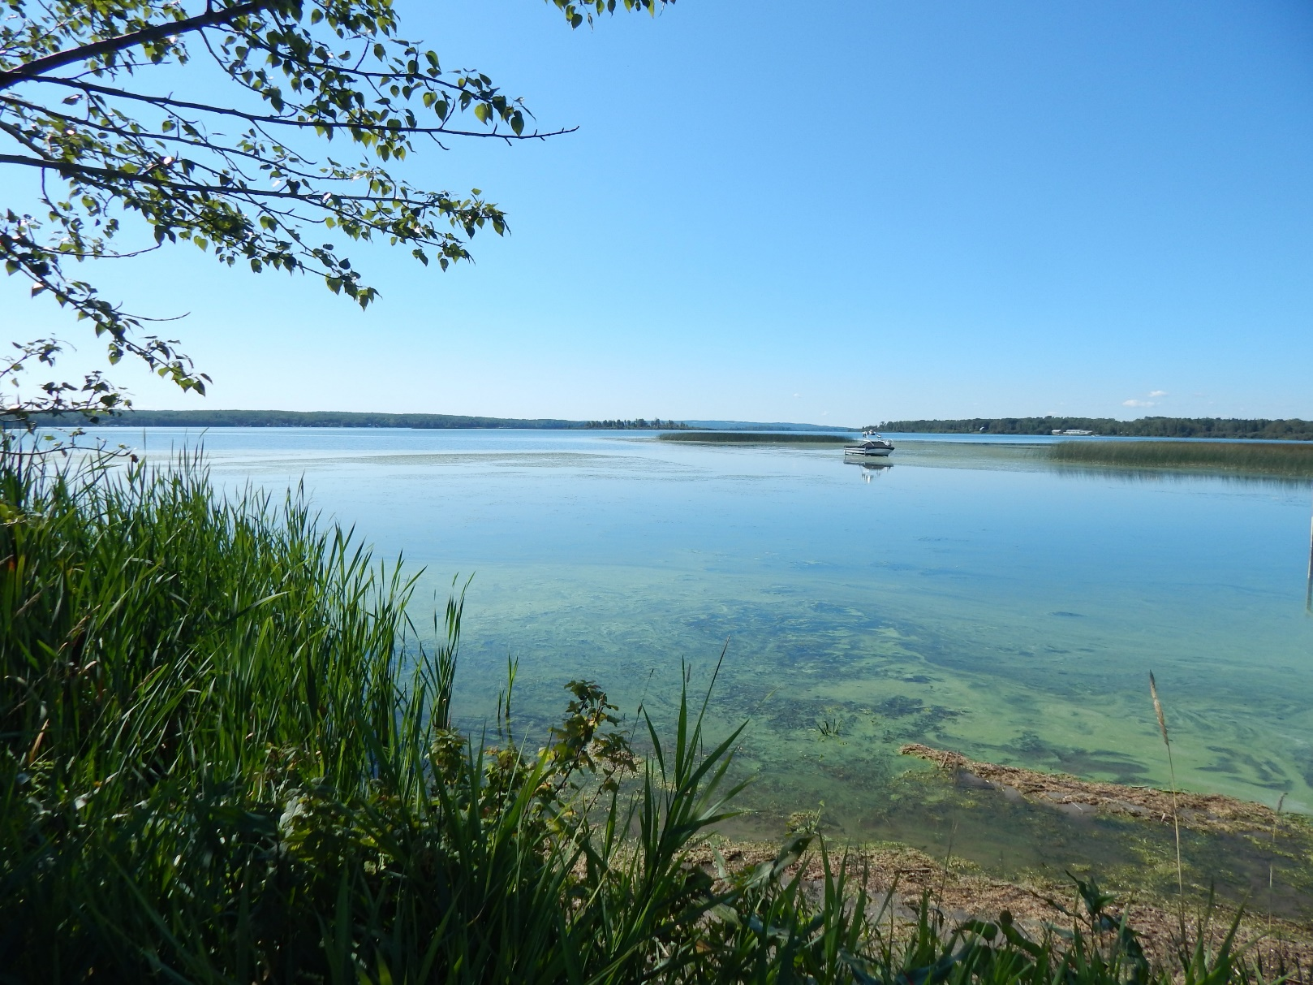
Challenges
Rapid residential expansion
Agricultural intensification
Loss of natural environments
Fluctuating water levels
High nutrient run-off
Invasive species
Notes:
Challenges in this subwatershed are representative of issues in many watersheds across Alberta (read slide)
This makes the Sturgeon a good working model: if you can solve the issues here, you can probably solve them elsewhere
Interestingly, this small subwatershed has approximately the same population, approximately 200,000 people, as the entire Athabasca watershed which covers an area of 150,000 km2 which is about 45X the size!
Also of note is the SR is not a major source of drinking water (all communities now are part of the EPCOR regional lines)
however, about half the population of the basin is rural, relying on groundwater, and this is one of the densest areas for groundwater wells in the province.
Provides 1% flow to NSR.

Slide 10
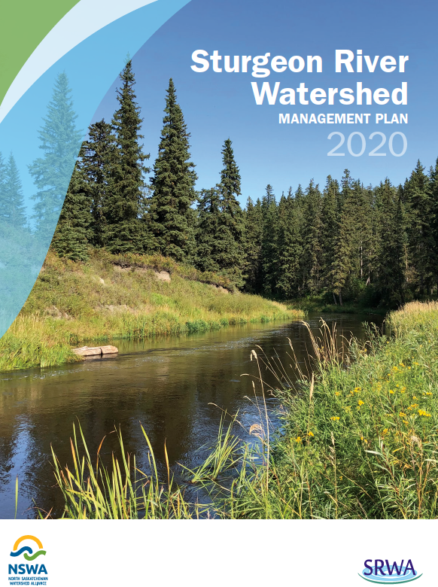
Watershed Management Plan
Watershed approach
Clear goals and performance measures
Voluntary alignment of policies and plans
Coordinates intermunicipal collaboration
Promotes local and regional stewardship
Encourages work to address knowledge gaps
Notes:
Third Recommendation from the State of the Watershed report was to develop a WMP, and this has recently been completed.
Note: A WMP is advisory only; the SR WMP has been accepted as information by a motion of each council member.

Slide 11
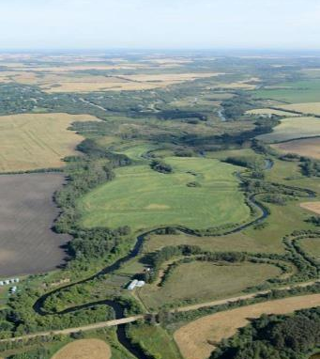
Six Outcomes
Align Policies and Plans
Safe, Secure Drinking Water Supplies
Healthy Aquatic Ecosystems
Reliable Water Supplies
Wise Land Use
Local and Regional Initiatives
Notes:
The WMP identifies:
6 Outcomes
12 Goals
29 Strategies
These are then translated into a 10-year Workplan:
34 Short term Actions (2020 – 2022) –
(30 Long term Actions (as time and resources permit))
Recently received an Alberta Community Partnership grant of $200,000 (2020 – 2023) which will be used to address priority short term actions

Slide 12
Plan Implementation
Watershed Management Plan outlines outcomes to be addressed over 10 year timeframe
Work will be prioritized by Steering and Technical Committees based on importance and timeliness of actions and resource availability.
Alberta Community Partnership grant of $200,000
(2020 – 2023) addressing priority short term actions
Notes:
Communications
Policy alignment and guidebook for riparian areas and development

Slide 13
Priorities and Next Steps 2021 - 2023
Riparian and Wetland Conservation and Restoration Strategies
Water Quality/Aquatic Ecosystem Monitoring Program
Watershed Planning Alignment and Tools
(flood risk areas, riparian setbacks, environmentally sensitive areas, overlay maps)
Communications and Engagement
(Educational forums, workshops, information resources)
Notes:
Covid setbacks

Slide 14
Lake Isle + Lac Ste. Anne State of the Watershed Report
2017

Slide 15
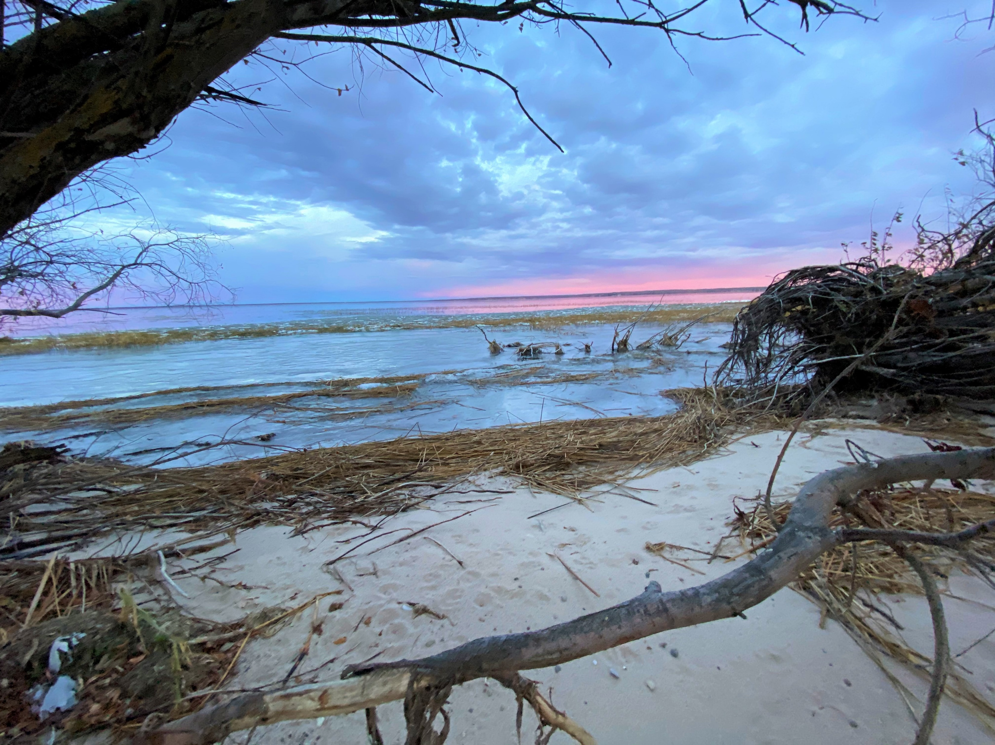

Slide 16
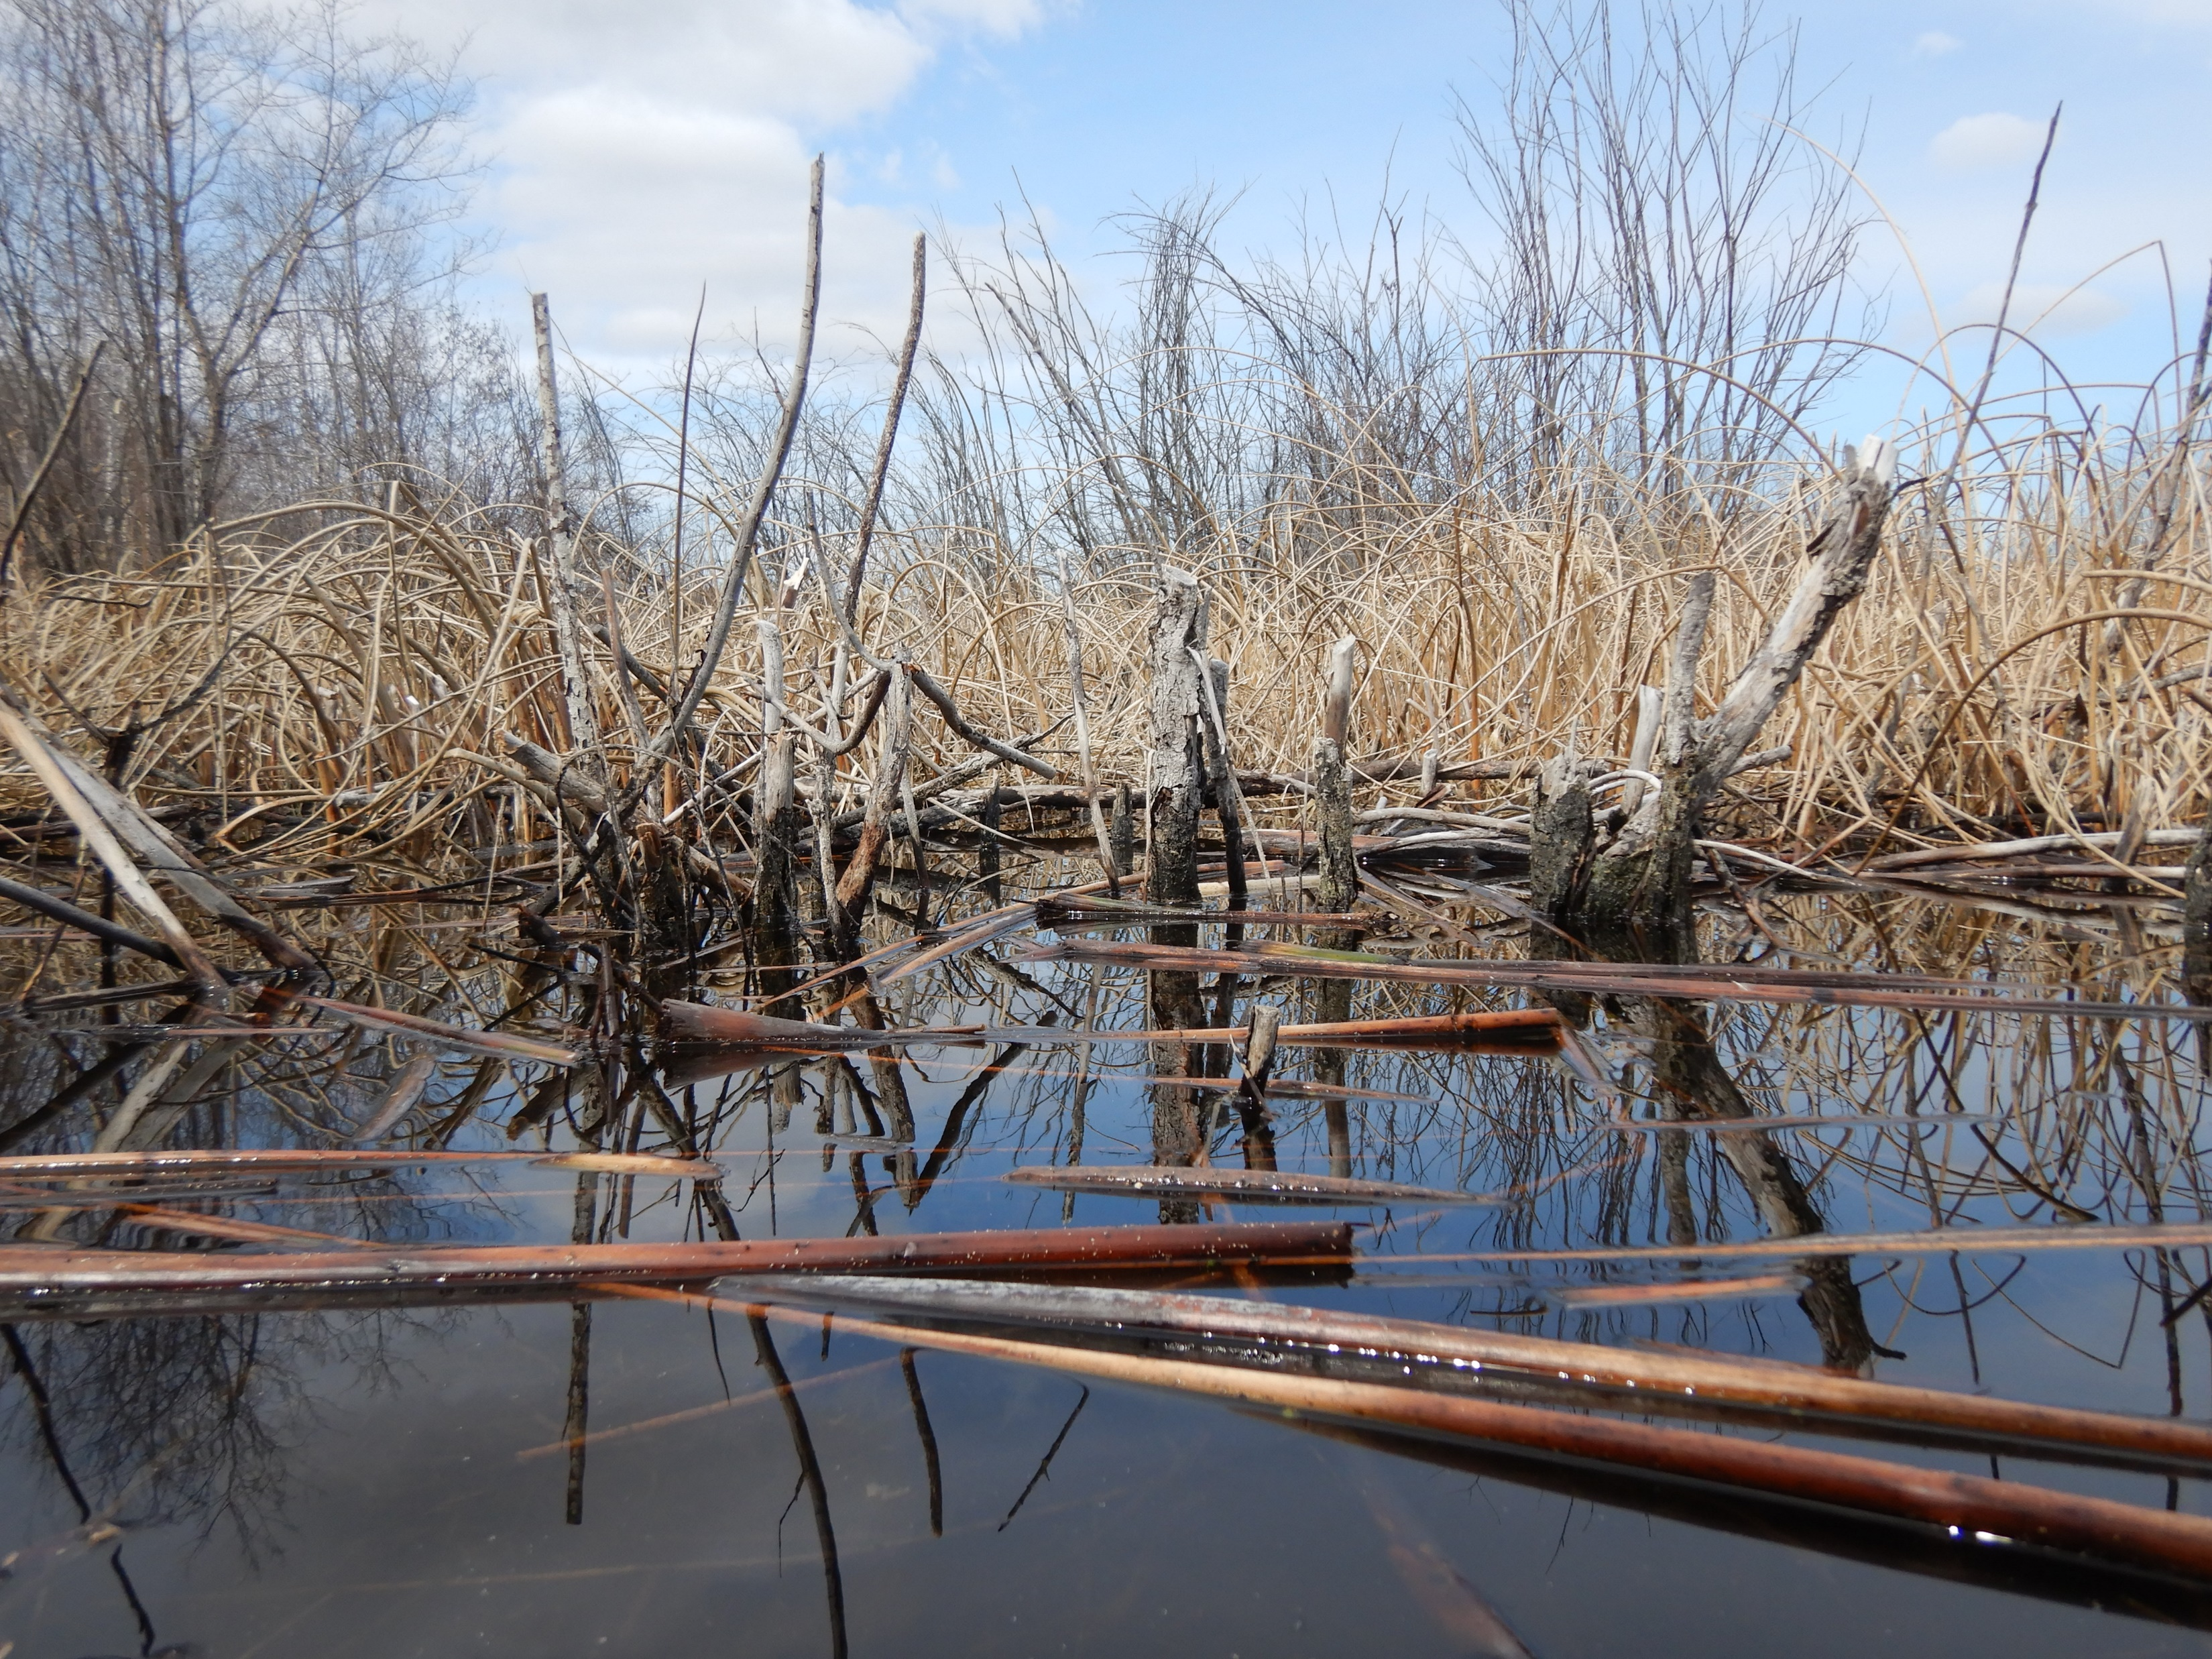
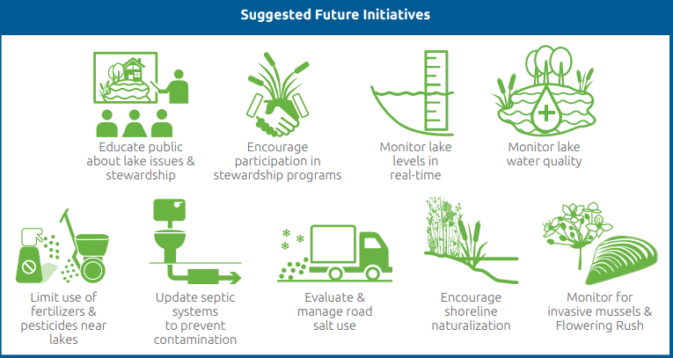

Slide 17
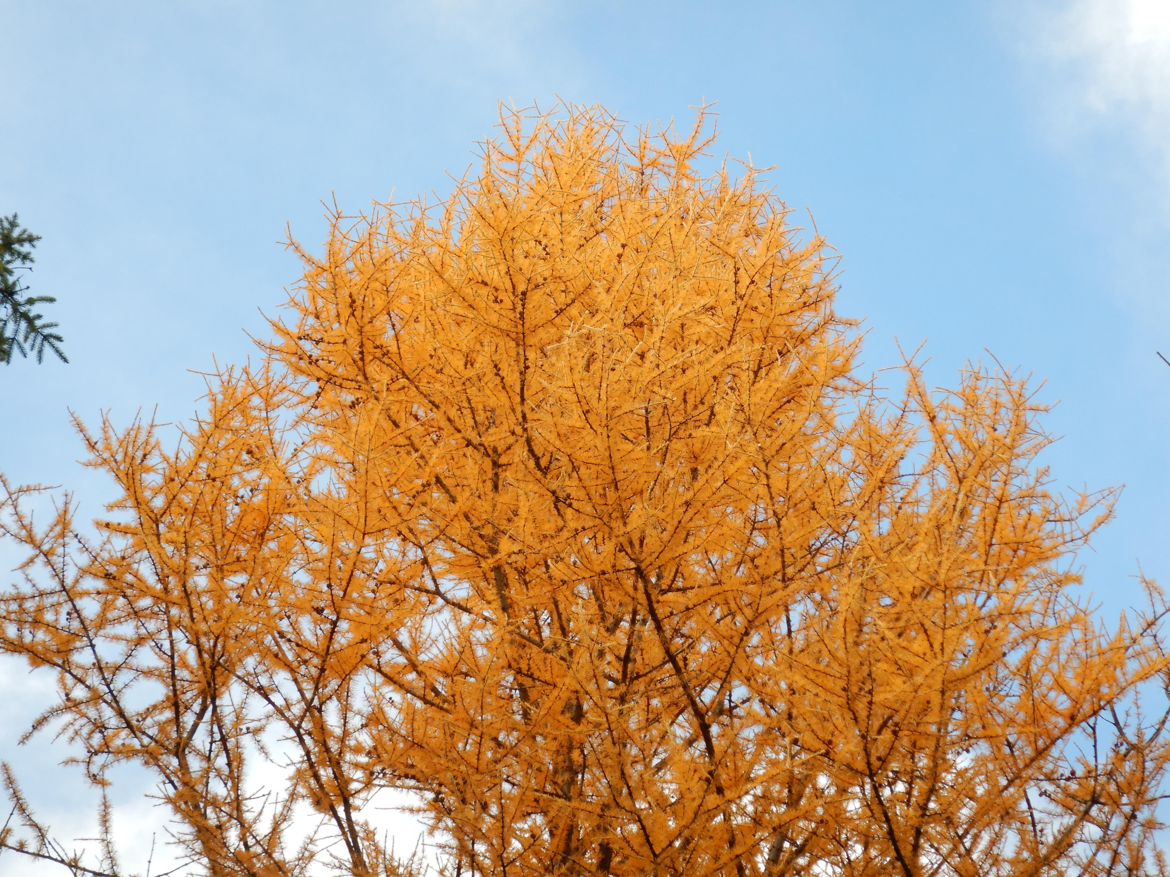
Current Efforts

Slide 18
SRWA Water Quantity Working Group
Hydrology Factors
Groundwater
Water Extraction
Stormwater Management
Storage + Release
Notes:
In 1951 a weir was installed. Not in condition to regulate water levels.
Considered regulating water levels in the 1970. Negative downstream affects

Slide 19
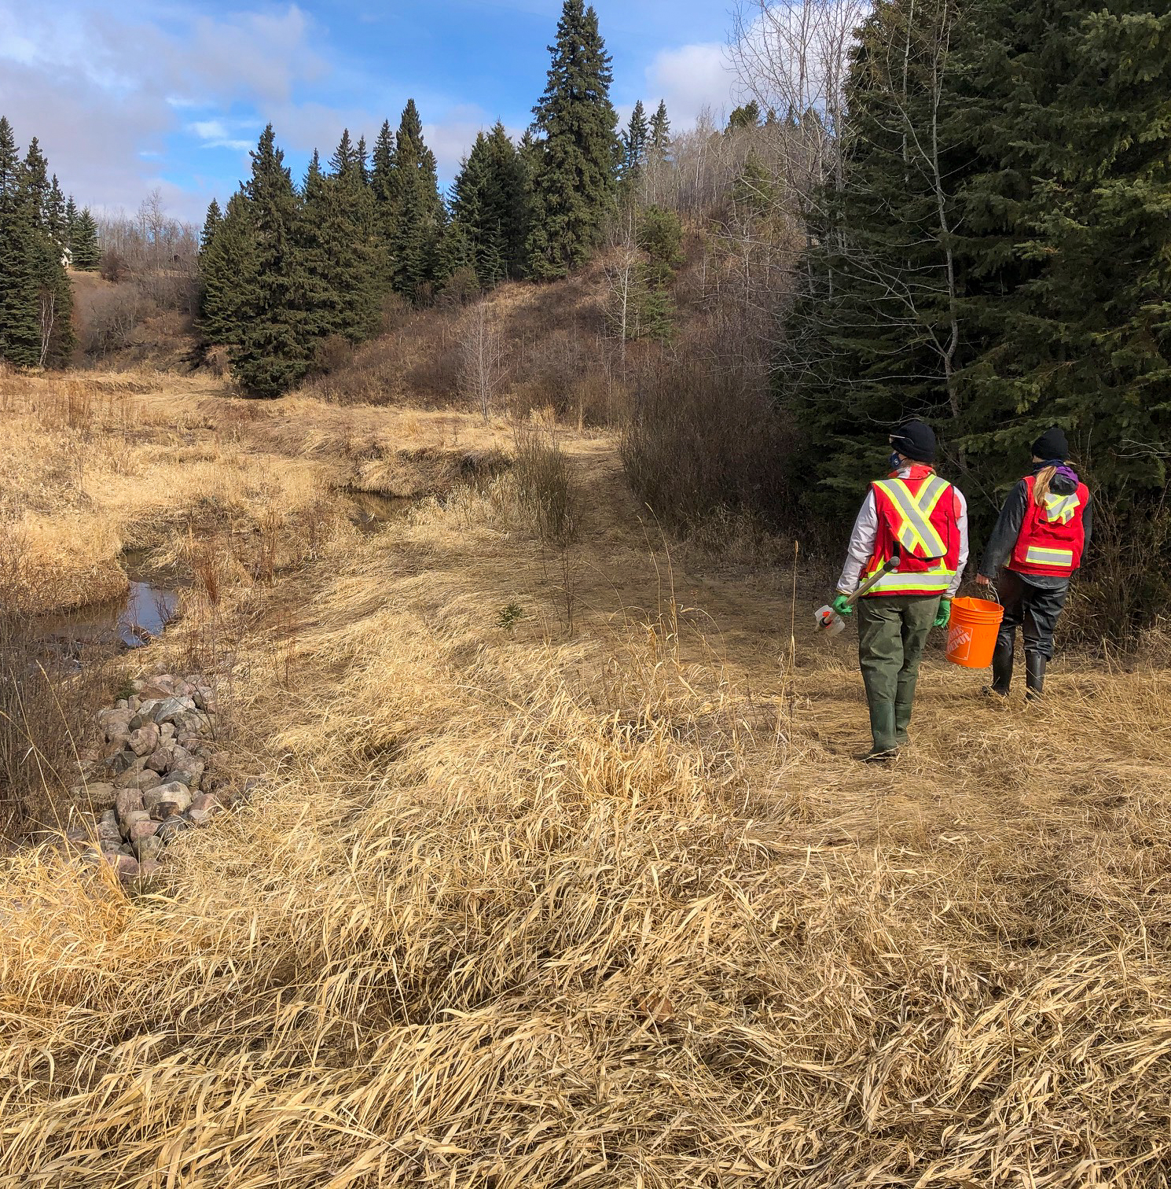
Water Quality Monitoring
Sturgeon River WQ Monitoring
Tetra Tech Consulting
12 sites (8 Sturgeon and 4 Tributaries)
3 sampling events/year
High flow (spring), summer storm and low flow (late summer/fall)
Nutrients, salts, sediment, oxygen
Notes:
Two year program 2021 and 2022

Slide 20
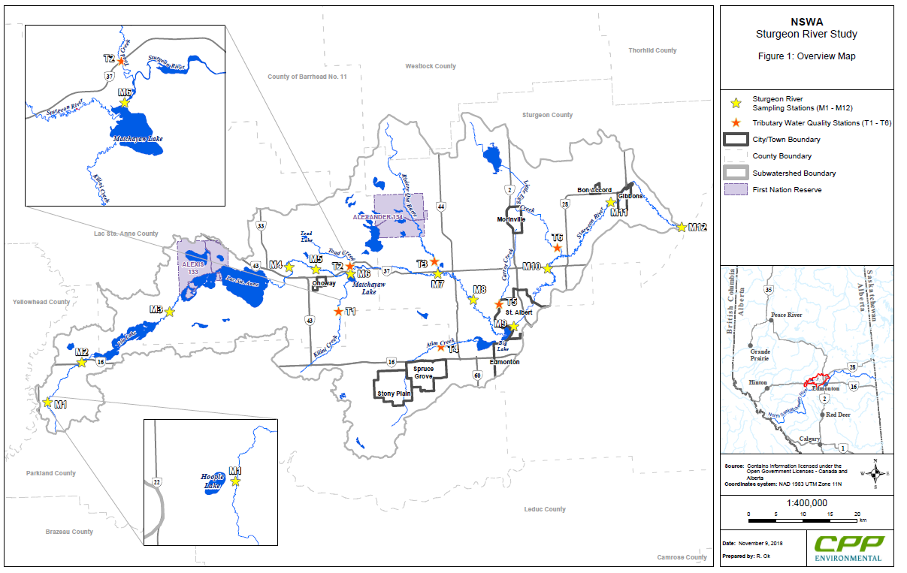
Notes:
M2 – upstream of Ilse
M3 – between Ilse and Lac Ste Anne
M4 – after Lac Ste Anne
M7 – before RQB
M8 – after RQB
M10 – after SA
M11- before Gibbons/WaterSHED station
M12 – confluence of NSR
T1-Kilini
T3 – RQB
T4 – Atim
T5 – Little Egg/Manawan
Find other reports on the website

Slide 21
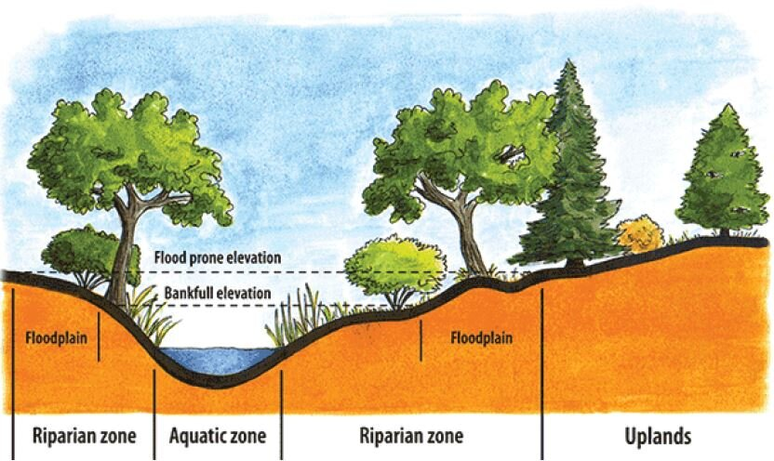
Riparian Area

Slide 22
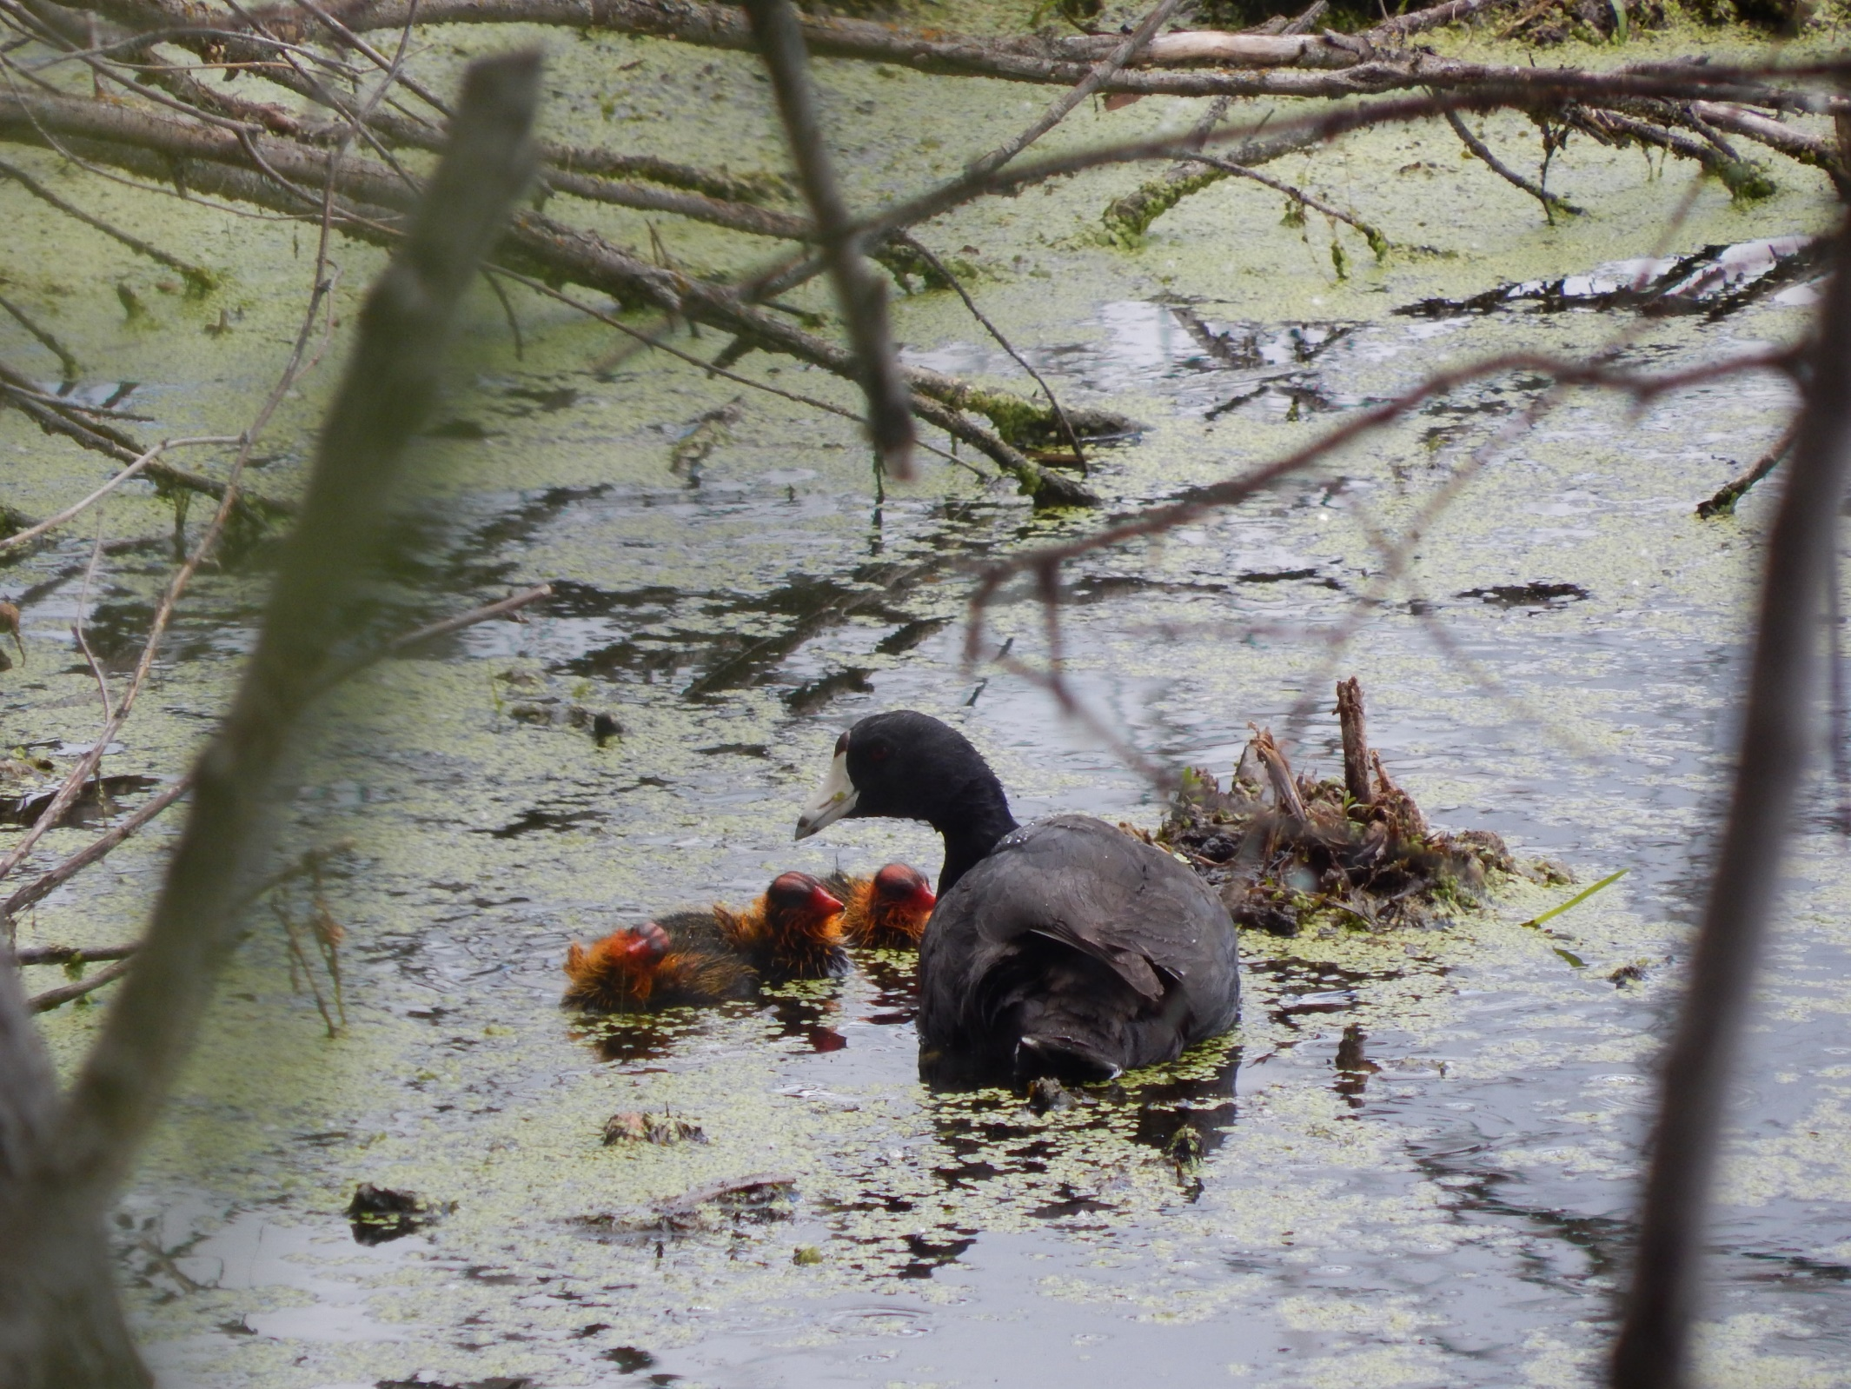
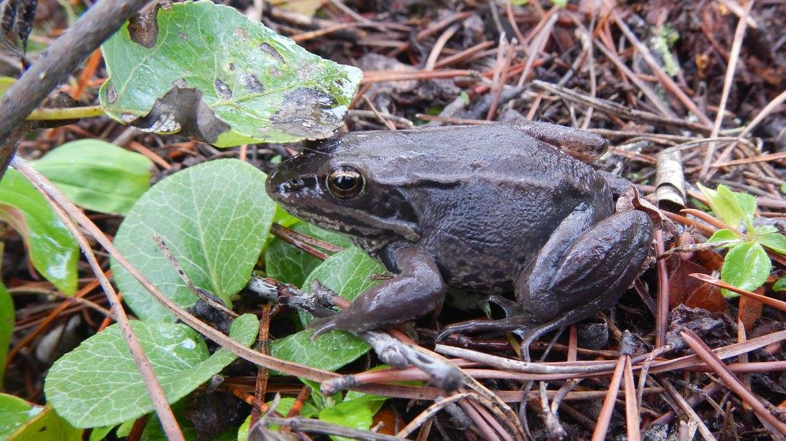
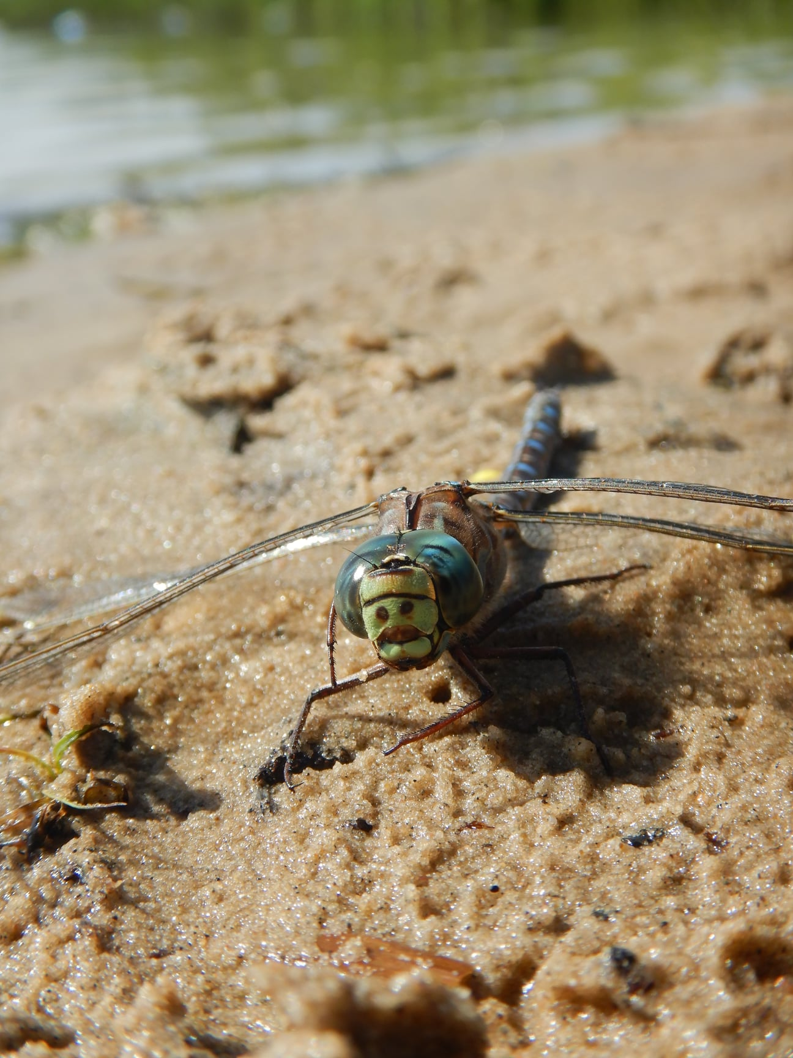
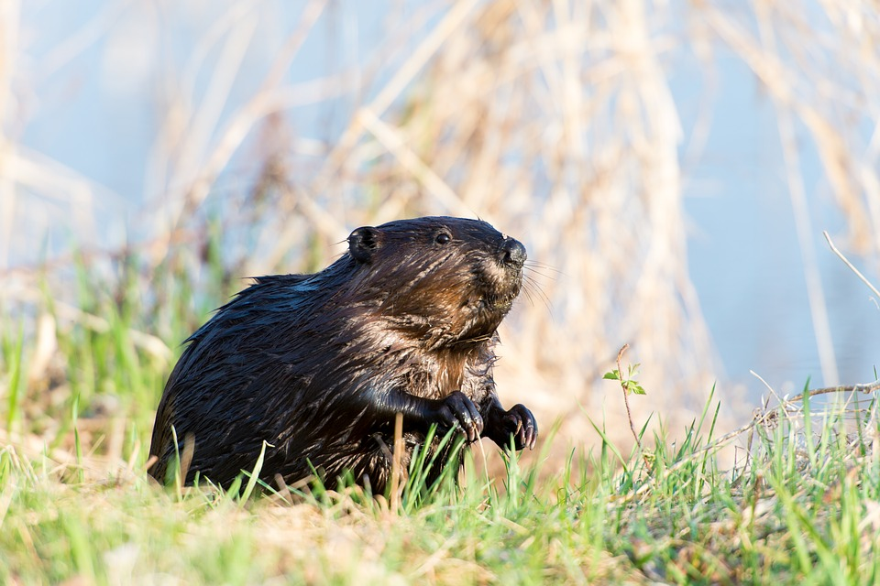

Slide 23
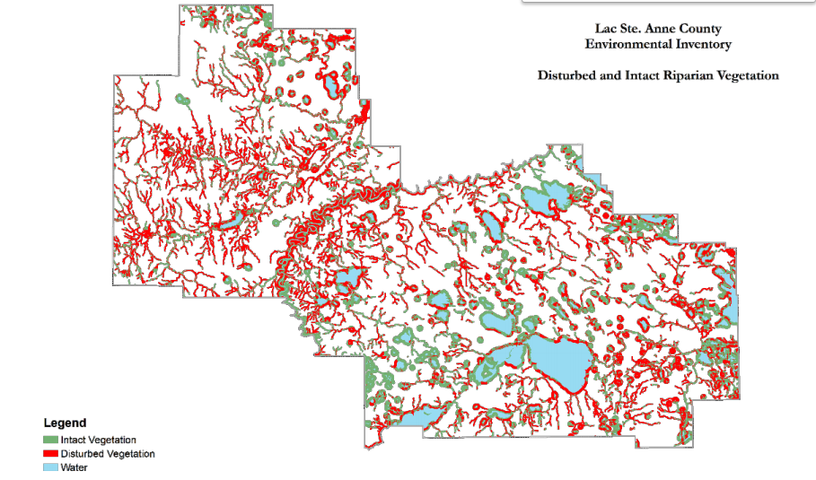

Slide 24
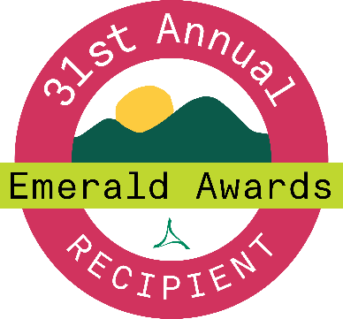
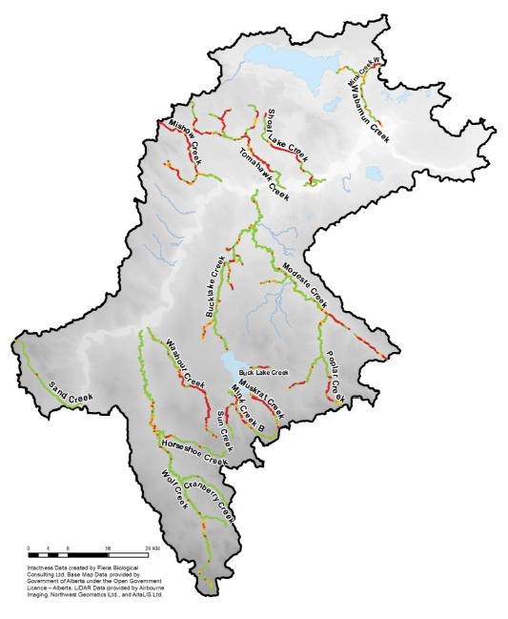
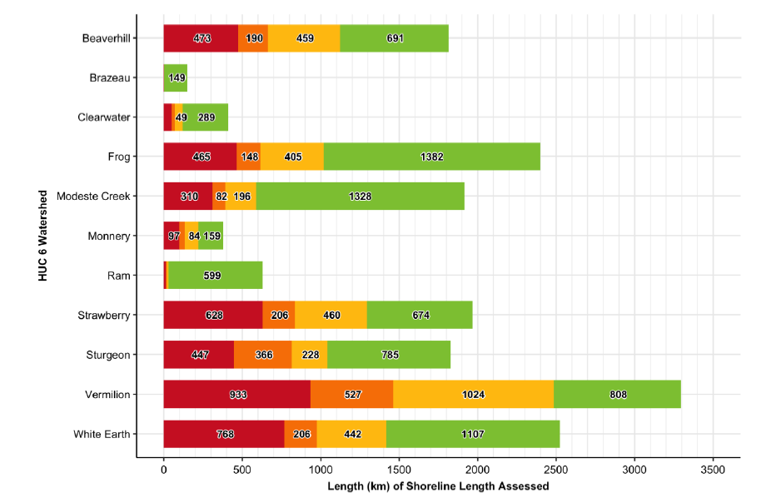
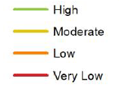
Riparian Health Action Plan
1
3
2
Data
Policy
Action
65% Target

Slide 25
Riparian 101 + 102 Training
Three key purposes:
Riparian data access x2
Resources
Projects on the ground

Slide 28
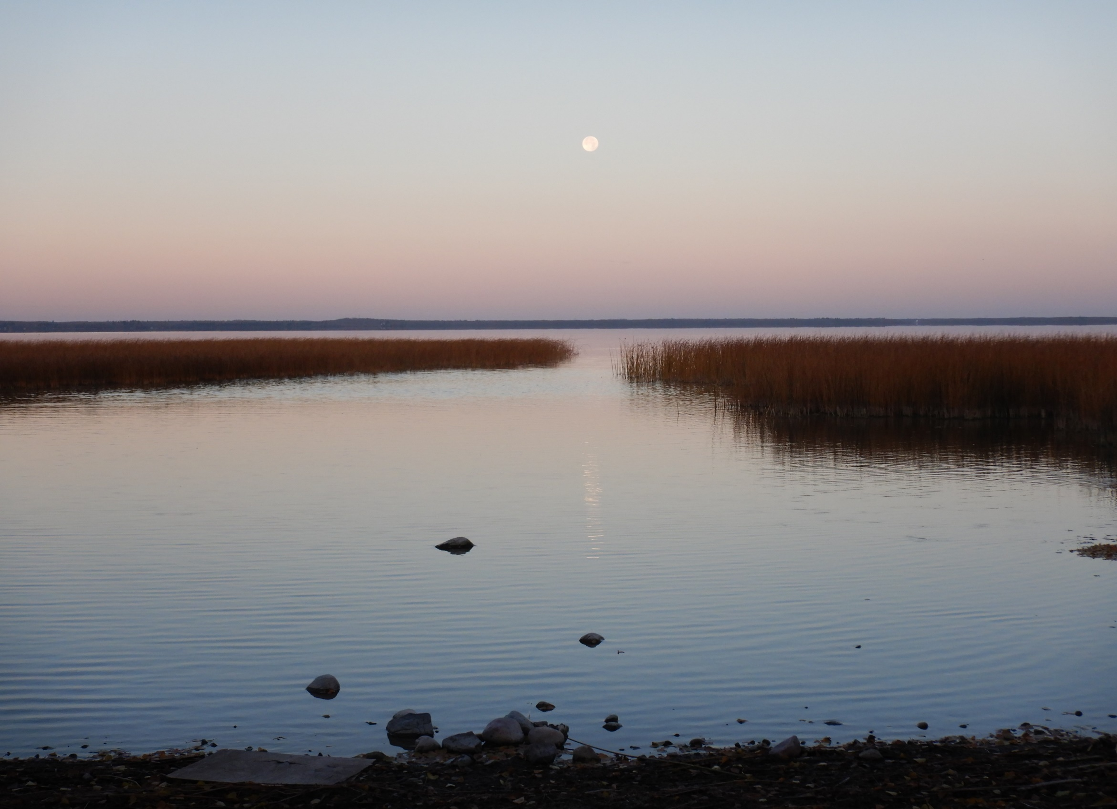
Upcoming Initiatives

Slide 29
NSWA’s Wetland Strategy
Purpose:
Fill knowledge and capacity gaps, align wetland policy and planning, increase collaboration with stakeholders, provide educational opportunities, achieve the common goals of better conserving and restoring the wetlands in our watershed.
Current Initiatives:
Complete an inventory of wetlands in the NSR watershed
(In process)
Wetland Day Forum – September 22, 2022
(Save the date, registration coming soon)
Wetland Training Opportunity
(In process – Fall/Winter 2022)
Notes:
We have received WRRP funding to support wetland training for our subwatershed alliances members, staff of municipalities, Indigenous communities, and NGOs in the NSR watershed to take an introductory, intermediate or advanced wetlands course based on their current needs and level of knowledge. Through this opportunity, NSWA's goal is to elevate capacity, enhance the opportunity to take on the Wetland Replacement Program and ultimately provide strong roots for partners to conserve wetlands and accomplish restoration initiatives in their region.
Professional development

Slide 30
Regional Lake Stewardship Project
Engaging workshops
Educational restoration projects
Aligned Communications
Address communication gaps
Support water quality monitoring

Slide 31
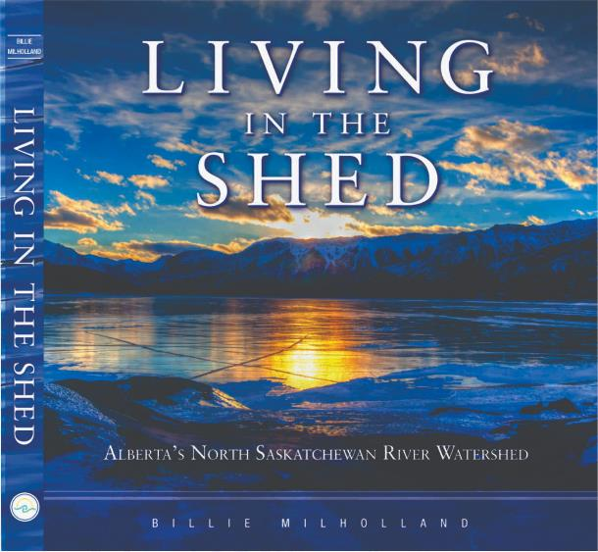
Outreach + Education
Educational Forums
In Stream Newsletter

Slide 32
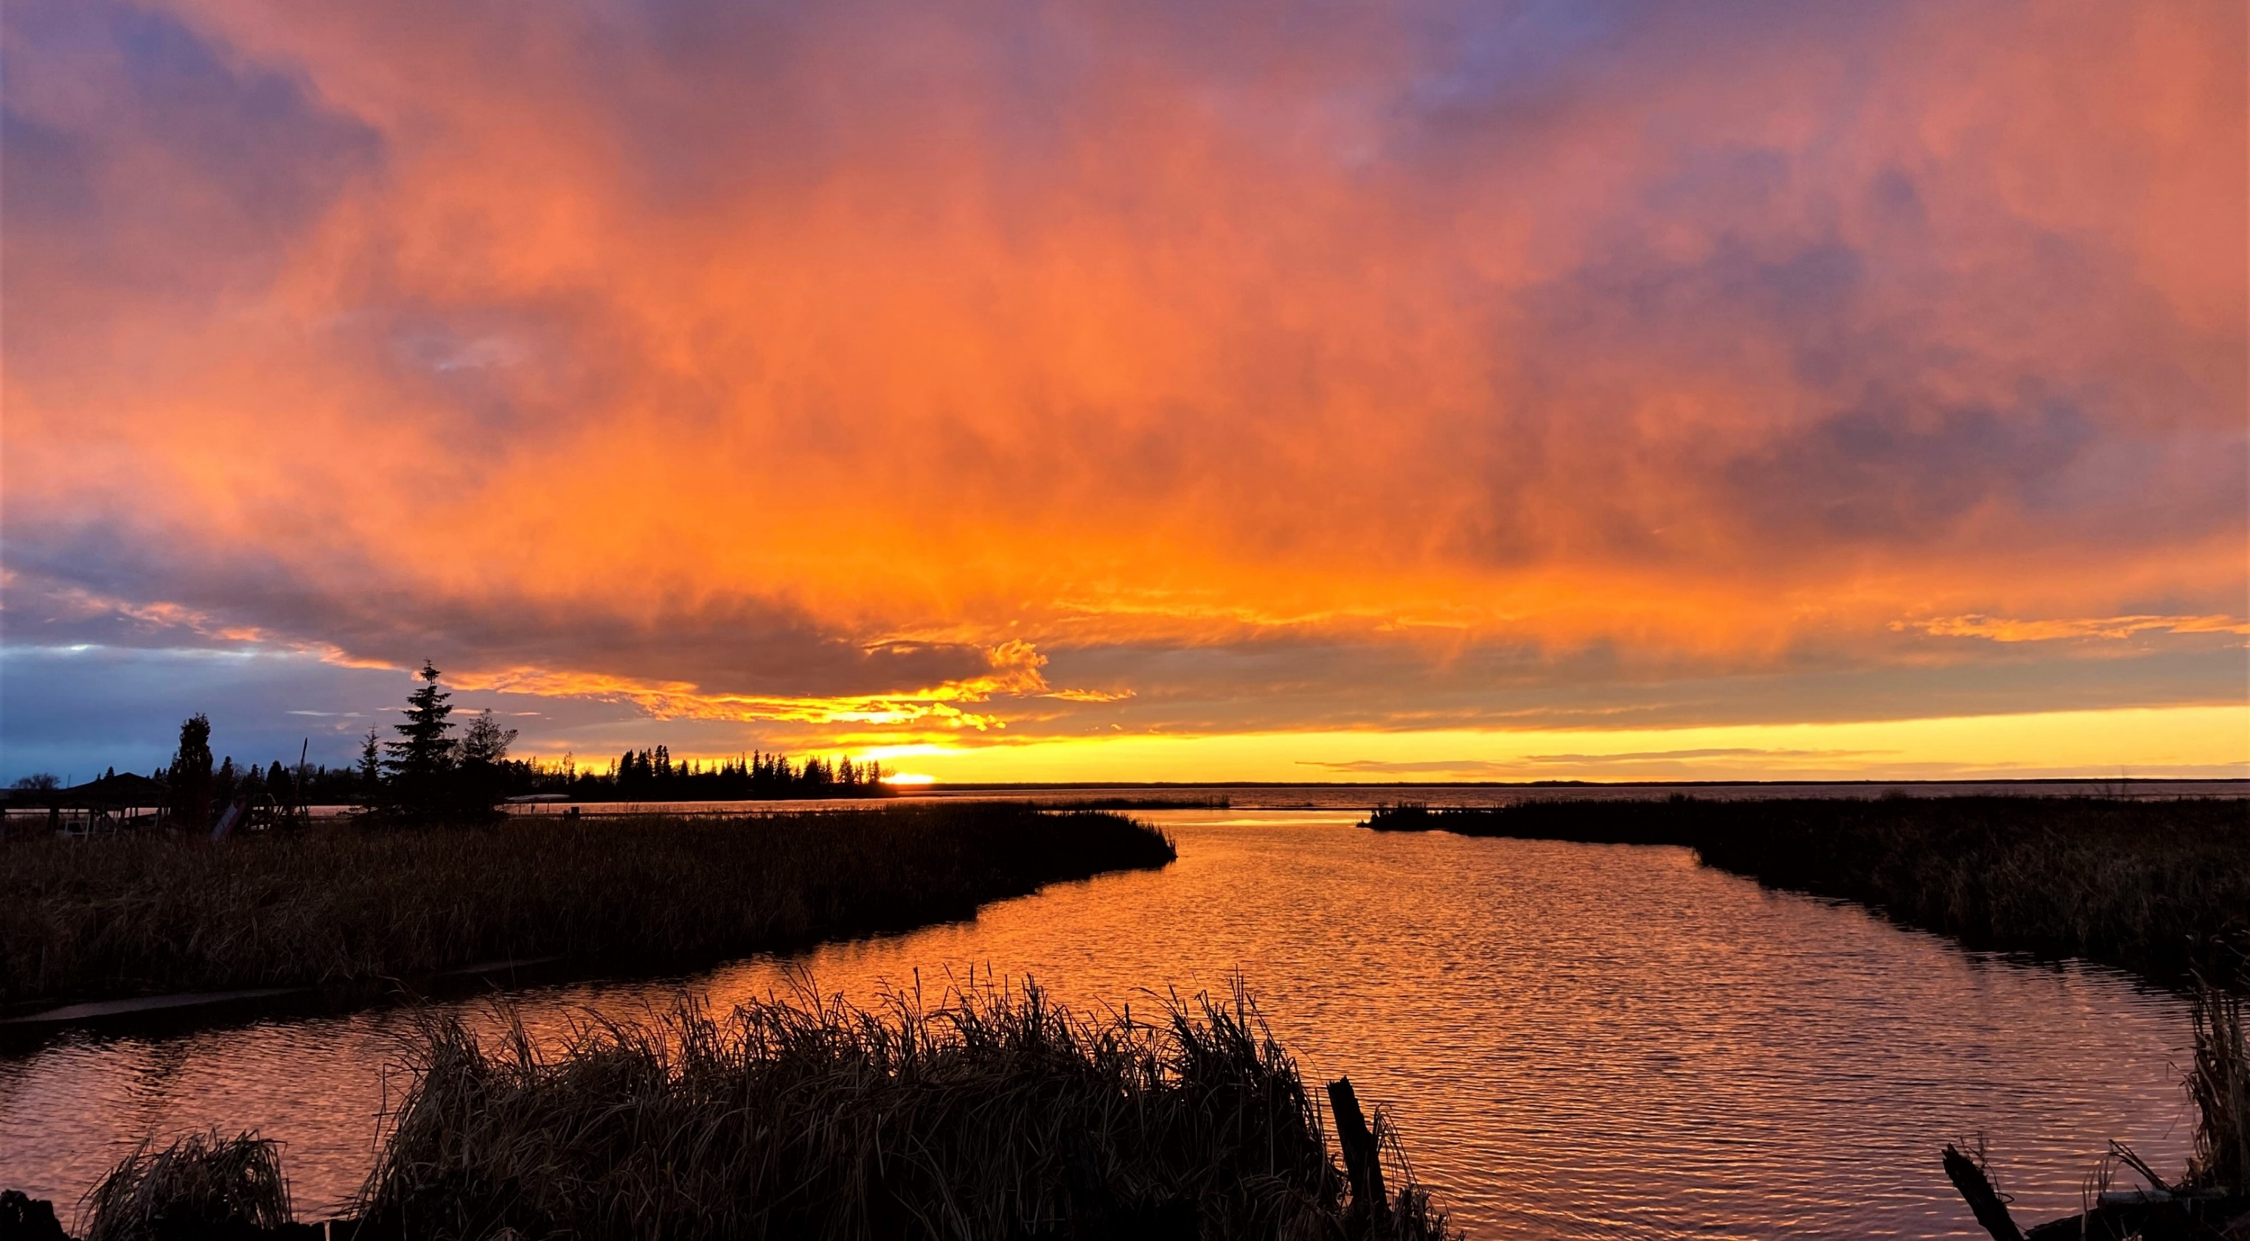
Thank you! kelsie.norton@nswa.ab.ca

