Slide 1

2021 Update
Michelle Gordy | LILSA AGM | August 21, 2021

Slide 2
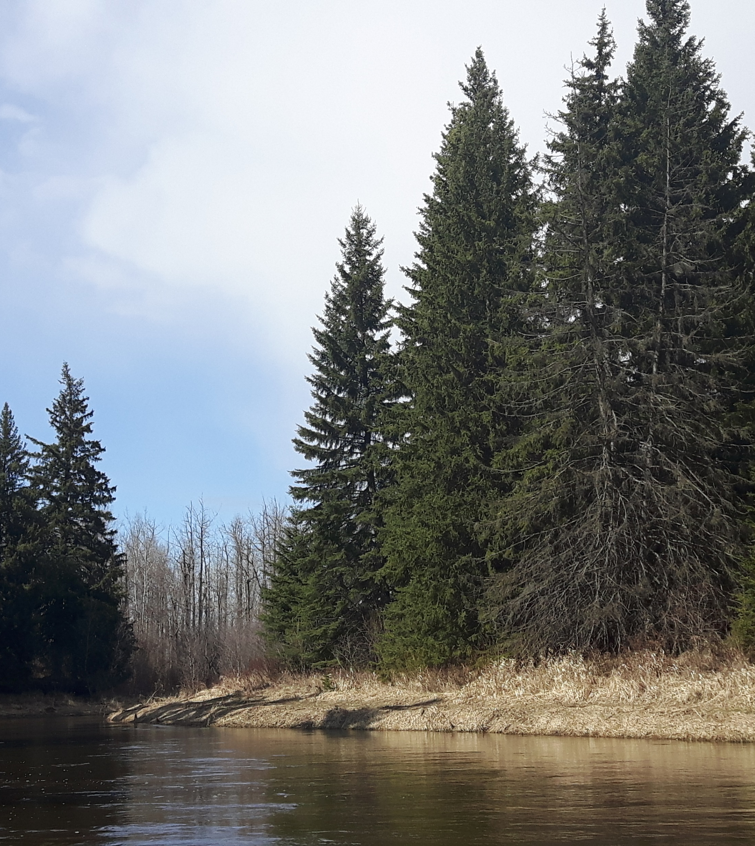
Outline
Background
Watershed Management Plan
Priorities and Next Steps
Current work & Relevance to LILSA

Slide 3
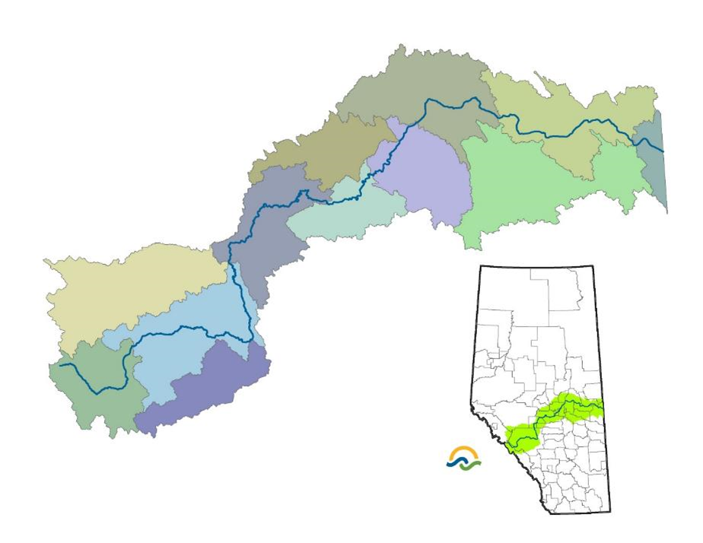
Sturgeon Subwatershed

Slide 4
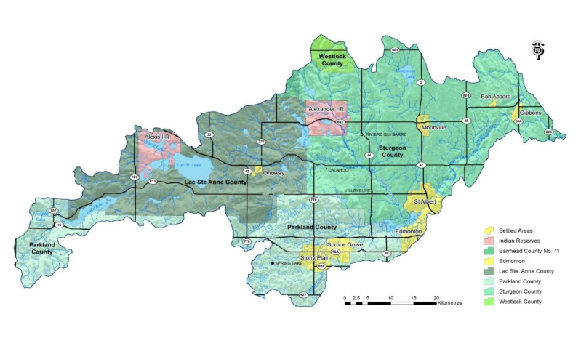
Sturgeon River Watershed

Slide 5
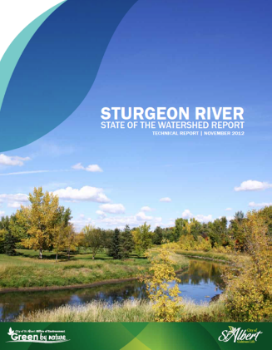
State of Report
Completed in 2012 by the City of St. Albert.
Assessed overall ecological health using 15 indicators and gave an overall grade of FAIR.
  Establish a municipally led watershed group
  Fill information gaps by completing technical studies
  Develop an Integrated Watershed Management Plan
Notes:
Alberta Environment and Parks has developed a watershed planning framework for Alberta which includes several key steps/reports:
A State of the Watershed Report –is the first step and summarizes all the information that is know about a watershed. It provides the benchmark for moving forward and includes a preliminary assessment of the ecological health.
In 2012 the City commissioned a state of report to summarizes all the information that is know about the Sturgeon River watershed and to provide a benchmark for moving forward with a preliminary assessment of the ecological health. GRADE of FAIR
The report makes 3 recommendations
The next step is to develop a Watershed Management Plan – it fills in the data gaps identified in the State of the Watershed report and develops objectives and actions to address priority issues.

Slide 6
Sturgeon River Watershed Alliance
Lac St. Anne County
Parkland County
Sturgeon County
City of Edmonton
City of Spruce Grove
City of St. Albert
Town of Gibbons
Town of Morinville
Town of Onoway
Town of Stony Plain
Village of Alberta Beach
Summer Villages of Lac Ste. Anne & County East
Alexander First Nation
Alexis Nakota Sioux Nation
Metis Nation of Alberta
Alberta Conservation Association
Alberta Environment and Parks
Big Lake Environmental Support Society
Lake Isle/Lac Ste Anne WQM Society
Wagner Natural Area Society
Notes:
The first recommendation of the State of the Watershed Report was to form a municipally led subwatershed group.
The alliance:
Was formed in 2014
Includes 12 municipalities with both elected officials and municipal staff
Also includes Provincial Government (AEP) and local stewardship groups.
Recently, re-engaging indigenous communities and sharing knowledge.
Wanted to work collaboratively as water issues don’t follow municipal boundaries and wanted to use opportunities for grant funding
Watershed management at the sub-watershed level is more effective as “local issues can be dealt with by local solutions”.
NSWA helps facilitate the formation of the group, ongoing meetings, grant writing, technical studies and writing of reports.

Slide 7
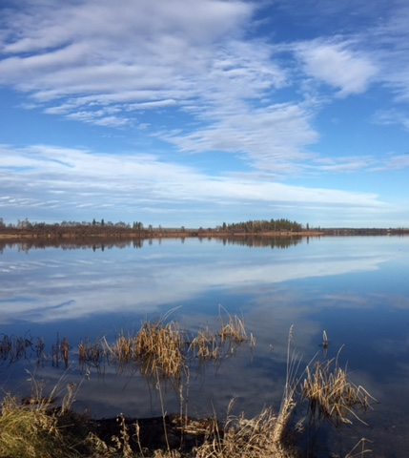
Information Gaps
Water Quantity
Groundwater
Water Quality
Aquatic Health
Riparian Areas
Land Planning Tools
Notes:
1st recommendation: Create a municipally led watershed group
2nd recommendation: fill data gaps. With NSWA assistance, the SRWA completed a number of technical reports between 2015 and 2019

Slide 8
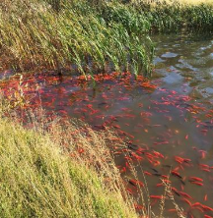

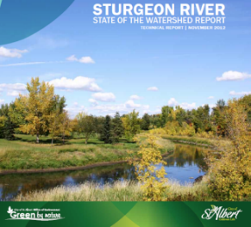
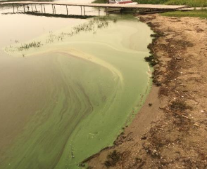
Challenges
Rapid urban/country residential expansion
Agricultural intensification
Increase in stormwater runoff and pollution
Loss of natural areas, wetlands, riparian intactness
Fluctuating water levels
High nutrient inputs / poor water quality
Blue-green algae, fish kills, invasive species (flowering rush)
Notes:
Challenges in this subwatershed are representative of issues in many watersheds across Alberta (read slide)
This makes the Sturgeon a good working model: if you can solve the issues here, you can probably solve them elsewhere
Interestingly, this small subwatershed has approximately the same population, approximately 200,000 people, as the entire Athabasca watershed which covers an area of 150,000 km2 which is about 45X the size!
Also of note is the SR is not a major source of drinking water (all communities now are part of the EPCOR regional lines)
however, about half the population of the basin is rural, relying on groundwater, and this is one of the densest areas for groundwater wells in the province.

Slide 9
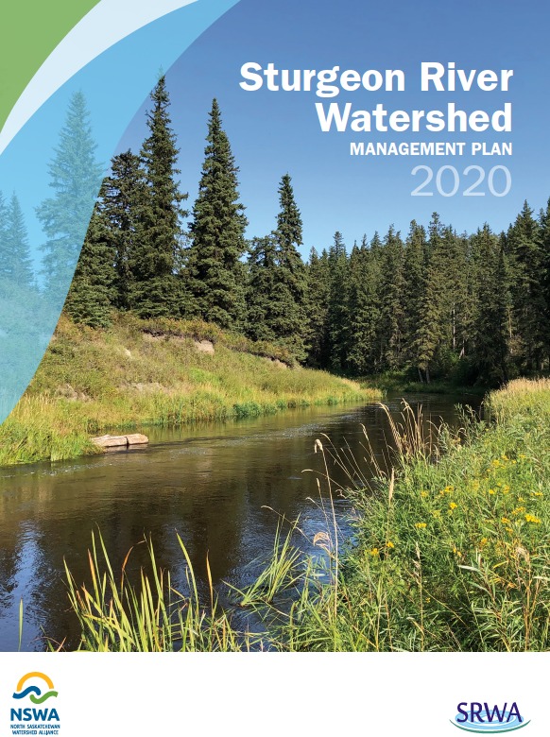
Watershed Management Plan
Watershed approach
Clear goals and performance measures
Voluntary alignment of policies and plans
Coordinates intermunicipal collaboration
Promotes local and regional stewardship
Encourages work to address knowledge gaps
Notes:
Third Recommendation from the State of the Watershed report was to develop a WMP, and this has recently been completed.
Note: A WMP is advisory only; the SR WMP has been accepted as information by a motion of each council member.

Slide 10
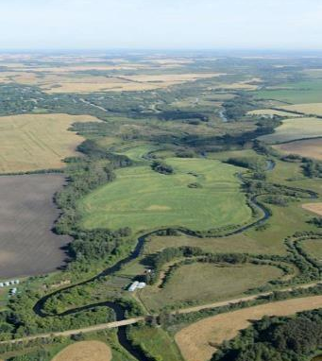
Six Outcomes
Aligned Policies and Plans
Safe, Secure Drinking Water Supplies
Healthy Aquatic Ecosystems
Reliable Water Supplies
Wise Land Use
Local and Regional Initiatives
Notes:
The WMP identifies:
6 Outcomes
12 Goals
29 Strategies
These are then translated into a 10-year Workplan:
34 Short term Actions (2020 – 2022) –
(30 Long term Actions (as time and resources permit))
Recently received an Alberta Community Partnership grant of $200,000 (2020 – 2023) which will be used to address priority short term actions

Slide 11
Aligned Policies and Plans
1. Well informed decision-making leads to aligned policies and plans, which in turn ensures a healthy watershed.
Goals:
  Policies, plans and management actions are aligned
  Decision making is based on best available knowledge
Key Actions:
  Riparian & Wetland Strategy including policies and tools
  Build on existing water quality monitoring programs
Notes:
1 outcome
2 goals
12 strategies
8 ST
4 LT

Slide 12
Aligned Policies and Plans
Actions:
  Submit WMP to Government of Alberta and Edmonton Metropolitan Region
  Identify policy and planning gaps
  Continue to engage with province and municipalities
  Work with indigenous communities to share knowledge
  Provide guidance on best management practices
  Riparian Strategy including policies and tools
  Build on existing water quality monitoring programs
Notes:
8 short term actions
Draft WMP reviewed by AEP technical staff
Planning Alignment Study completed recently
Sharing BMPs between municipalities such as mapping and GIS tools and planning technical reviews
Town of Gibbons gave the draft WMP to their consultant developing a recreation plan to ensure watershed values incorporated into this area of the lower Sturgeon River…
4 long term actions
Continue work with AUMA, Alberta Water Council and RMA
Encourage municipalities to use SRWMP to inform municipal policy and planning over time
Overlay maps
Identify research gaps and opportunities

Slide 13
Safe, Secure Drinking Water
2. All residents have access to safe, secure drinking water supplies, whether they are on public or private systems that draw from surface or groundwater.
Goals:
  Residents have access to safe, secure drinking water
  Groundwater is understood and managed sustainably
Key Actions:
  Encourage governments to identify issues and enhance programs
  Educate planning staff on potential GW risks
Notes:
1 Outcomes
2 Goals
4 Strategies
90% of rural Albertans rely on groundwater for drinking water supply. Sturgeon watershed has one of the highest densities of household groundwater wells in the province.
4 Short term Actions (2020 – 2022)
5 Long term Actions (as time and resources permit)

Slide 14
Safe, Secure Drinking Water
Actions:
  Encourage municipalities to collect information on private water systems and identify any current issues
  Encourage private water programs such as Working Well and drinking water testing
  Encourage Government of Alberta to maintain/enhance groundwater well monitoring programs
  Educate planning staff on potential groundwater risks
Notes:
4 short term actions
Likely already being captured through utilities
Alberta Health Services drinking water testing and Working Well program
Shared groundwater summary with all municipal planning staff
Groundwater Forum / Source Water Protection Forum
5 long term actions
Share educational materials to promote water conservation and source water protection
Encourage Government of Alberta to undertake groundwater studies
Undertake trend analysis of existing wells
Identify key recharge and discharge areas at risk
Provide input to NSRP on groundwater risks

Slide 15
Healthy Aquatic Ecosystems
3. Aquatic ecosystems, including our rivers, lakes, wetlands and other waterbodies, are healthy.
Goals:
  Water quality is improved
  Aquatic ecosystems are healthy
  Develop and implement wetland and riparian area strategies
  Lakes and their watersheds are recognized as highly valued, limited resources and managed such that they are healthy for current and future generations
Notes:
1 Outcomes
4 Goals
9 Strategies
12 Short term Actions (2020 – 2022)
12 Long term Actions (as time and resources permit)
Top concern from SC, TAC and residents

Slide 16
Healthy Aquatic Ecosystems
Key Actions:
  Develop wetland, riparian and flood plain goals and targets
  Conserve priority fish habitat for key species
Notes:
12 short term actions
Technical committee is currently compiling information about road salt and snow storage practices across all 12 municipalities
Lac Ste. Anne gave the CPP watercourse crossing report to their Transportation department to inform future bridge, culvert infrastructure work…
Tech Committee working on a Riparian strategy;
Sturgeon County (planner Rachel and eventually, will take a proposal to Ag Services Board) to stimulate riparian restoration in the agricultural lands of Little Egg Creek, an important tributary of the Sturgeon
Priority fish habitat areas in River Que Barre and in Gibbons area
12 long term actions
Reduce contamination loading from point sources by improving wastewater management
Promote agricultural best management practices to reduce nutrient, bacterial and pesticide loading
Promote urban stormwater best management practices to reduce sediment, nutrient, bacteria and pesticide loading
Support work of land programs to protect riparian areas
Support lake watershed stewardship groups and programs
Seek research partnerships to study cumulative effects on aquatic ecosystem health
Develop model land use bylaws and policies on priority issues
Use indicator information to report on the state of the watershed every five years
Complete a drained/existing wetland inventory
Conduct an ecosystem valuation of watershed/natural assets to inform government planning
Improve fish habitat where conditions are poor
Conduct invasive species surveys to prioritize areas for action

Slide 17
Reliable Water Supplies
4. Reliable, quality water supplies are available for a sustainable economy.
Goals:
  Water supply is managed effectively to support aquatic ecosystems, communities and the economy
Key Actions:
  Compare existing data to instream flow needs
  Explore models to determine current and future water needs
  Identify and promote beneficial management practices to promote water conservation
Notes:
1 outcome
1 goal

Slide 18
Reliable Water Supplies
Actions:
  Compare existing data to instream flow needs
  Explore models to determine current and future water needs
  Identify and promote beneficial management practices to promote water conservation
Notes:
3 short term actions
Mostly work to be done with Alberta Environment and linked to work underway.
AUMA/RMA have excellent water conservation bmps for municipalities
3 long term actions
Encourage licensees to report actual water use
Maintain existing flow gauges and establish new stations on tributaries to improve water balance calculations
Ensure economic value of water as well as trade-offs are understood and inform local and regional decision making

Slide 19
Wise Land Use
5. Wise land use ensures the cumulative effects of growth and development are mitigated for, the land is resilient to climate change, and individuals and communities are well prepared for flood and drought events.
Goals:
  The cumulative effects of land use are understood and considered in decision making
  The effects of climate change are understood and mitigated
Notes:
1 outcome
2 goals
1 short term action
3 long term actions

Slide 20
Wise Land Use
Key Actions:
  Promote LEED standards and low impact development
  Support programs such as ALUS Canada, Green Acreage program and Environmental Farm Plans
Notes:
2 short term actions
3 long term actions
Compile existing or create new maps showing environmentally significant areas
Identify and prioritize areas where there is more value for low impact development
Conduct a study to assess a possible Sturgeon River protection corridor

Slide 21
Local and Regional Initiatives
6. Residents and stakeholders support the Sturgeon Watershed Management Plan and are willing to participate in local and regional initiatives to improve watershed health.
Goals:
  Residents are engaged through education, outreach and stewardship opportunities
  The SRWA is representative, well-attended and effective at using a collaborative approach to implement the SRWMP.
Notes:
1 outcome
2 goals

Slide 22
Local and Regional Initiatives
Key Actions:
  Provide support to local NGOs and stewardship actions
  Provide support to Steering and Technical committees
  Develop a workplan and budget and apply for grants
Notes:
5 short term actions
4 long term actions
Align key messages and develop materials on key issues
Provide opportunities for improving understanding of indigenous values and traditional knowledge
Encourage Indigenous communities, agriculture and industry to participate on committees
Prepare an annual report on the SRWMP implementation

Slide 23
Watershed Management Plan Implementation
Watershed Management Plan outlines outcomes to be addressed over 10 year timeframe
Work will be prioritized by Steering and Technical Committees based on importance and timeliness of actions and resource availability.
Alberta Community Partnership grant of $200,000 (2020 – 2023) will address priority short term actions

Slide 24
Priorities and Next Steps
2021 - 2023
  Riparian and Wetland Conservation and Restoration Strategies
  Water Quality/Aquatic Ecosystem Monitoring Program
  Watershed Planning Alignment and Tools (flood risk areas, riparian setbacks, environmentally sensitive areas, overlay maps)
  Communications and Engagement (Educational forums, workshops, information resources)
Notes:
4 major projects (paraphrase slide)

Slide 25
Current Work

Slide 26
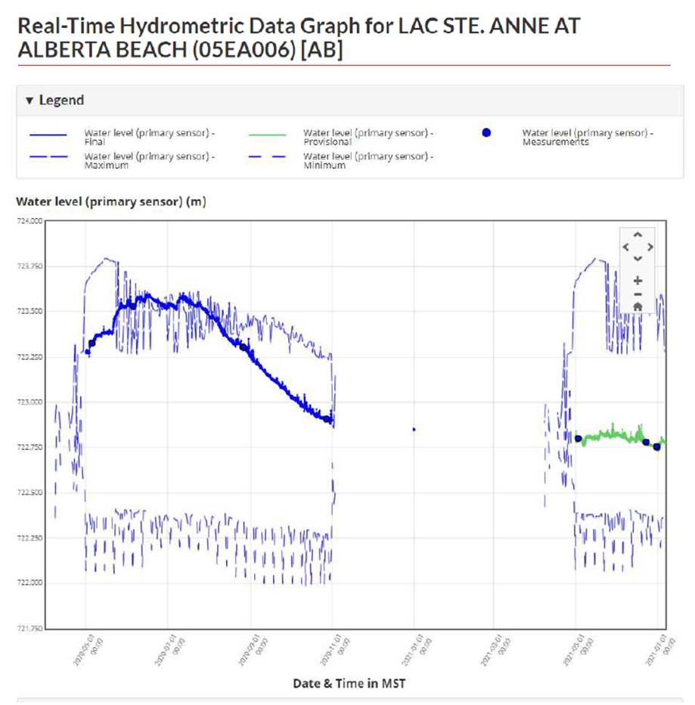
Water Quantity
  2021 Water Levels
    Significant variability between 2020 and 2021
    2020: good snow cover and wet summer had waters levels higher than normal
    2021: Lack of snow and dry spring have water levels lower than normal
Ilse Lake and Lac Ste. Anne
0.75 metre lower than last spring
Still not at minimum levels recorded
Wide variability perceptions
Notes:
Two year program 2021 and 2022

Slide 27
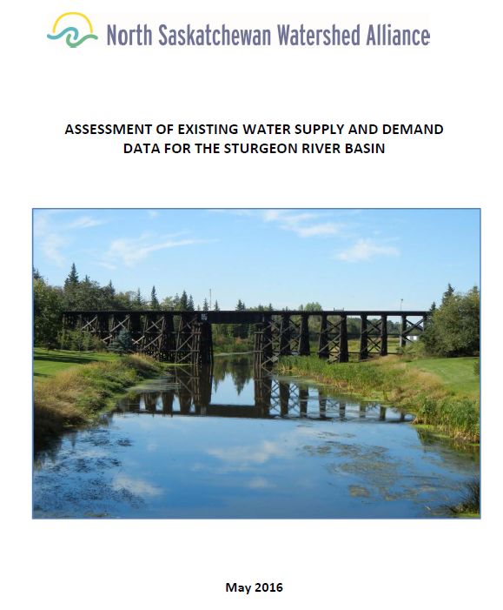
Water Quantity
Desktop Instream Flow Needs:
Not met in up to 35% of years,
  Most significant in weeks 25-30 (June-July)
Goal 4.1 Water Supply is managed efficiently to support aquatic ecosystems, communities and the economy
Action Plan:
Establish mainstem water quantity working group (AEP, SRWA, Technical support)
Notes:
One way is to do a preliminary review of instream flow needs
Although there is limited flow data, it does appear that the main stem of the Sturgeon River is highly allocated in the summer months of July and August when both the need for IFN for aquatic health and human demands are important
Additional data will need to be assessed to determine if we are at a critical point.
Only for 1972 – 1991 and water allocations have increased since 1991
RAMP also recommending intensifying agricultural activities
Identified in WMP as needing more review

Slide 28
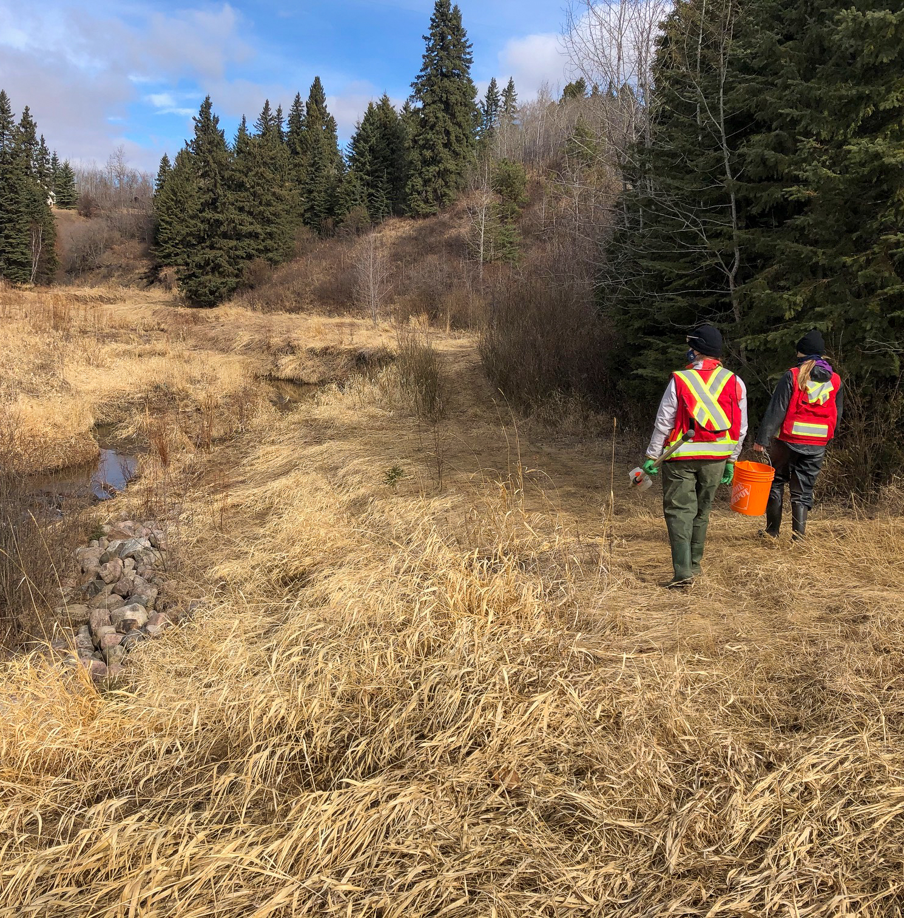
Water Quality Monitoring
  Sturgeon River WQ Monitoring
    Tetra Tech Consulting
    12 sites (8 Sturgeon and 4 Tributaries)
    3 sampling events/year
    High flow (spring), summer storm and low flow (late summer/fall)
    Nutrients, salts, sediment, oxygen
Notes:
Two year program 2021 and 2022

Slide 29
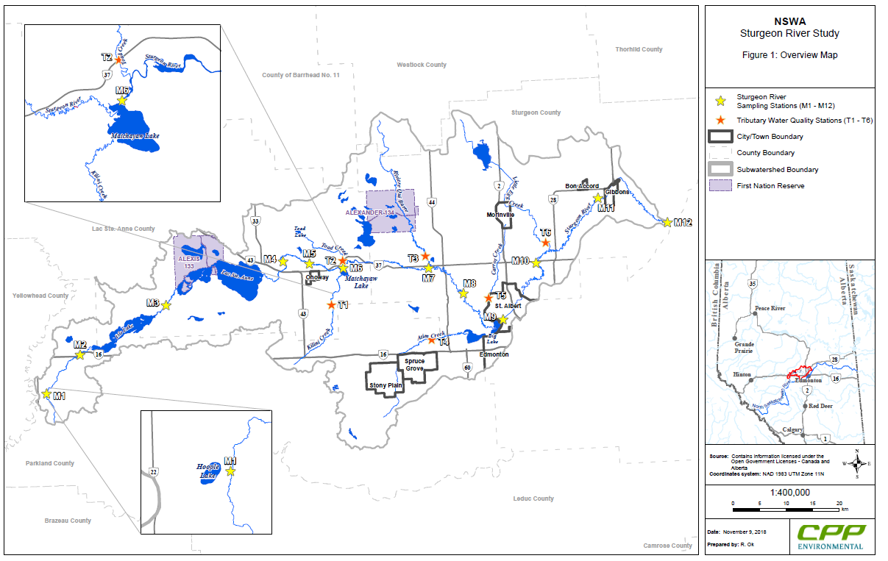
Notes:
M2 – upstream of Ilse
M3 – between Ilse and Lac Ste Anne
M4 – after Lac Ste Anne
M7 – before RQB
M8 – after RQB
M10 – after SA
M11- before Gibbons/WaterSHED station
M12 – confluence of NSR
T1-Kilini
T3 – RQB
T4 – Atim
T5 – Little Egg/Manawan

Slide 30
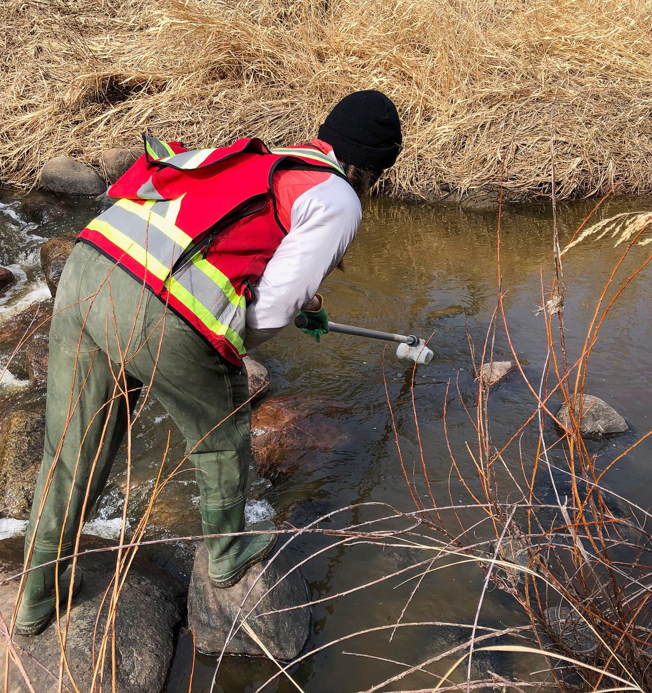
Water Quality Monitoring
  First Sample Event
    Spring sampling April 8th
    Preliminary findings:
        TSS and Turbidity exceedances
        Some high nutrient and salts values but no exceedances
        Good dissolved oxygen values
Notes:
One site sampled April 21st after melt

Slide 31
Developing a Riparian Strategy

Slide 32
Why are riparian areas important?
Ecosystem services provided by riparian habitats:
  Recharge aquifers
  Filter water and increase water quality
  Trap and retain sediment
  Build and maintain streambanks
  Store flood water and reduce flood water energy
  Reduce and dissipate stream energy
  Maintain biodiversity
  Create primary productivity

Slide 33
Developing a Riparian Strategy
Increase public awareness via education and outreach
Provide greater support to private land stewardship initiatives
Facilitate policy alignment & integrated water and land use planning
Where needed, advocate for restoration efforts on crown lands
Promote research and knowledge building

Slide 34
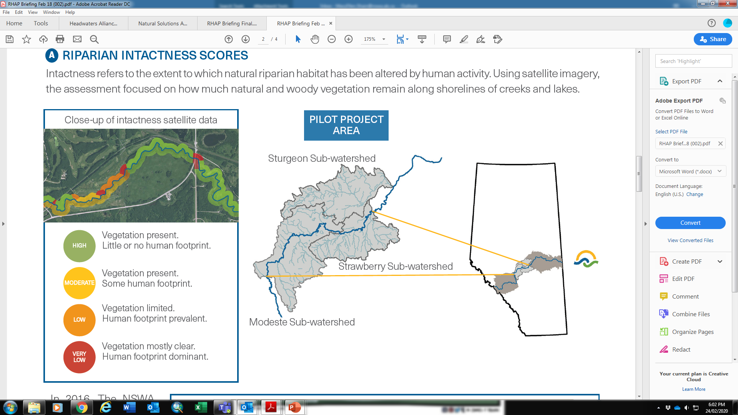
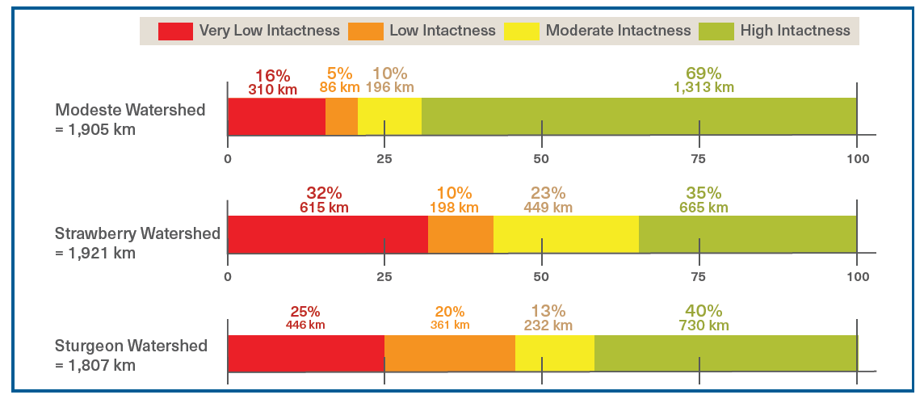
Intactness Pilot Project

Slide 35
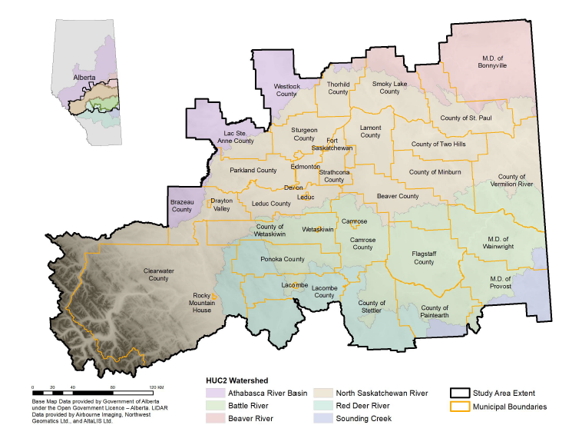

Slide 36
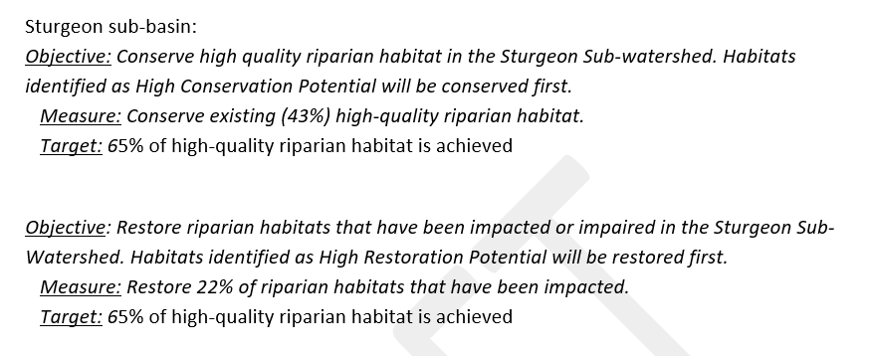
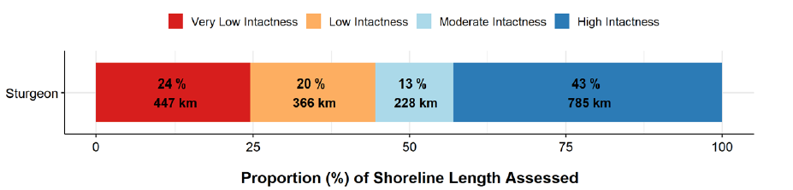
Sub-watershed Targets

Slide 37
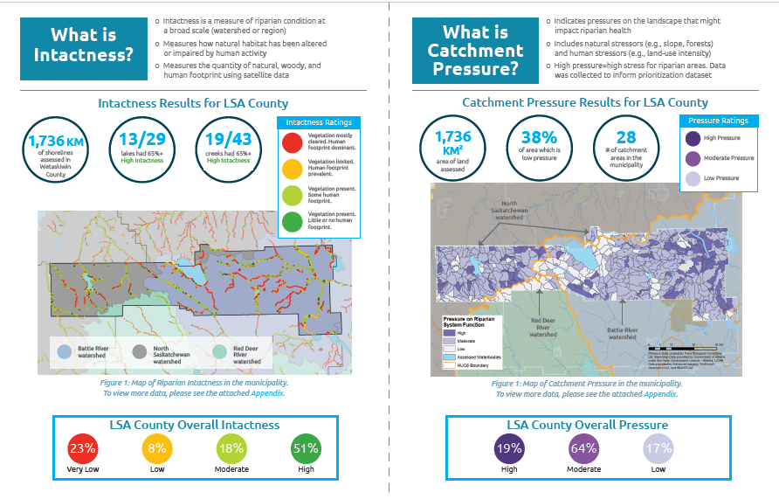
Municipal Report Cards

Slide 38
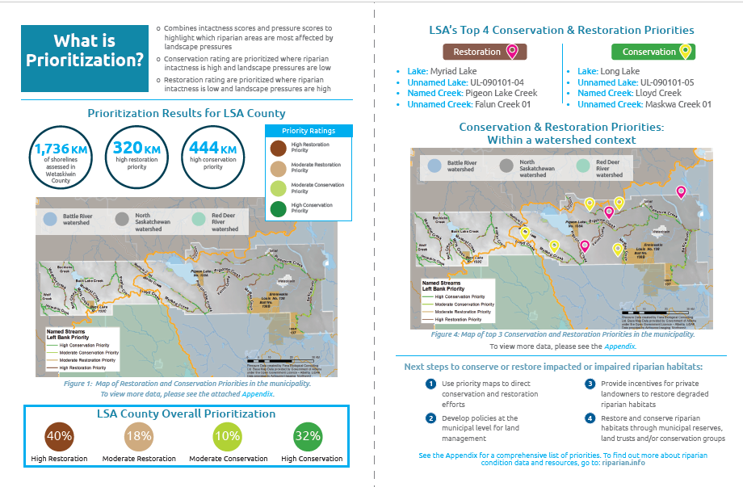
Municipal Report Cards

Slide 39
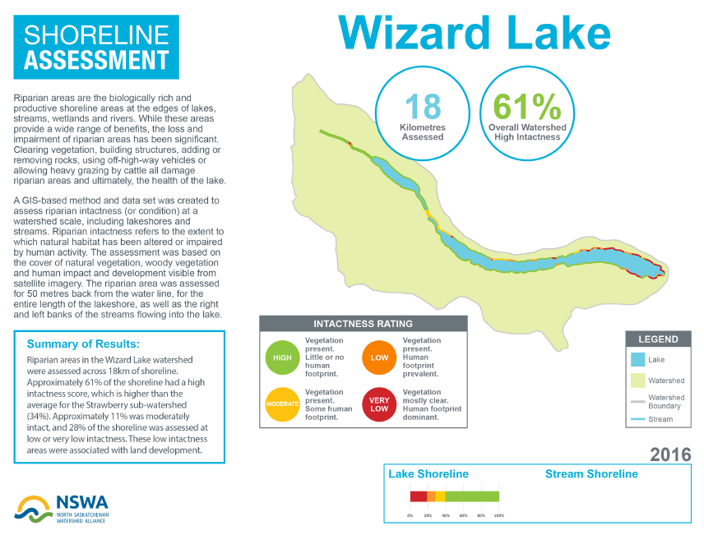
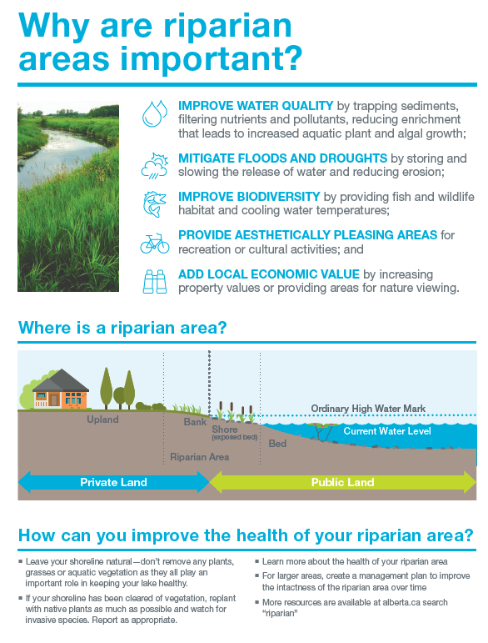
Waterbody Report Card

Slide 40
Strategy 2. Provide greater support to private land stewardship initiatives
Action 2.1. Encourage more recreational lake property owners to restore their shorelines by promoting and getting more capacity to lake groups and lake programs (e.g. Living by Water, WWMC, LILSA) to in turn…
Action 2.2. Get more agricultural private land owners doing on-the-ground restoration projects by collaborating with existing initiatives to build capacity to expand into areas where projects are currently absent.
Action 2.3. Highlight areas needing work and work that has been done

Slide 41
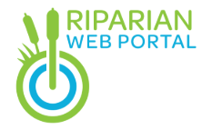
Web-portal
Three key purposes:
Riparian data access x2
Resources
Projects on the ground

Slide 42
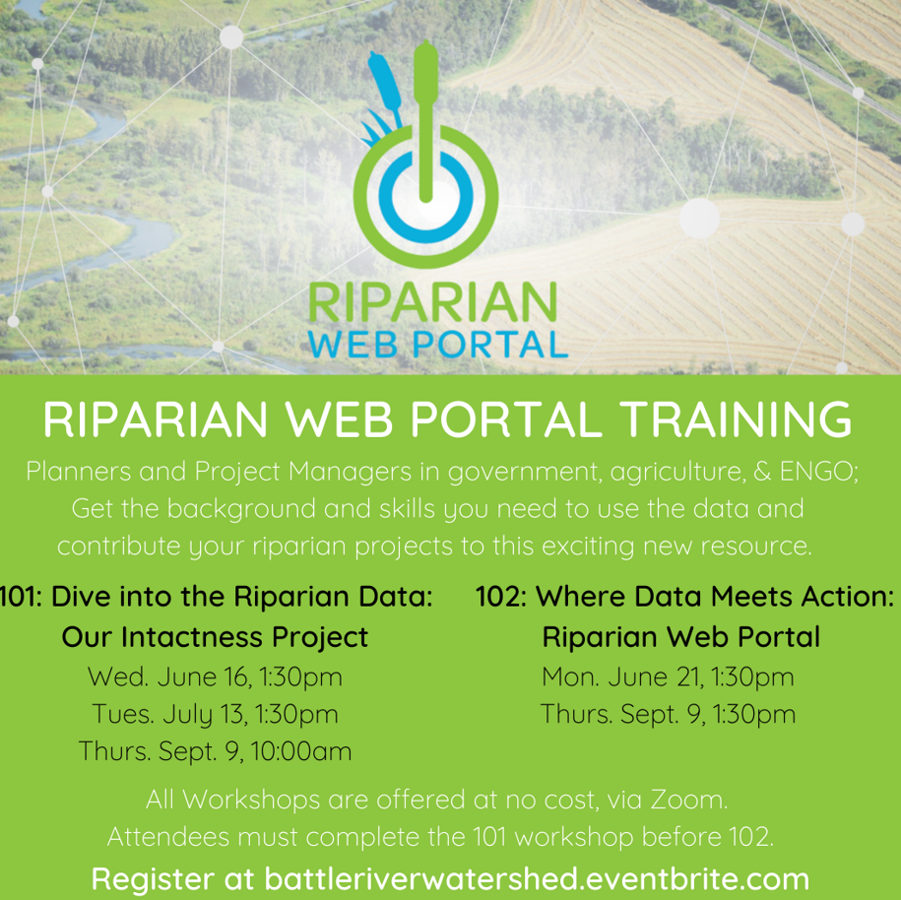

Slide 43
Thank You!

Slide 45
Why “municipally-led”?
Under the revised (2019) Municipal Government Act, the purpose of a municipality includes “to foster the well-being of the environment”.
Additionally, as per Section 60(1): “subject to any other enactment, a municipality has the direction, control and management of the bodies of water within the municipality, including the air space above and the ground below”.
Municipalities are land use managers, using legislated planning processes to make decisions daily that impact watersheds.
Boots on the ground who know their backyards well.
Notes:
See slide

Slide 46
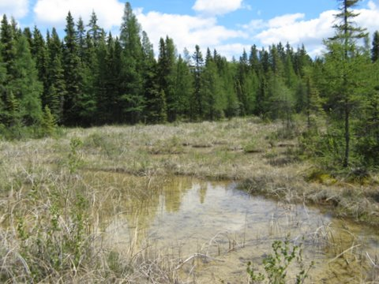
Information Gaps
SRWA partnership secured over $500,000 in grants
NSWA coordinated grants and consultants for 8 technical studies and 3 technical bulletins
Municipal staff vetted reports and their implications
All reports available on www.nswa.ab.ca
Notes:
2nd recommendation: fill data gaps. With NSWA assistance, the SRWA completed a number of technical reports between 2015 and 2019 and Leah is going to tell you more about those in a few minutes.

