Slide 1
LILSA
2021 Annual General Meeting
Help support LILSA, memberships can be purchased at the door for $20.
All membership sales between Jan 1 and the end of the AGM will be entered in a draw for 1 of 2 $25 gift cards for Salt and Pepper Restaurant in Darwell. You do not need to be present to win.

Slide 2
Agenda
1. Memberships
2. Approval of Agenda - Motion
3. Approval of AGM Minutes from Aug 15, 2020– Motion
4. President’s Report – Motion
5. Financials – Motion
6. Election, 2 Directors (4 year term)
7. Flowering Rush update
8. LILSA Survey
9. Questions
10. Adjournment (of business portion of meeting)
11. Membership Gift Card Draw
12.Presentation: Land Stewardship Centre – Milena McWatt
13. Presentation: Sturgeon River Watershed Alliance – Michelle Gordy
14. Questions/Discussion

Slide 3
LILSA AGM Minutes from AGM: Aug 2020 Virtual meeting: Aug 15, 2020 at 9:30 AM Participants: 22
Meeting Protocol reviewed
Memberships: please purchase a membership through our website: www.lilsa.ca
Approval of Agenda – Motion to accept: Scott Jendruk, unanimously accepted
Approval of 2019 AGM Minutes – Motion: Angela Duncan, unanimously accepted
President’s Report – presented by Bernie Poulin: posted on LILSA website. Motion to accept: Kelsey Norton, unanimously accepted
Financials – presented by Patti Fish: Motion to accept: Connie Stonehouse, unanimously accepted

Slide 4
2020 AGM Minutes Continued
7. By-Election (2 directors): Angela Duncan and Patti Fish stepping down from their director positions. 3 nominations for positions
Dustin Deslauriers: nominated by Scott Jendruk
Candis Scott: self nomination
Connie Rogan: nominated by Carla Laidlaw
Election results: Candis Scott and Dustin Deslauriers elected
8. Flowering Rush Update: Presented by Bernie Poulin – Motion to accept: Carla Laidlaw, unanimously accepted
9. 2020/2021 Priorities voted on: Cyanobacteria, Lake Levels and Flowering Rush– Motion to accept: Connie Rogan
10. Questions/Discussion
11. Adjournment (of business portion of meeting): motion to Adjourn: Angela Duncan at 10:25 AM
12. Sturgeon River Watershed Management Plan – presented by Petra Rowell (SRWA)

Slide 5
President’s Report
President: Bernie Poulin

Slide 6
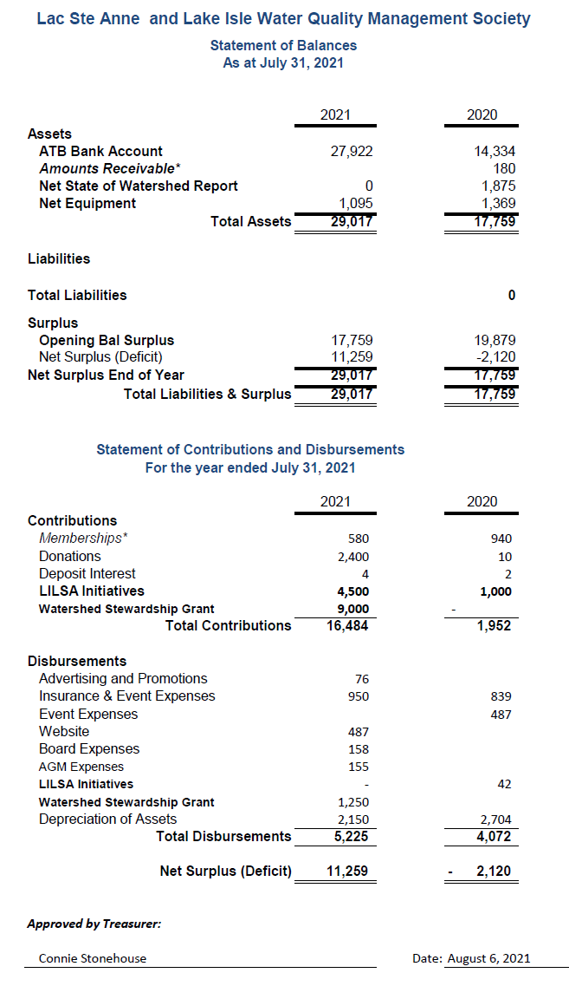
Financials
Surplus is due to outstanding Watershed Stewardship grant and lack of activity due to Covid 19.

Slide 7
Election – 2 Board Director Position (4 year term)
Call for nominations – 3 times
You may nominate yourself or someone else (they must accept your nomination)
No experience is necessary, just a desire to help maintain and improve the quality of our lakes
Candidate comments – if applicable
Vote
Vote is by secret ballot
You may write up to 2 names from the nominated candidates on your ballot
The nominees are:
1. Bernie Poulin- nominated by Roger
2. Uwe Brandt – self nomination
3.
4.
5.
6.

Slide 8
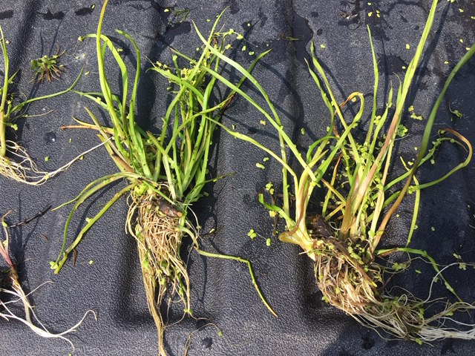
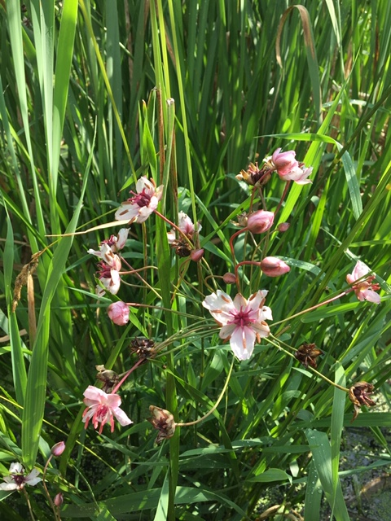
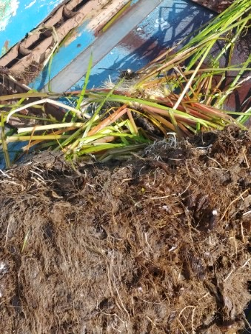
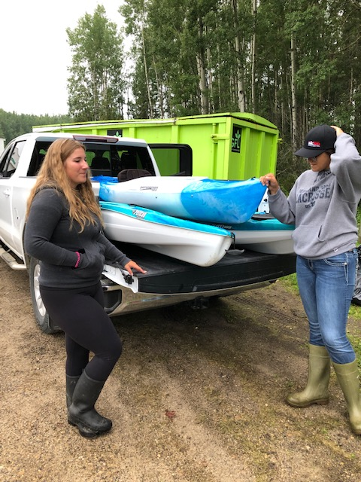
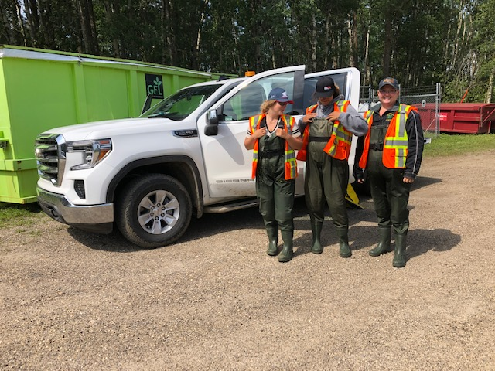
Flowering Rush Update

Slide 9
Survey

Slide 10
Questions???
Coming up next…
Presentation: Land Stewardship Centre – Milena McWatt
Presentation: Sturgeon River Watershed Alliance – Michelle Gordy
Questions/Discussion

Slide 11
Land Stewardship Centre Milena McWatt

Slide 12
Sturgeon River Watershed Alliance Michelle Gordy

Slide 13
Questions/Discussion Thank you for coming!

