Slide 2
Land Stewardship Centre
Established in 1996
Not-for-profit, charitable organization
Governed by a volunteer Board of Directors
Supported by program advisory committees
Operated by core staff
Notes:
Celebrating our 25th anniversary this year
Registered charity with a volunteer Board
Additional guidance from program advisory committees
We have a small group of core staff members working on several initiatives

Slide 3
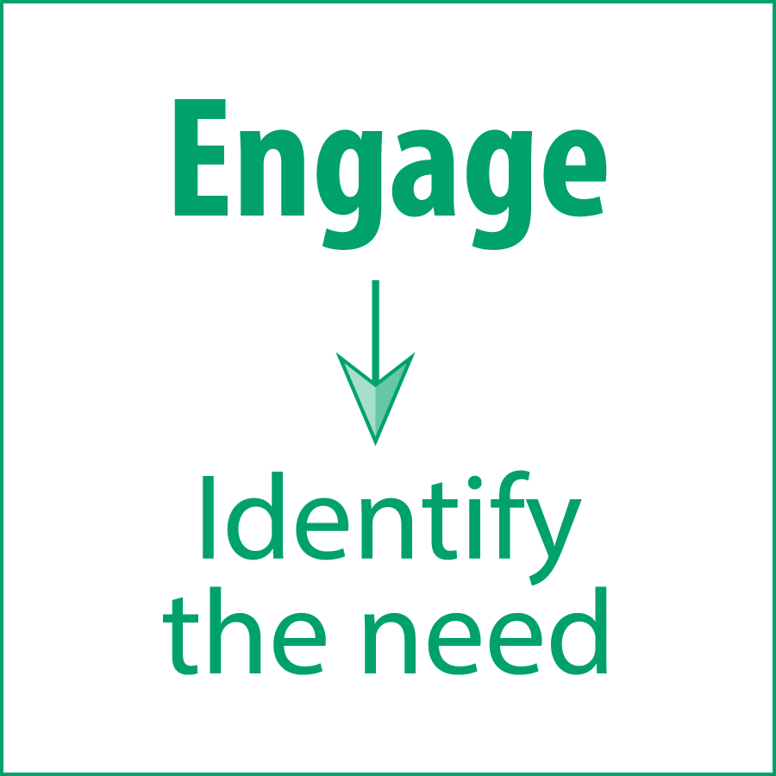
Our Approach
Notes:
Engage:
Individuals, community groups, partners
Inform:
Partners and relationships
Enable:
Programs, resources, tools

Slide 4
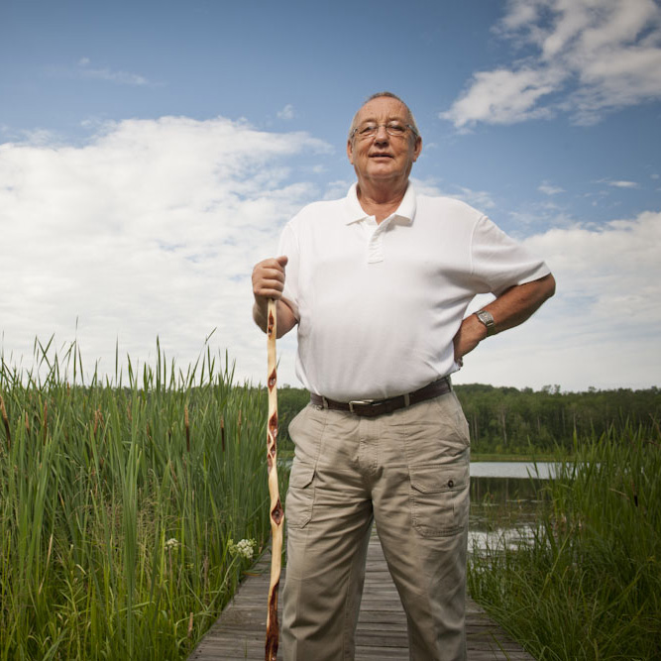
We Help People
Understand the value of ecosystem services
Recognize important stewardship priorities
Apply key stewardship principles in land and resource use decisions
Learn from those who provide good stewardship examples
Notes:
LSC’s efforts help people:
Understand the value of ecosystem services
Recognize important stewardship priorities
Apply key stewardship principles in land and resource use decisions
Learn from those who provide good stewardship examples
…and directly complement CPAWS and others’ efforts to support local stewardship and advance nature based solutions to mitigate the impacts of climate change.

Slide 5
We Develop Solutions
Facilitate partnerships and networks
Provide services, tools and develop resources
Deliver core programs
Support provincial and national initiatives
Collaborate on the development of stewardship practices, programs and policies
Work directly with individuals and organizations responsible for managing land and associated natural resources
Notes:
Core programs include:
Green Acreages Program
Green Communities Guide
Watershed Stewardship Grant Program
Conservation Land Registry
Conservation Easement Registry
Alberta Stewardship Network

Slide 7
Stewardship
Our collective responsibility to retain the quality and abundance of our land, air, water and biodiversity, and to manage this natural capital in a way that conserves all of its values, be they environmental, economic, social or cultural.
Notes:
After the first introductory slides, I will invite each participant to turn on their video and introduce themselves with: name, a brief description of their property, why they were interested in attending the workshop, and whether they have done any improvements to their properties already.
Stewardship: it’s in our name and it’s the foundation of the work we do at LSC.
LSC definition: Our collective responsibility to retain the quality and abundance of our land, air, water and biodiversity, and to manage this natural capital in a way that conserves all of its values, be they environmental, economic, social or cultural.
FIRST POLL: Do you consider yourself a steward for your acreage? (Yes/No/Don’t Know)

Slide 8
14%
The last Alberta census indicated that rural residential landowners represent 14% of Alberta’s population – a growing proportion of the rural population.
Notes:
The last Alberta census indicated that rural residential landowners represent 14% of Alberta’s population – a growing proportion of the rural population.

Slide 9
Cumulative Effects
Changes to the environment caused by the combined impact of our collective actions
Number of rural residential properties increasing
Increasing impacts on soil, water, air and wildlife
Desire to “do the right thing”
But few resources available
Notes:
As the number of rural residential landowners increases, they will have a greater impact on the state of Alberta’s soil, water, air and wildlife resources through the cumulative effects of their land management practices.
These landowners want to “do the right thing” for their property but there are very few targeted resources available for them to get the information they need.
SECOND POLL: How many acres is your property?

Slide 10
Green Acreages: Resources
For acreage, hobby farm and recreational property owners
Develop and implement stewardship practices
Conserve and protect the valuable natural assets, such as air, land, water and wildlife
Make properties more resilient to climate hazards through best management practices
Notes:
Developed especially for acreage, hobby farm and recreational property owners, to help them develop and implement stewardship practices that conserve and protect the valuable natural assets, such as air, land, water and wildlife associated with their properties.

Slide 11
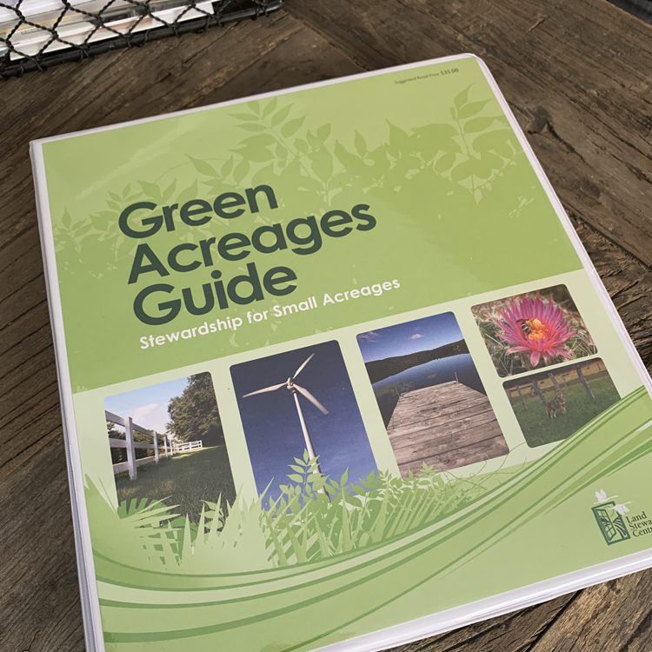
The Workbook
A comprehensive, self-directed stewardship planning tool and “living document.”
Notes:
A comprehensive, self-directed stewardship planning tool and “living document.”
Well-organized information on important topics of concern for new and existing acreage owners.

Slide 12
“Living in the country is something I have always wanted. I want to be an environmentally conscious landowner and the Green Acreages Guide helped me get a good start.”
- Steven Gehring, Acreage Owner, Rocky View County -
Notes:
Before we jump into the next segment, I first wanted to share this quote with you from an acreage owner who used the Green Acreages guide to prepare a stewardship plan for his property. Steven’s comments echo what we’ve heard from many people over the years – that they want to do the right thing with their acreages and these resources were just what they needed to get them on the right track.
We certainly hope this will be the same for all of you here this evening.
THIRD POLL: How many hours per week do you typically spend working on your acreage?

Slide 13
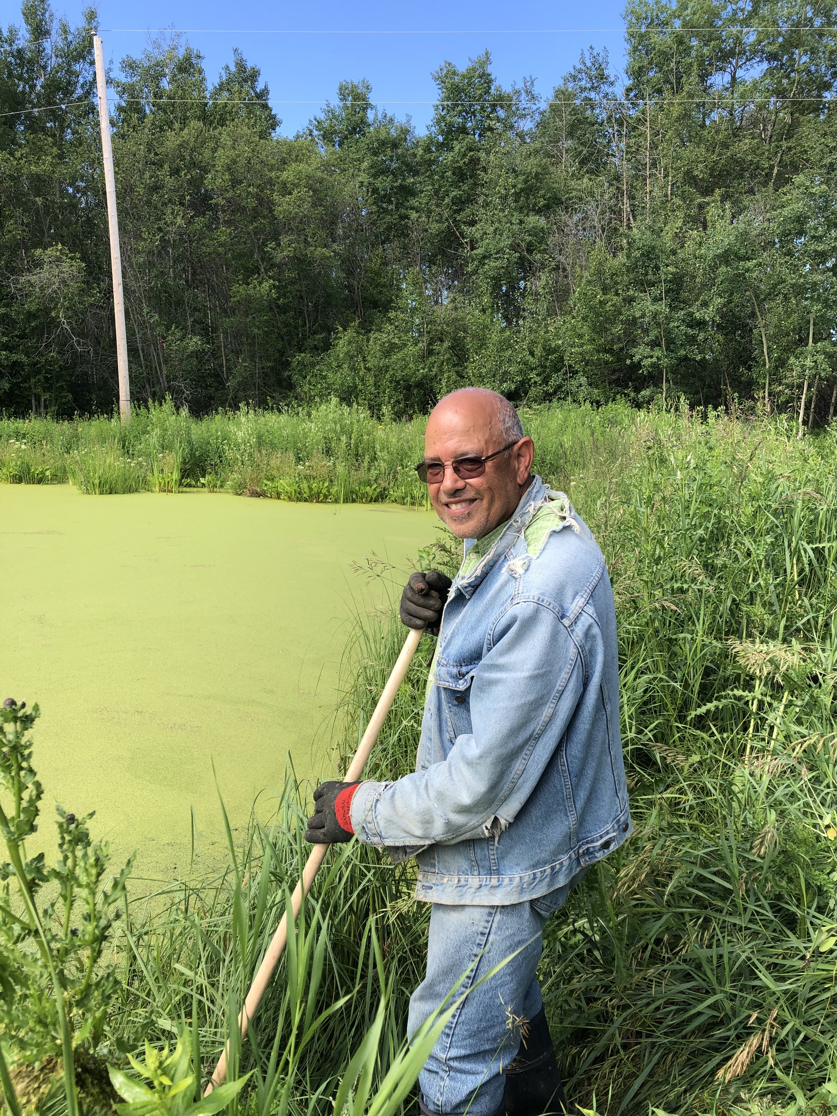
Green Acreages Project Funding
Alberta's Watershed Resiliency and Restoration Program
Support from rural municipalities
50-50 up to a maximum of $2500 per project
Lessen the impacts of flooding and drought (exacerbated by climate change)
Notes:
The “newest addition” to the Green Acreages resources = funding for eligible acreage stewardship projects!
Notion that yes, we are working 1-1 with property owners, but we also recognize the benefit of a cumulative effort and our support for community stewardship
Note how landowners can apply for the funding program (already have the workbook, which is step 1!)
Time frame is two years, so projects must be done either this fall or next year

Slide 14
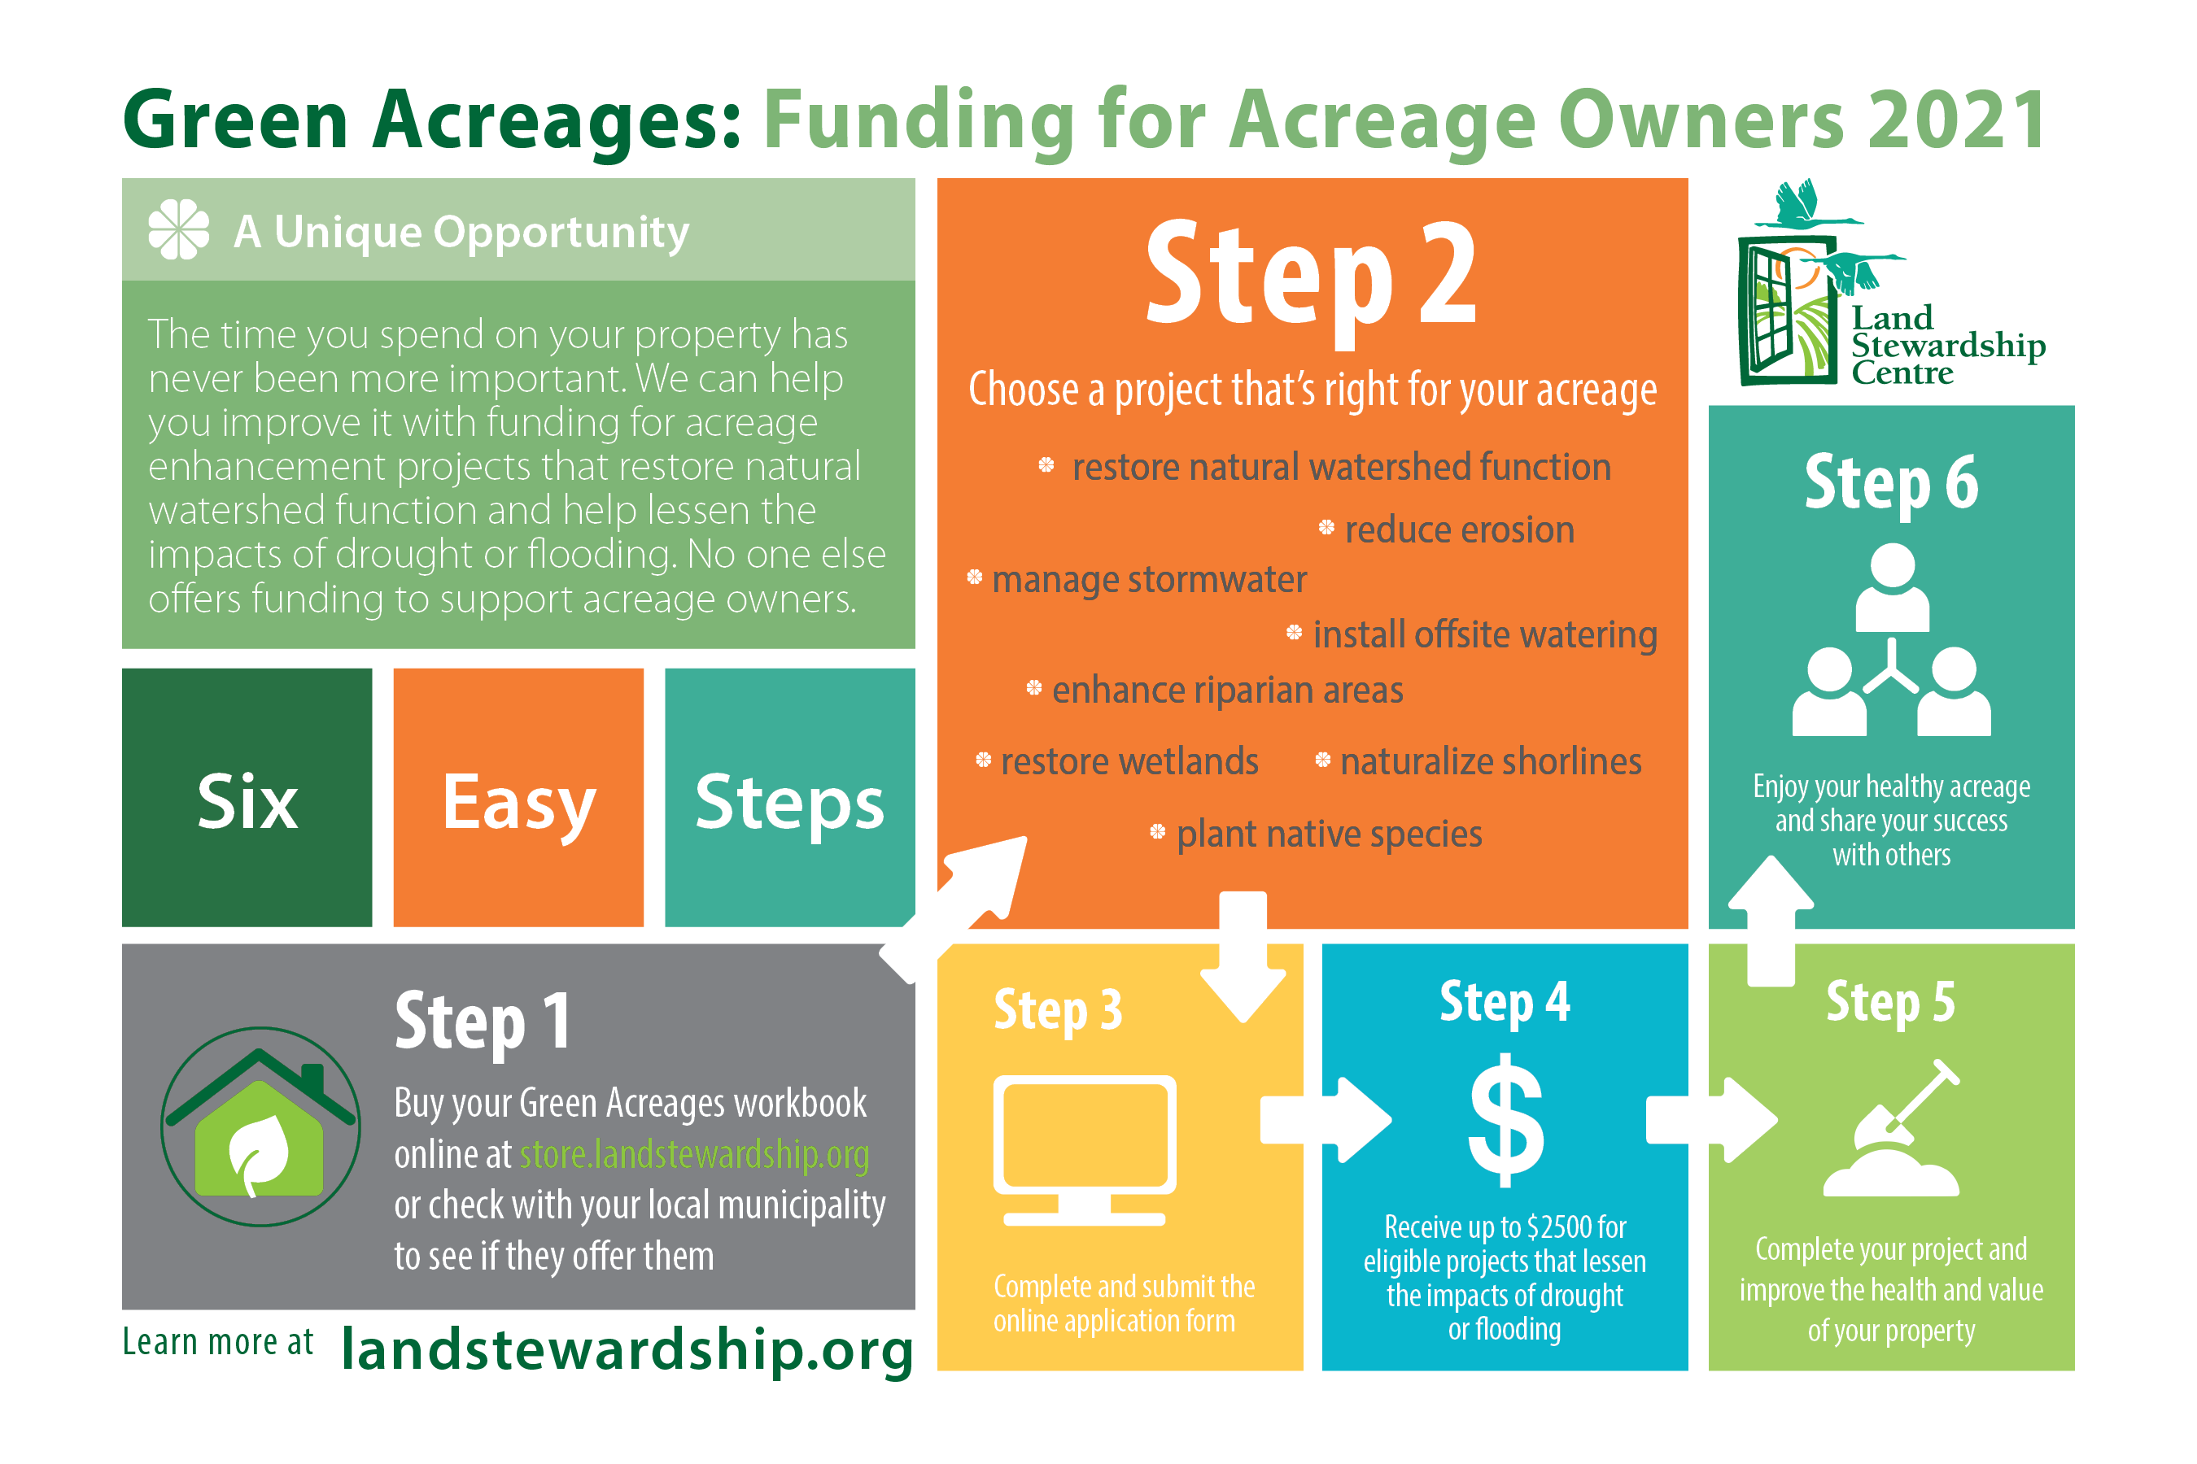

Slide 15
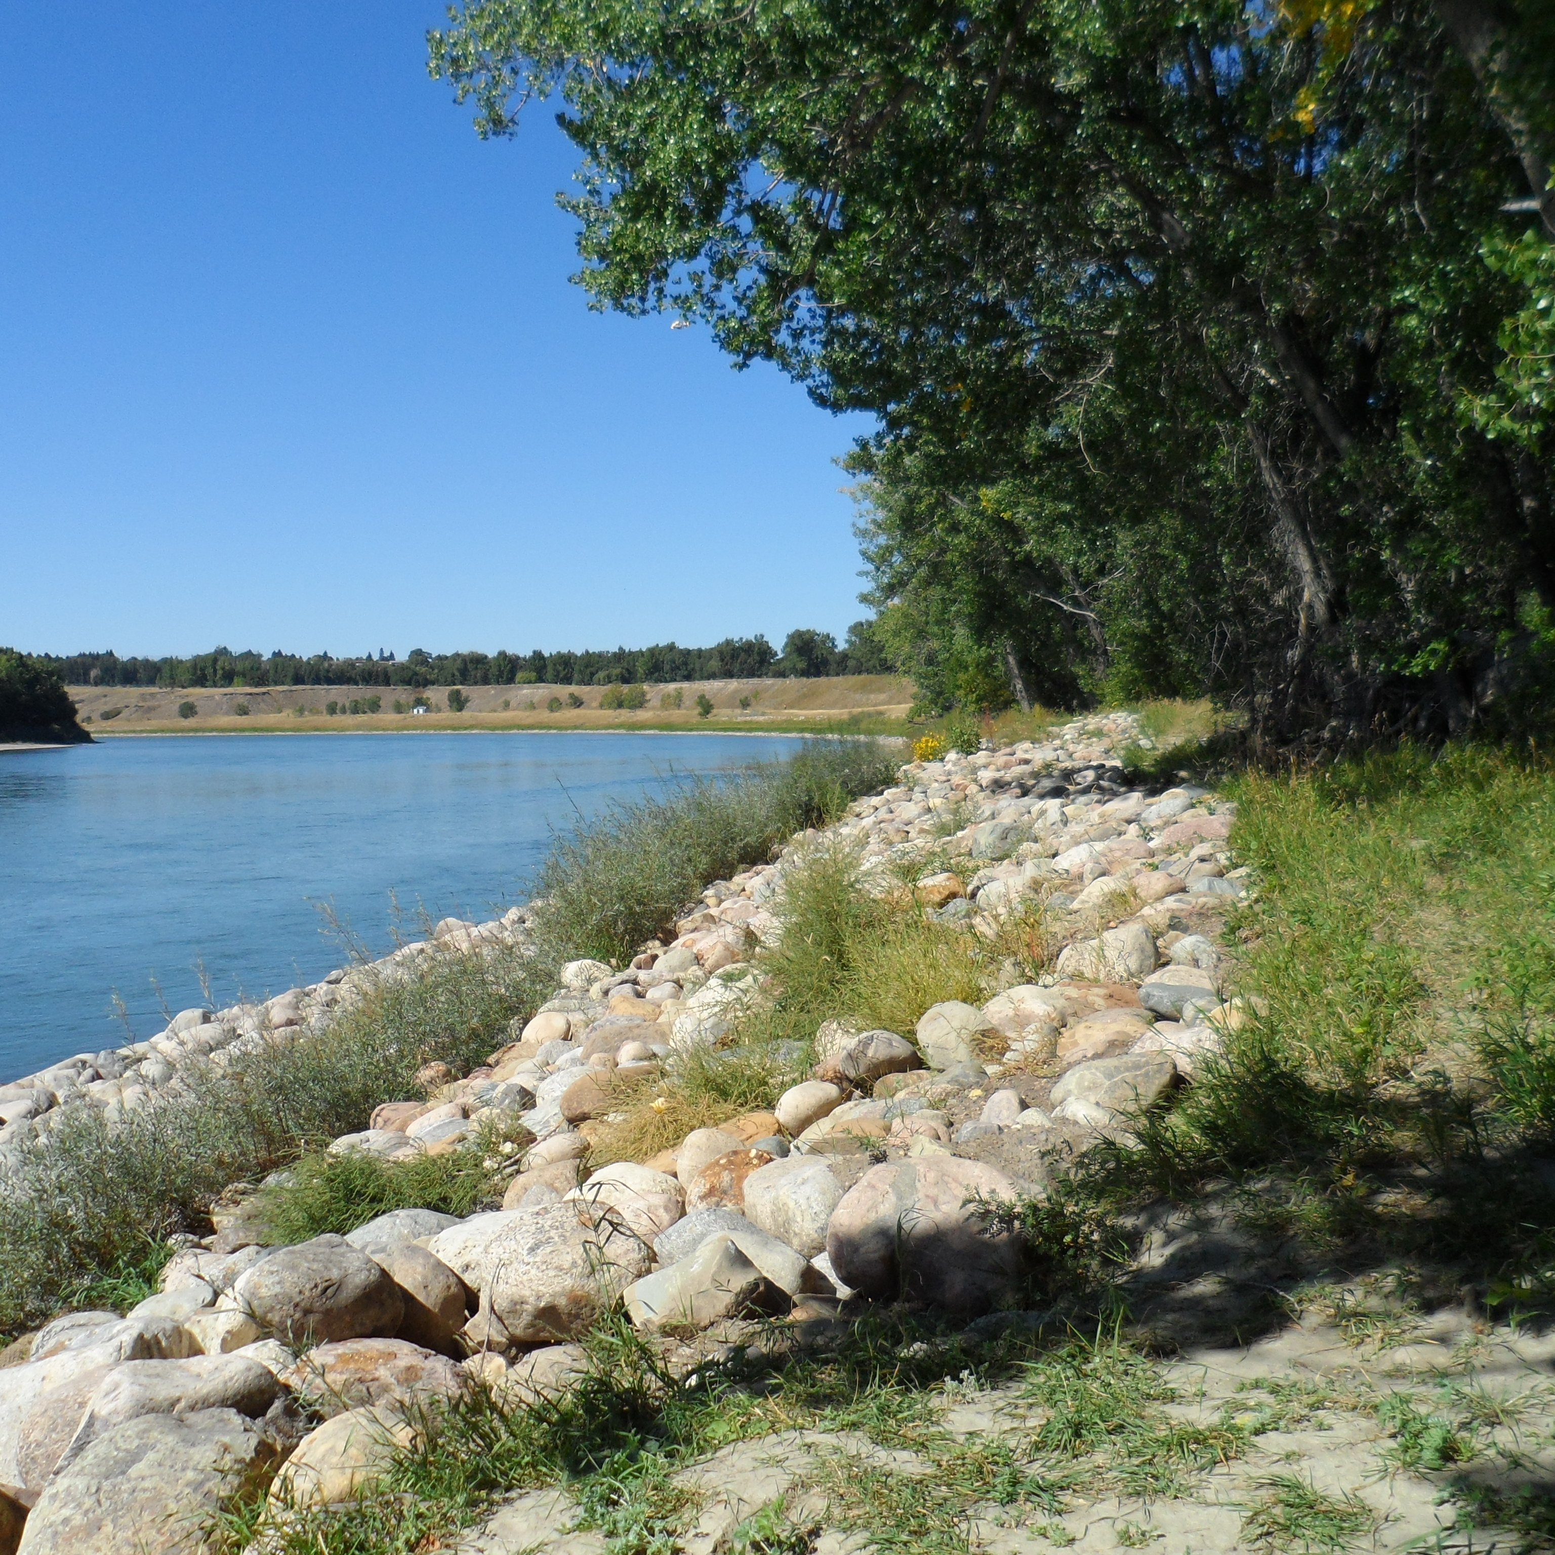
Eligible Projects
Projects which enhance natural watershed function
Wetland and riparian zone enhancements
Stormwater management
Shoreline remediation and/or re-naturalization
Erosion reduction measures
Exclusion fencing, off-site watering systems and stream crossings
Use of native species in planting initiatives
Notes:
Projects which enhance natural watershed function
Wetland enhancements, such as enhancing riparian and upland vegetation associated with wetlands
Stormwater management, such as erosion controls, planting vegetation, wetland enhancements or construction, hydrologic function enhancement for the watershed (may include planting, contouring, wetland construction), floodplain restoration, low-impact developments (such as rain gardens and bioswales)
Riparian zone enhancements through planting and buffers
Shoreline remediation and/or re-naturalization, such as planting native species, reinforcing shoreline through soil bioengineering and other natural methods
Erosion reduction measures (e.g., shoreline or riparian naturalization with native plants, establishing a buffer of native plants between landscaped areas and bodies of water, and re-establishment of shorelines through soil bioengineering and other natural methods
Exclusion fencing, off-site watering systems and stream crossings (e.g., to keep livestock out of water bodies and away from riparian areas
Use of native species in planting initiatives
ADD PHOTOS/EXAMPLE PICTURES IF I CAN FIND THEM HERE (waiting on examples/photos from Ken & Krista)

Slide 16
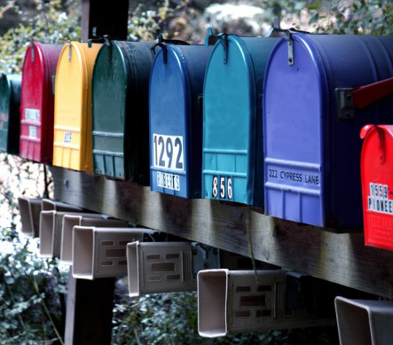
Connect
Land Stewardship Centre
17503-45 Avenue Edmonton, Alberta
Green Acreages Program
Milena McWatt
milena@landstewardship.org
Grassroots News e-newsletter
facebook | twitter | linkedin
landstewardship.org
Notes:
Just a reminder, after this workshop we don't just go away and leave you to your own devices. Just like your municipality, Land Stewardship Centre is here to help you on your stewardship journey.
Stay connected with us. Sign up for our e-newsletter – Grassroots News, connect with us on social media and check out our website.

