Slide 1
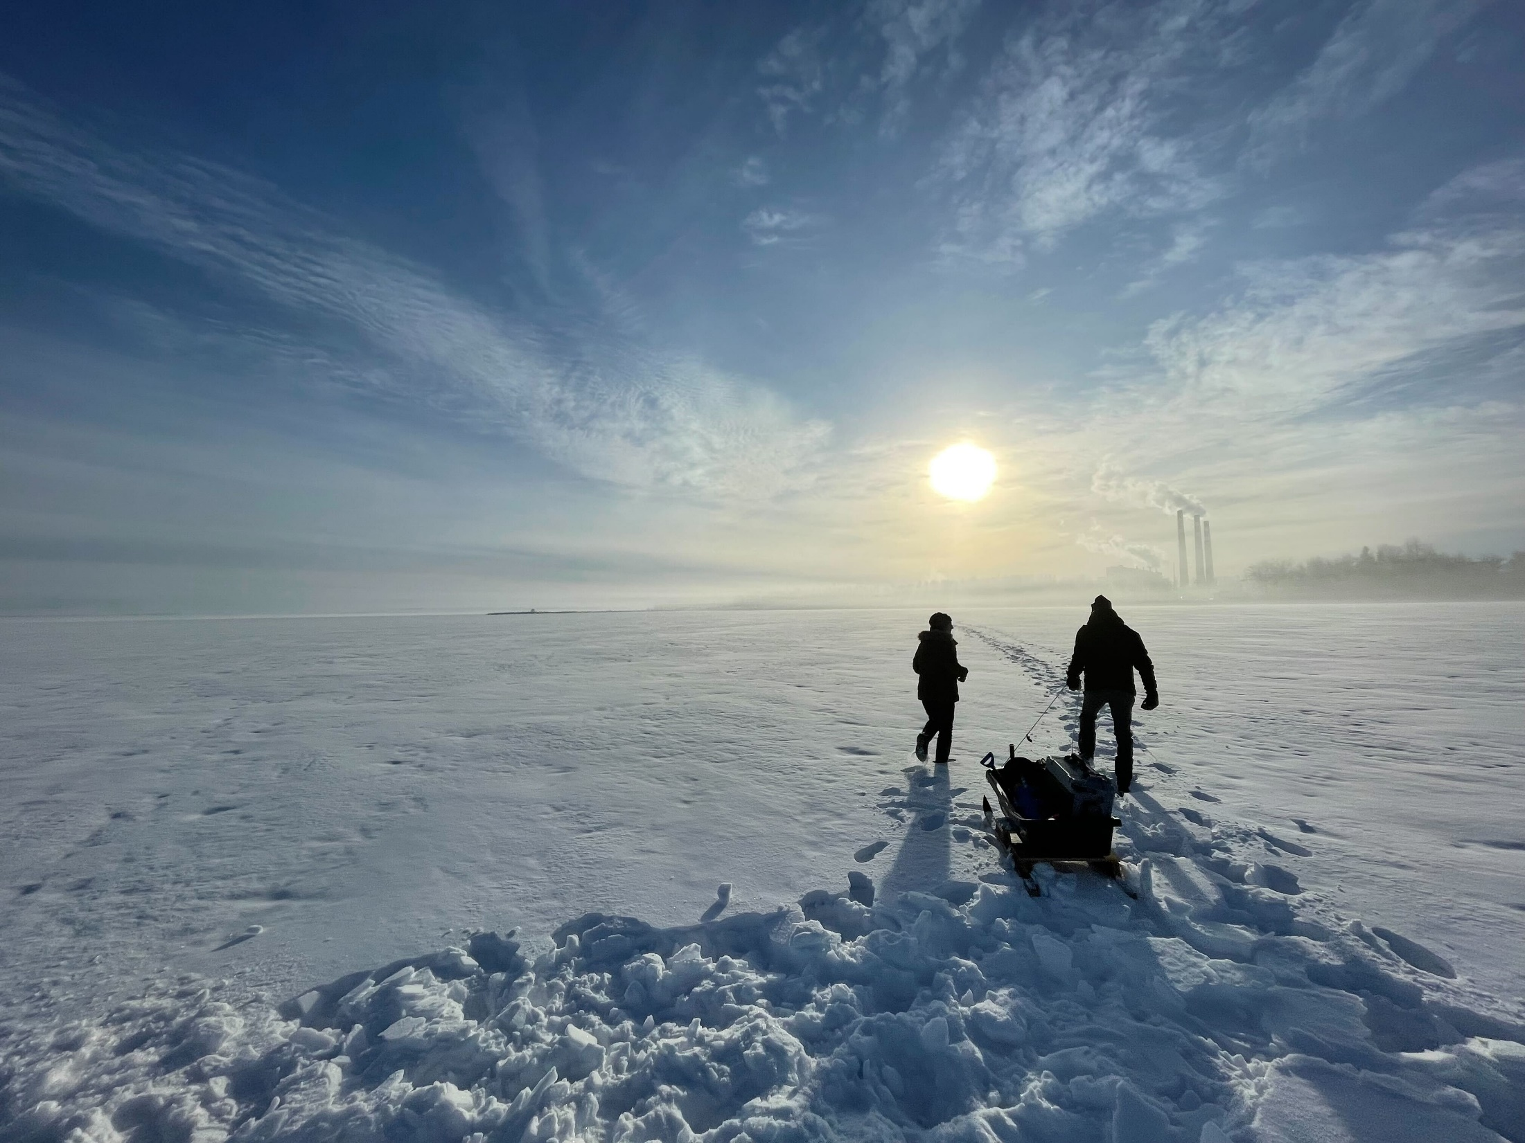
LILSA Annual General Meeting
August 20, 2022
Notes:
Always welcome a chance to chat about cit sci and we don’t have too many projects in the bow basin so this is a great opportunity.

Slide 2
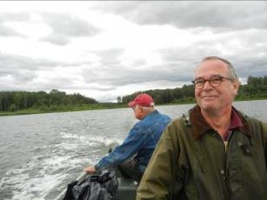
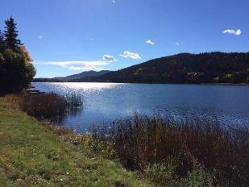
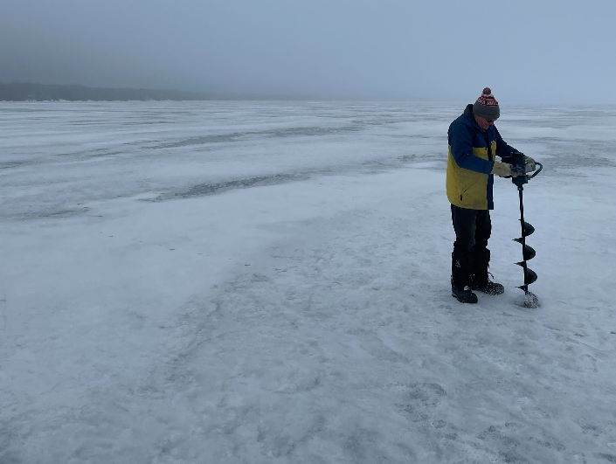
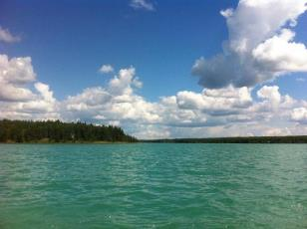
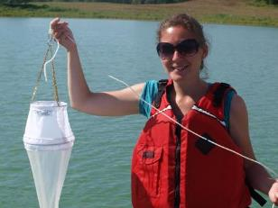
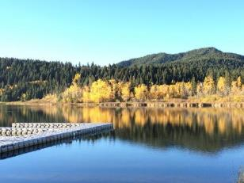
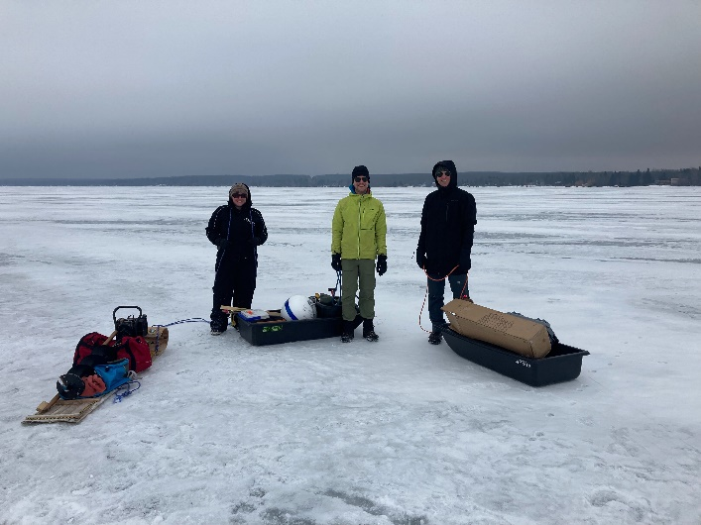
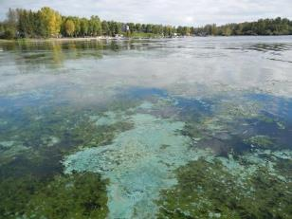
Notes:
Non-Profit
Charity
Current team: Bradley, Caleb, Kurstyn
Mission: Objective: undertake the collection of data and information to increase the knowledge of lake functions and management options

Slide 3
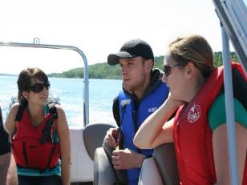
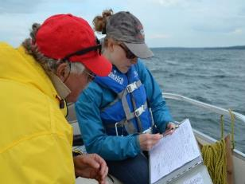
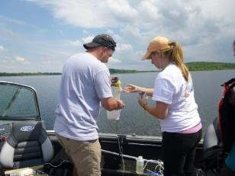
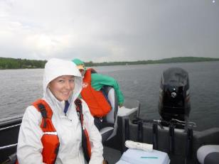
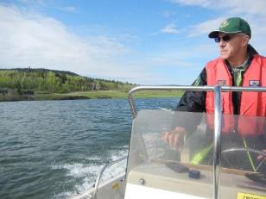
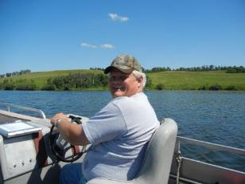
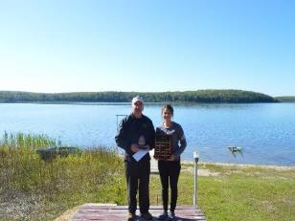
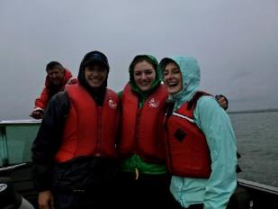
Notes:
LakeWatch program – flagship program. is dependent on volunteers. Participatory Monitoring Program.
Volunteers meet technicians 4 or 5 times throughout the summer.
Volunteers provide transportation!
10 point composite.

Slide 4
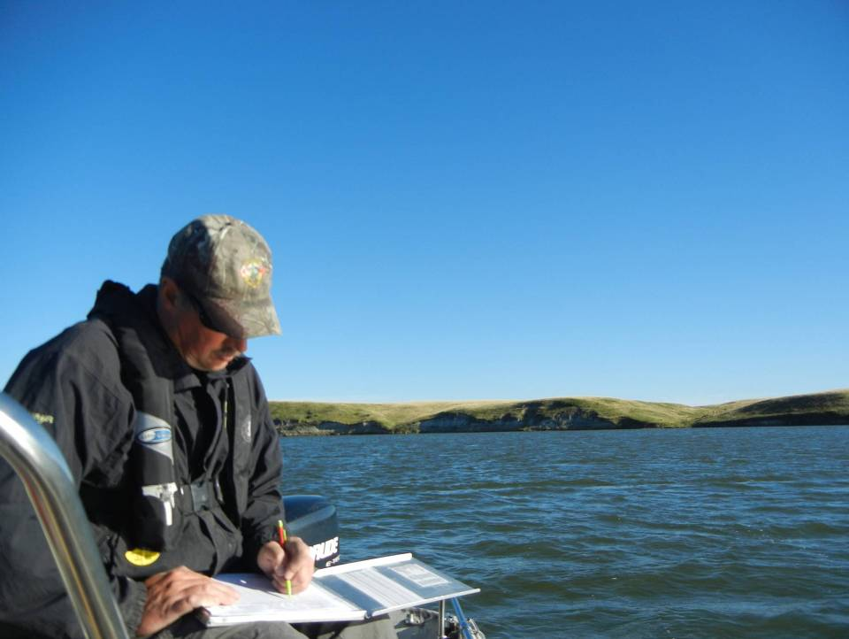
Nutrients
Chemistry
Physical Parameters
Biological Parameters
Invasive Species

Slide 5
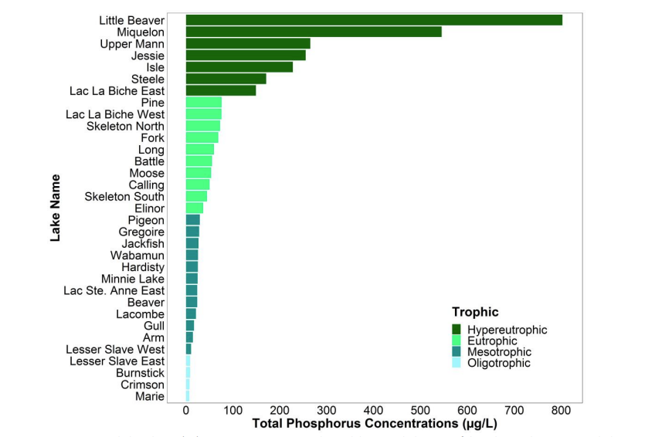
2021 Phosphorus at Lakes Across Alberta

Slide 6
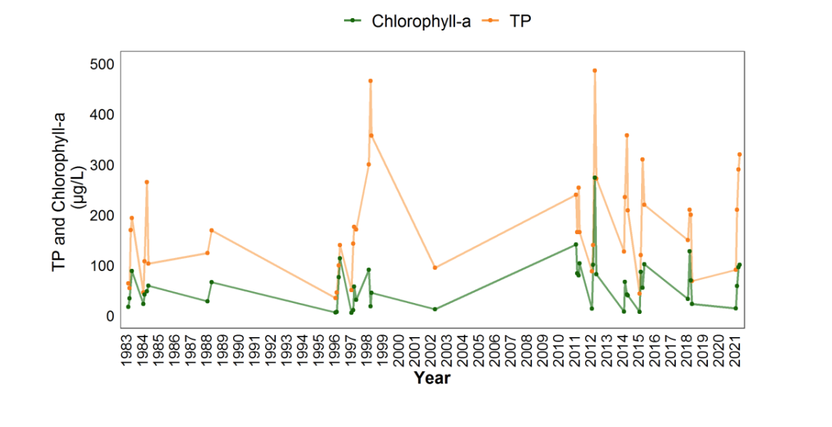
Long Term Trend Analysis at Isle Lake
ALMS Reports: www.alms.ca/reports

Slide 7
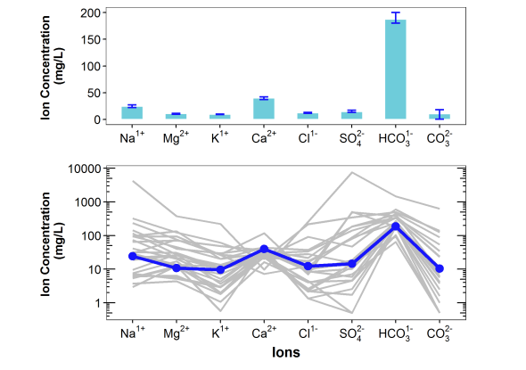
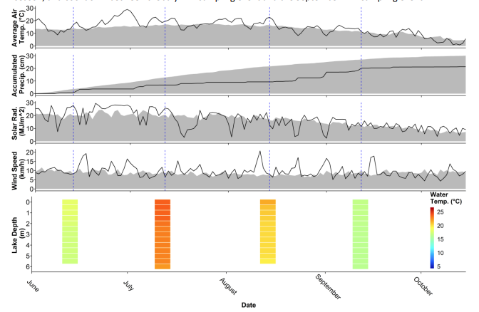
Understanding Ion Chemistry
Understanding Annual Weather

Slide 8
Beach Water Sampling

Slide 9
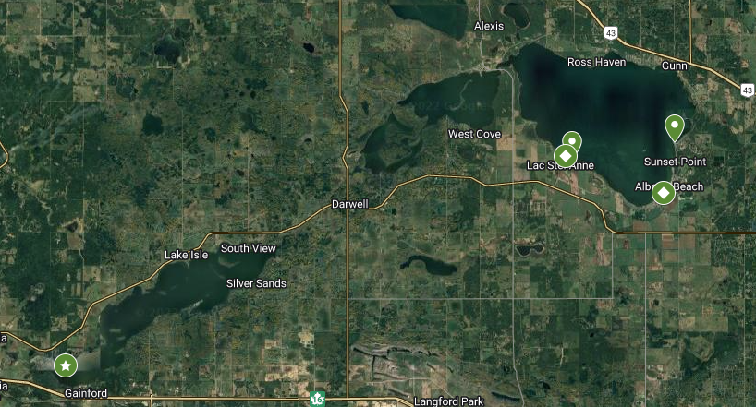
Beach Sample Locations

Slide 10
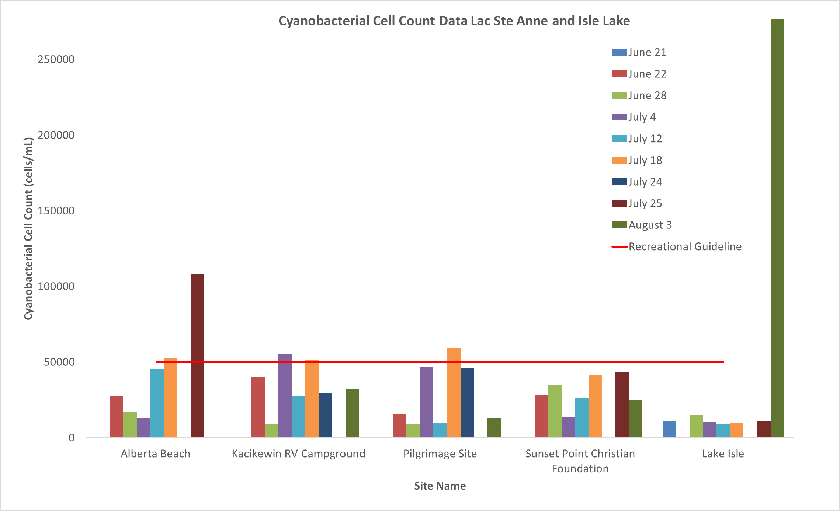
How Many Cyanobacteria (cells/mL) were at Each Beach Location?

Slide 11
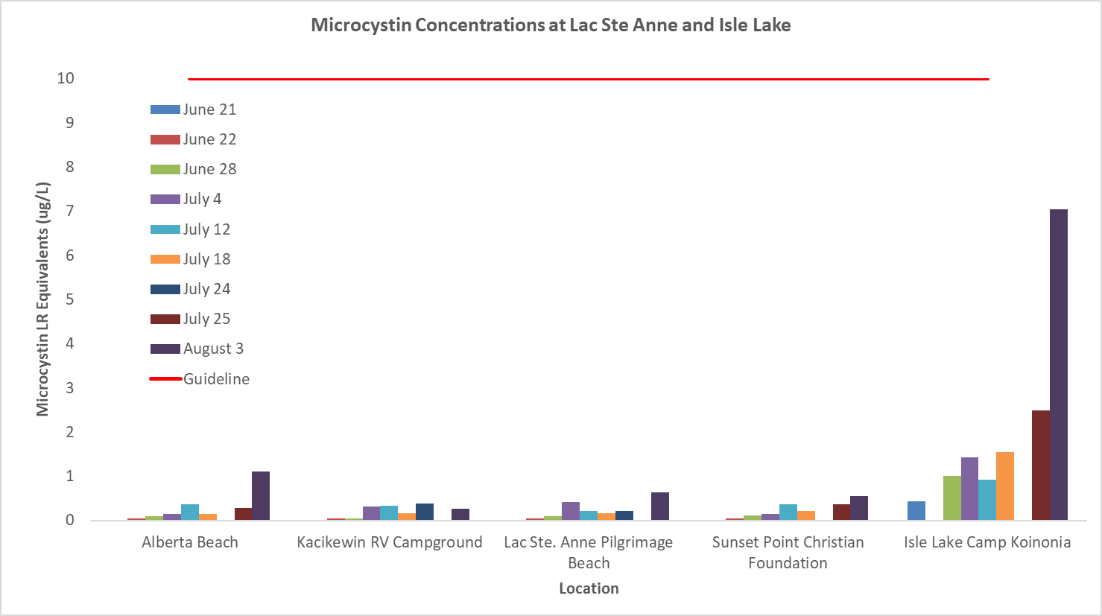
How Much Microcystin Toxin (ug/L) was at Each Beach Location?

Slide 12
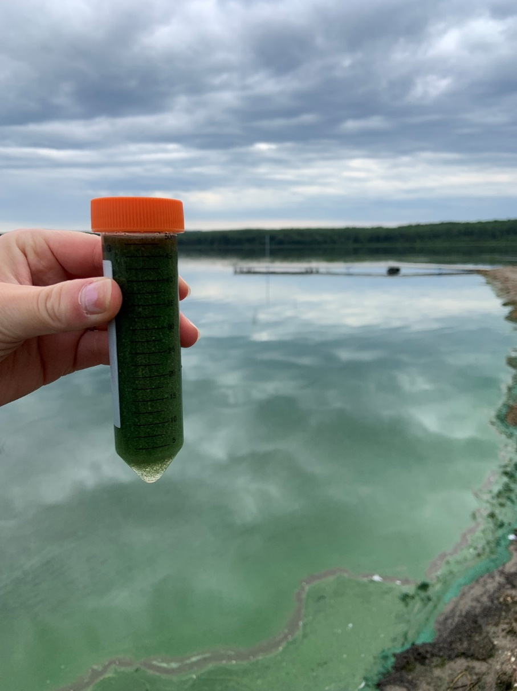
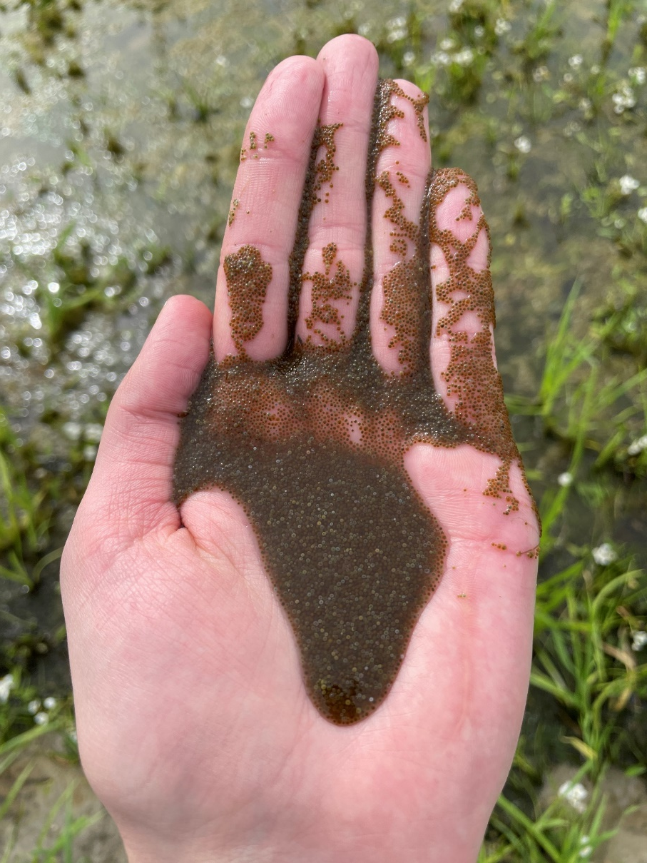
What About Grab Samples?
Isle Lake July 18th 2022
Cyanobacteria Cells Per mL: 50,593,557 Microcystin Toxin: 2087.98 ug/L
Alberta Beach
July 24th 2022

Slide 13
Alberta Beach
July 24th 2022

Slide 14
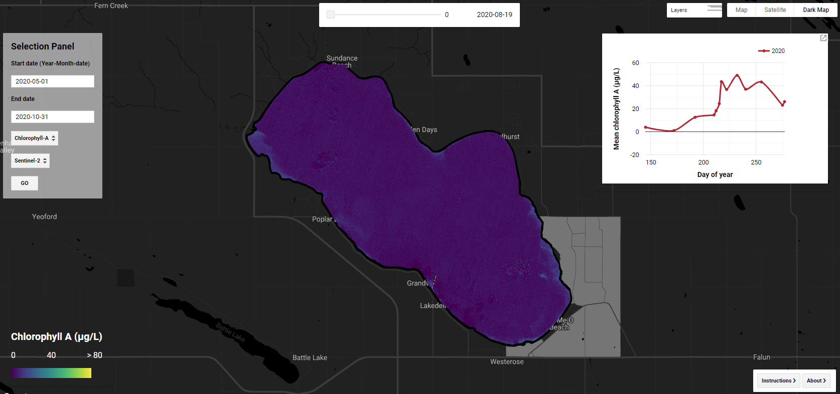
LakeWatch in Space

Slide 15
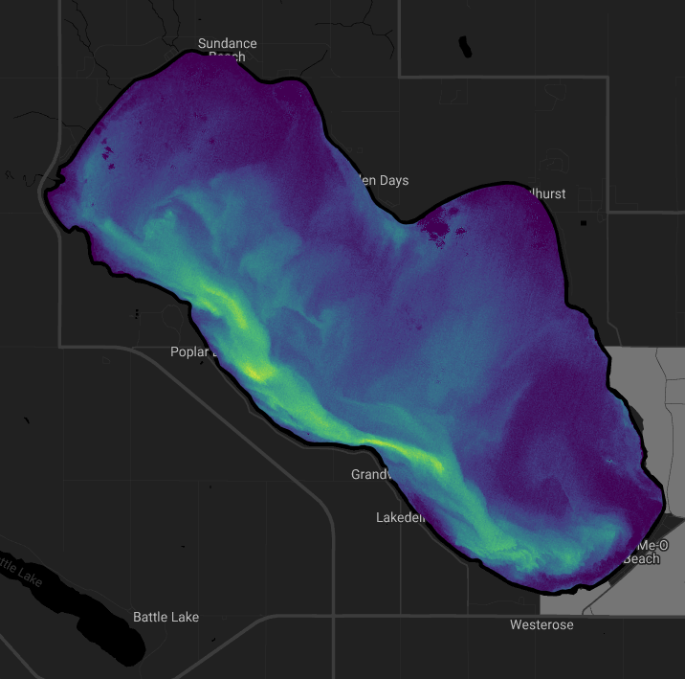

Slide 16
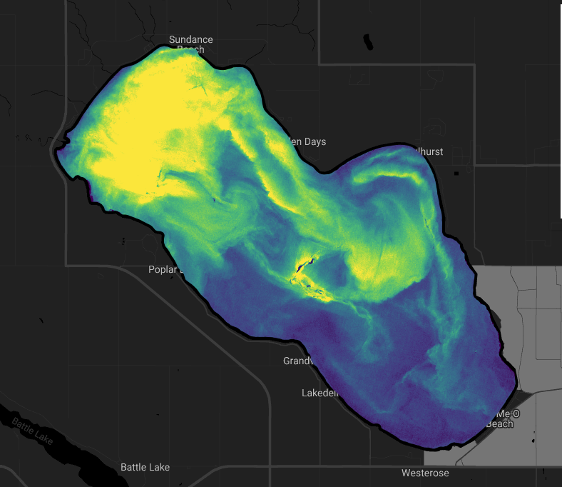

Slide 18
Notes:
Adaptable lakekeepers model provided an easy way to develop a winter program – the program focused partly on a new community of citizen scientists – winter anglers. Has been rewarding thinking about lakes differently under the ice.

Slide 19
Nutrients
Chemistry
Physical Parameters
Biological Parameters

Slide 21
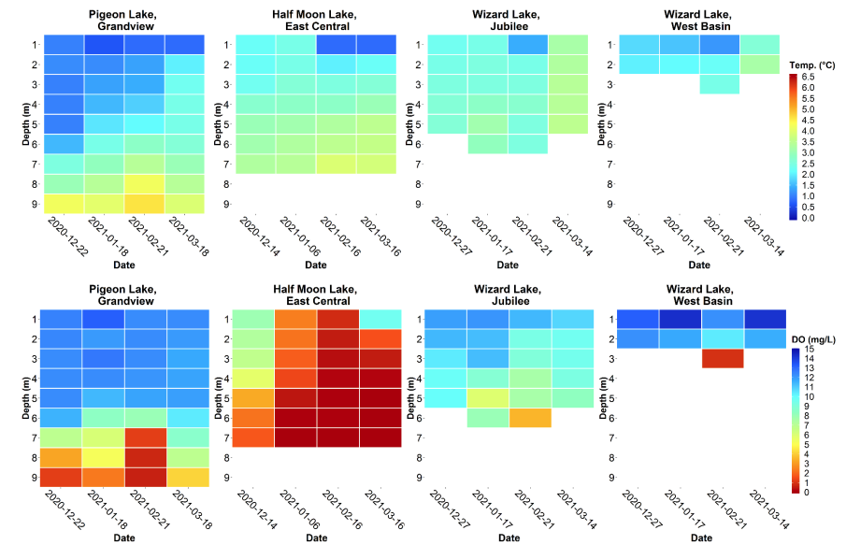
Winter Reports Highlight Nutrients, Temperature, Oxygen, and More.

Slide 23
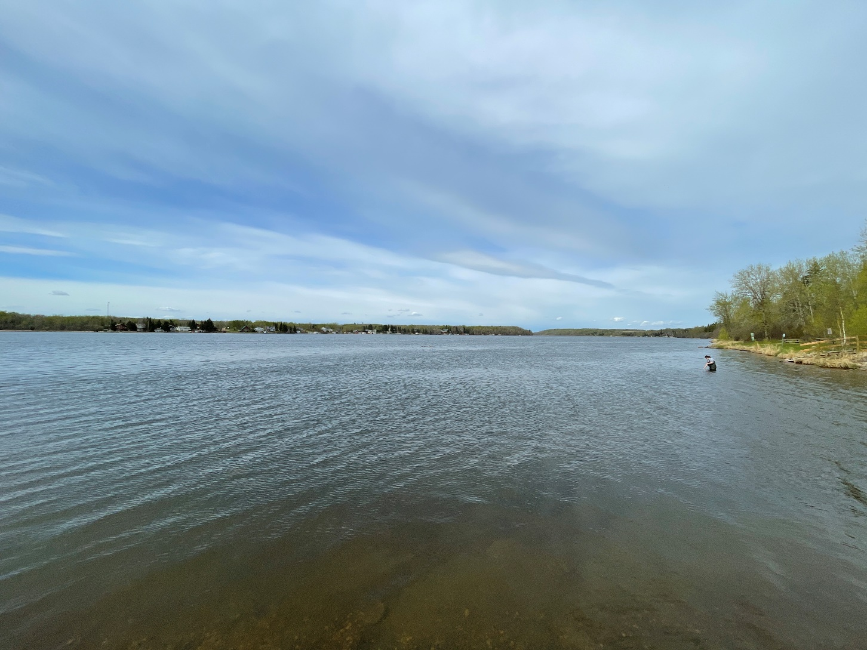
Thank You!
Bradley Peter
Executive Director
Alberta Lake Management Society
info@alms.ca
7850-702-2567

